Slide 1
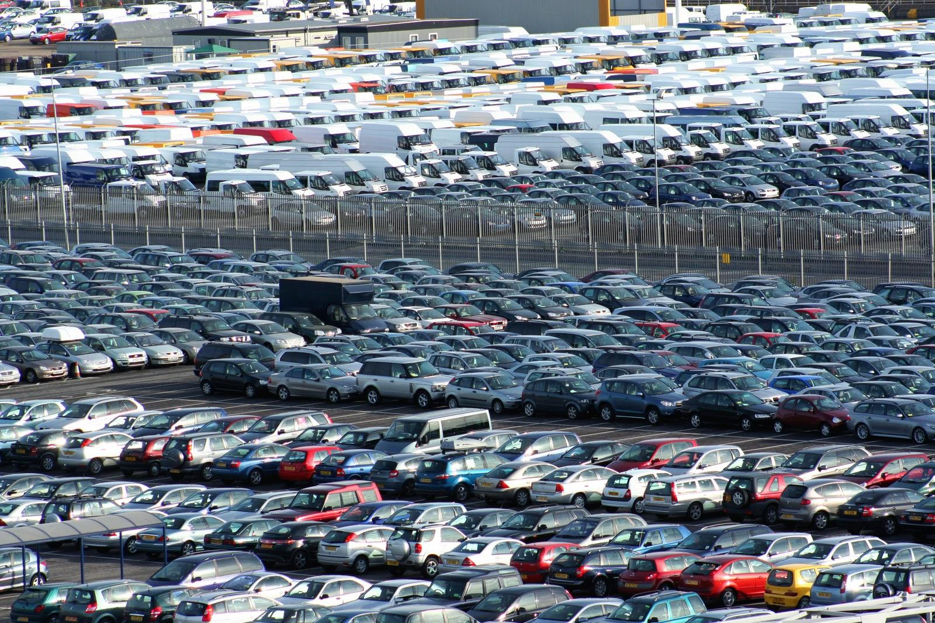
Developing a Successful Business Plan

Slide 2
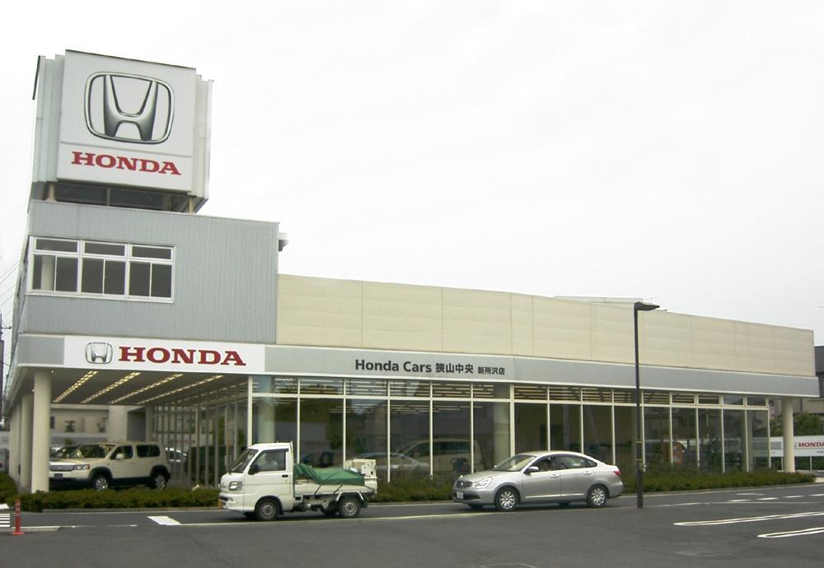
What are you going to produce/sell?
Slogan: New or Used its up to you!
We are going to sell cars (ford, lambo., bugatti, volkswagen, chevy, etc.)
There are different types of models that will suit each customer's taste

Slide 3
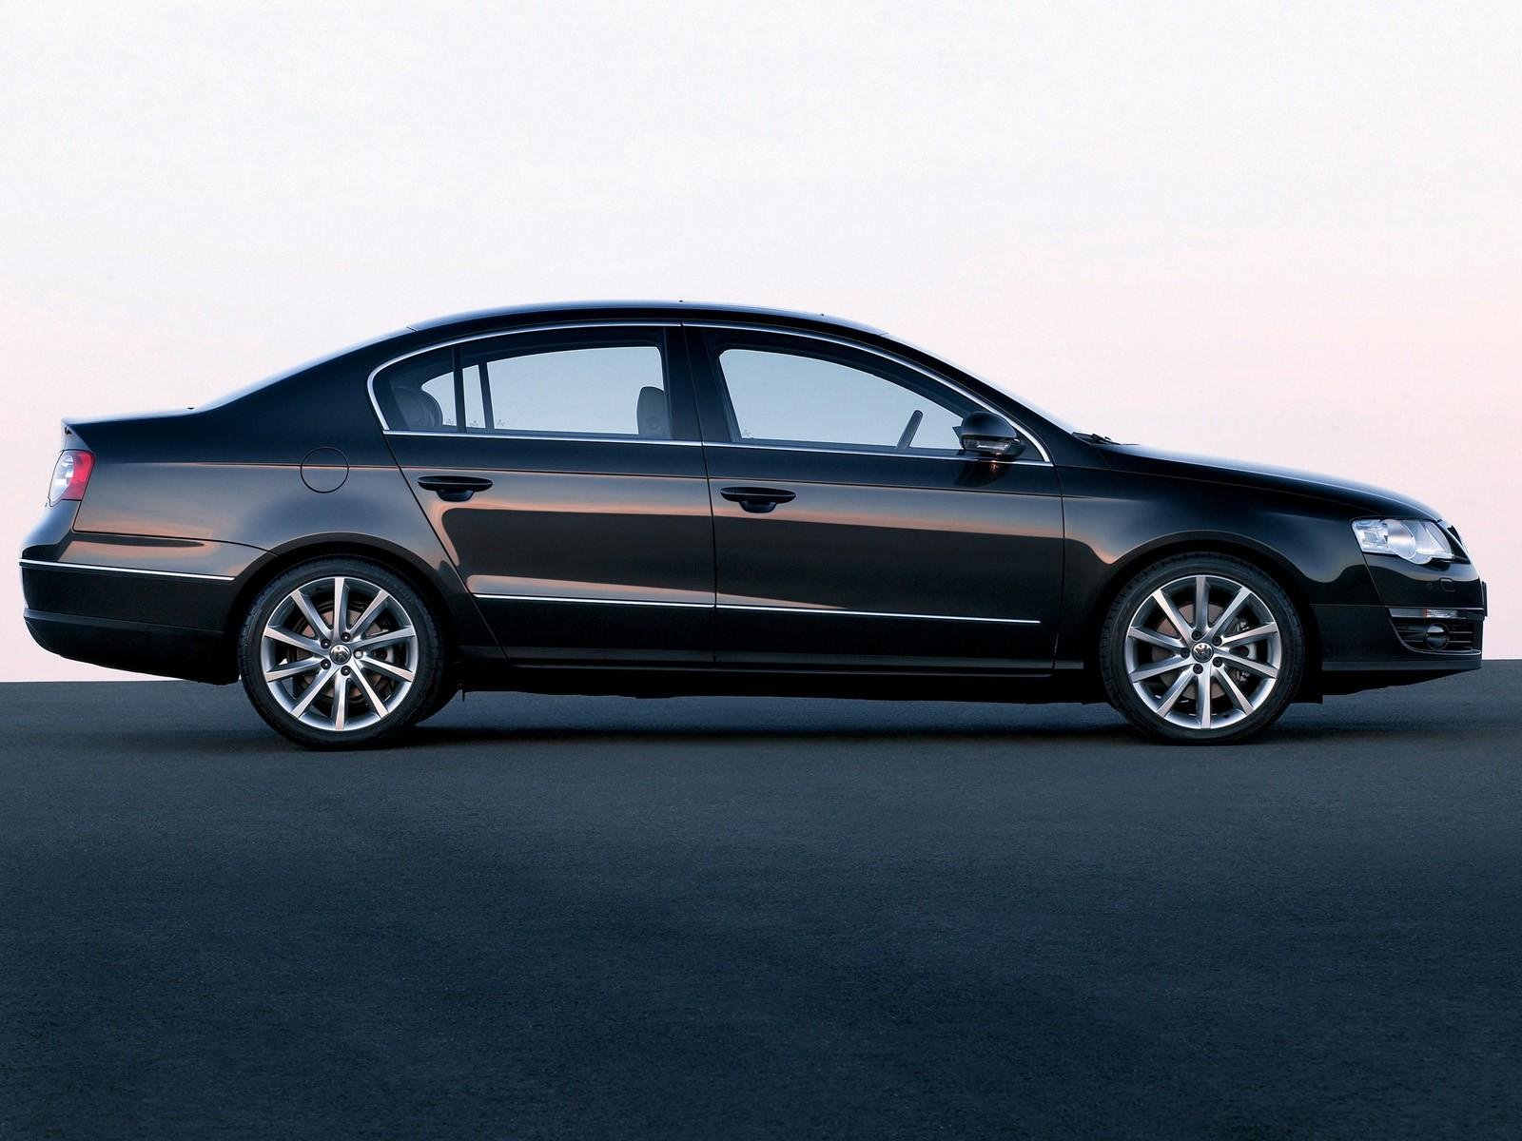
Volkswagen Passat
6-speed manual with overdrive transmission
6 speed auto-shift manual with overdrive transmission and auto-manual
6-speed automatic with overdrive transmission and auto manual
5-speed manual with overdrive transmission

Slide 4
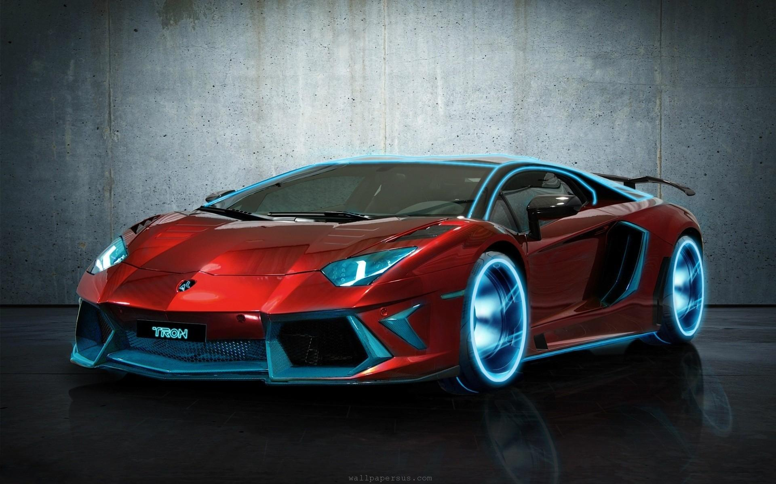
Lamborghini
7-speed auto-shift manual with overdrive transmission and auto manual

Slide 5
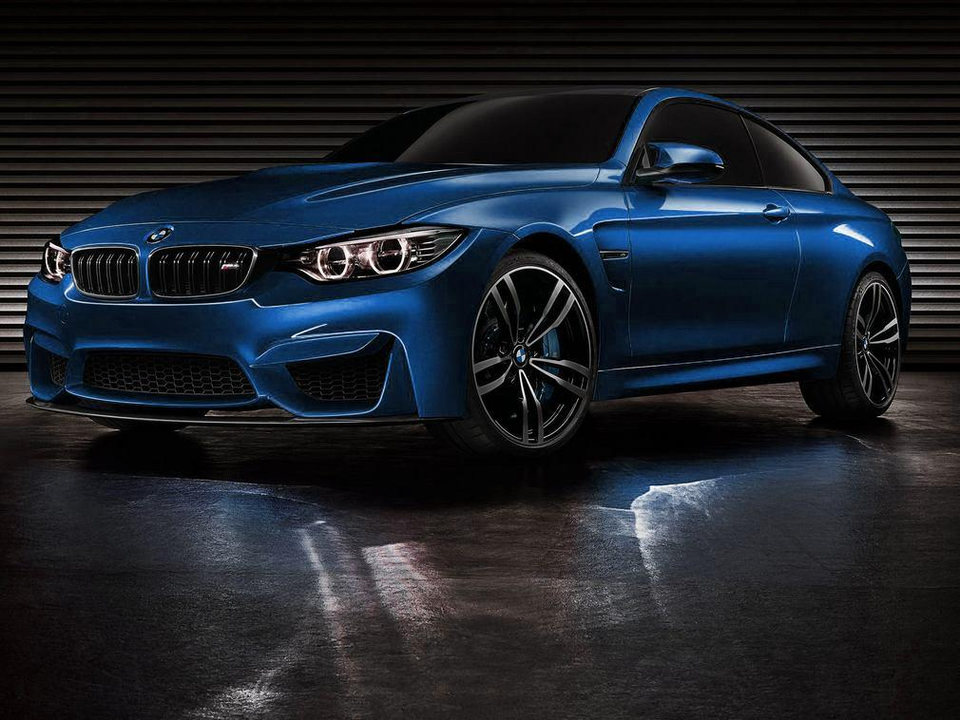
BMW M5
6-speed manual with overdrive transmission
7-speed auto-shift manual with overdrive transmission and auto manual
High performance variant of 5 series

Slide 6
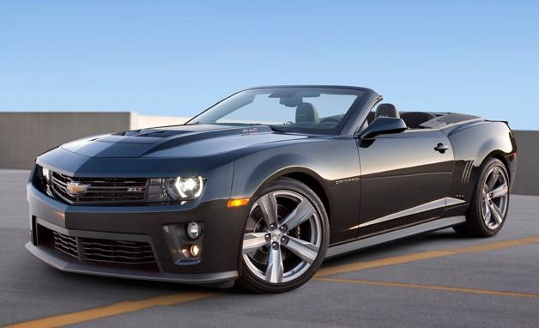
Camaro zl1
6-speed manual with overdrive transmission
6-speed automatic with overdrive transmission and auto manual

Slide 7
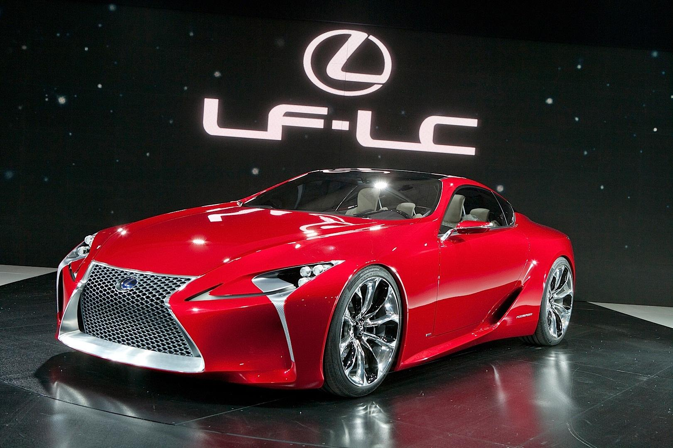
Lexus LF
The Lexus LF line is a serious of concept cars built by Lexus, the luxury vehicle division of Toyota Motor Corporation.
The “LF” designation refers to Lexus Future.

Slide 8
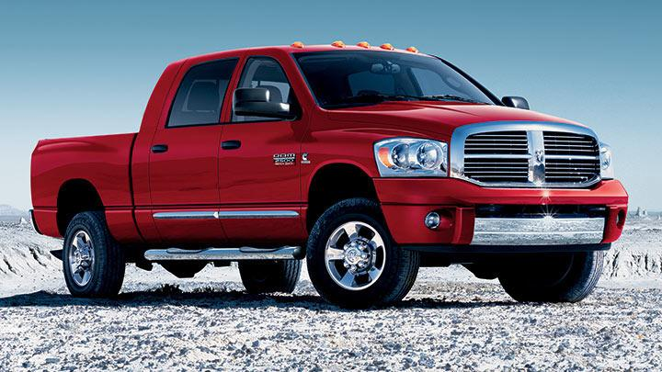
Dodge Ram 2500
Remote Start+
Uconnect Voice Command w/ Bluetooth® Connectivity
Fog Lamps
60/40 Split-Folding Backseat

Slide 9

.
Questions????
How are you going to sell it?
Open up a car dealership in town
Where are you going to sell it?
We will be located on Cooper Hill Rd 5.5 miles from the Correctional Institution, I think its a good place to sell the car because it would be so much space if you tear down the trees
Who is going to buy it?Why?
People that are willing to spend and have a job and are eligible to drive a car without a curfew
How will you advertise it? Why that way?
We will advertise it through commercial, because people look at television a lot
How much money do you think you need to start your business? What will the $ be used for?
We would probably need $150,000-500,000 the most to buy some of the cars and for the repairs of the cars

