Slide 1
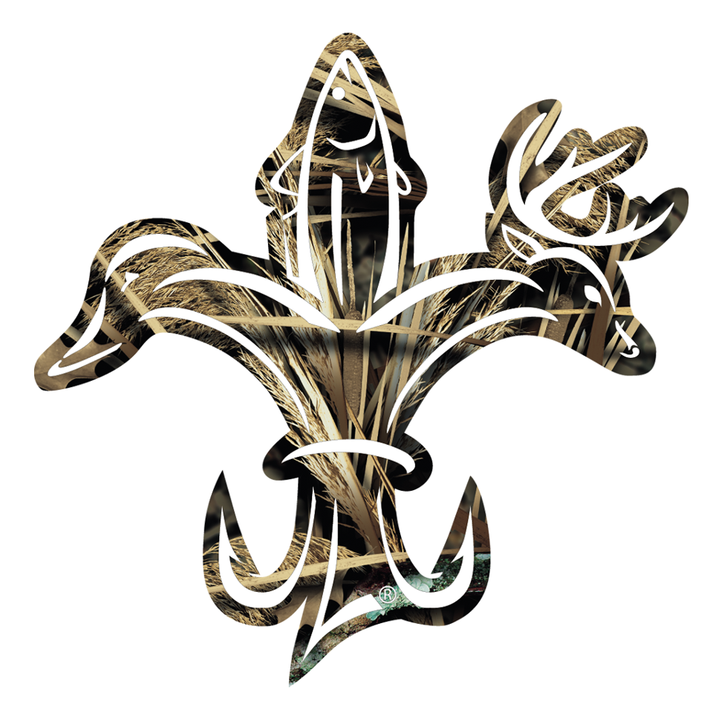
Triple F Sporting Goods
Hunter White
Trevor Alston
Patrick Smiley

Slide 2
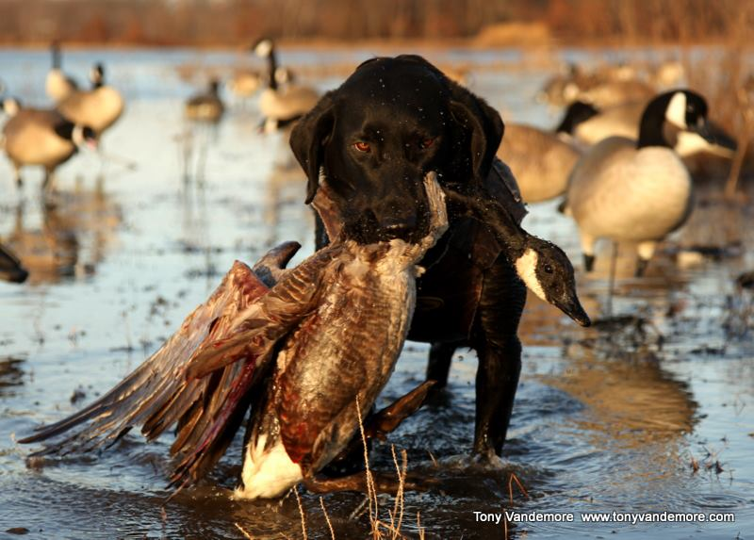
What we are all about
We supply all types of hunting apparel from bow hunting to duck hunting to dog hunting ect.
We have a large variety of calls for all types of game
We have the latest clothing gear such as Under Armour, Field and Stream, Drake, and Realtree\
We also carry all types of firearms from your typical pistols, shotguns, rifles ect.
Our Motto: You got it you want it you need to to have your big game

Slide 3
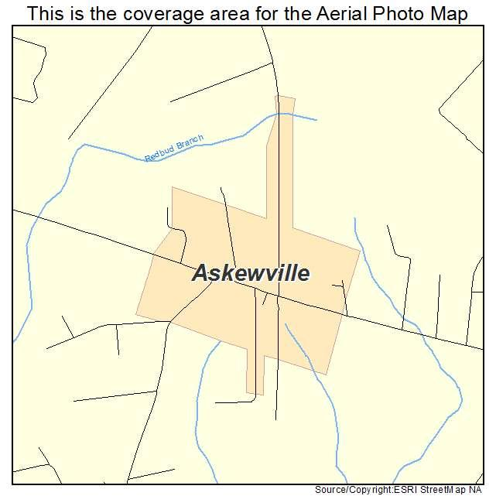
Location
We will be located in Askewville,NC right in front of the Country mart going out of Askewville
This town is a good choice for business because most of your hunters in Bertie County are in this town

Slide 4
Money!!!
To complete our task of renting to own this piece of land we will need about 250,000 dollars to complete this task plus we need help spreading the word about the new business

Slide 5
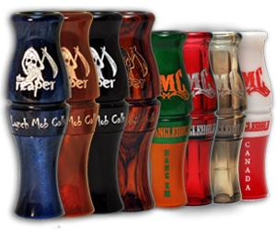
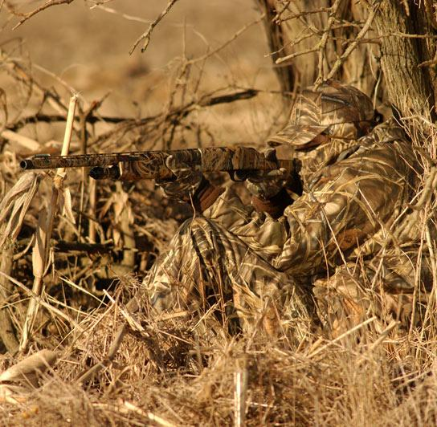
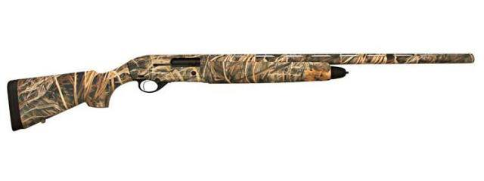
Our products

Slide 6
Questions
Who is going to buy your product? Why?
Hunters, because they are the ones who will buy the hunting gear.
How will you you advertise? Why that way?
Commercials, Because when it gets out on the the tv or the internet it will spread the word on more than billboards and other things.
What will your money be used for?
The money will be used for expenses,paint,supplies to start with and the ground layouts

