Slide 1
Sports Wear
By: Nekera Bond & Brianna Jackson

Slide 2
What We Produce/Sell
We sell things such as…
jackets and pants suits of football and basketball teams.
We also sell different types of name brand shoes such as Adidas, Jordans, Nikes and LeBron's.

Slide 3
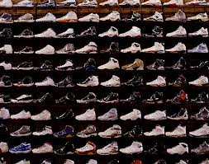
Jordans
Air Jordan shoes refer to the line of sneakers created for and endorsed by basketball superstar Michael Jordan.

Slide 4
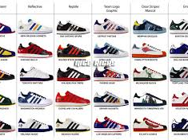
Adidas
Adidas is the largest sportswear manufacturers in Europe and the second biggest in the world, with American rival Nike being the biggest

Slide 5
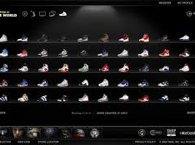
Nikes
NIKE, Inc. is the world’s leading innovator in athletic footwear, apparel, equipment and accessories.

Slide 6
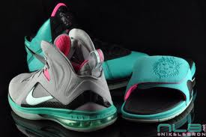
LeBron's
Ever since landing on the cover of Sports Illustrated as a High School Basketball Phantom, LeBron James has been one of this generation’s true sports icons. With supernatural gifts of flight and power, Nike is hoping that his performance on the court will inspire millions to buy his shoes.

Slide 7
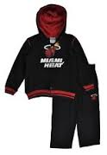
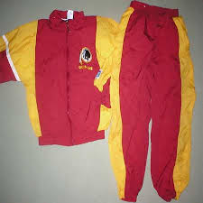
Sports
Basketball
Football

Slide 8
Questions????
How are you going to produce/sell it?
We are going to sell these products by making prices suitable for people.
Where are you going to produce/sell it? Why?
We are going to sell it in Windsor
Who is going to buy it? Why?
The people of Windsor
How will you advertise? Why that way?
Commercials and hang up flyers around town.
How much money do you think you will need to start your business? What will the money be used for?
We need at least $50,000

