Slide 1
Info About the NC Final Exam American History II
The test will be online.
The test will contain 40 items.
38 Multiple Choice Questions
2 Constructed Response Question.
Students will have 120 minutes to complete the test.

Slide 2
The test will be based on the Essential Standards AH.2.H.1 – AH.2.H.8.
The essential standards are listed in your class syllabus and online @ http://www.ncpublicschools.org/docs/acre/standards/new-standards/social-studies/american-history-2.pdf
Standard 1 | Standard 2 | % of Questions
AH.2.H.1 | AH.2.H.2 | 15 – 20 %
AH.2.H.1 | AH.2.H.3 | 18 – 22 %
AH.2.H.1 | AH.2.H.4 | 15 – 21 %
AH.2.H.1 | AH.2.H.5 | 11 – 15 %
AH.2.H.1 | AH.2.H.6 | 11 – 15 %
AH.2.H.1 | AH.2.H.7 | 12 – 16 %
AH.2.H.1 | AH.2.H.8 | 3 – 7 %

Slide 3
The NC Final will be based on these Essential Standards for Am History II
AH1.H.1 & AH2.H.1 (Connected to All NC Final Questions)
Apply the four interconnected dimensions of historical thinking to the American History Essential Standards in order to understand the creation and development of the United States over time.
AH1.H.2 & AH2.H.2 (15 – 20% of NC Final)
Analyze key political, economic and social turning points in American History using historical thinking.
AH1.H.3 & AH2.H.3 (18 – 22% of NC Final)
Understand the factors that led to exploration, settlement, movement, and expansion and their impact on United States development over time.
AH1.H.4 & AH2.H.4 (15 – 21% of NC Final)
Analyze how conflict and compromise have shaped politics, economics and culture in the United States.
AH1.H.5 & AH2.H.5 (11 – 15% of NC Final)
Understand how tensions between freedom, equality and power have shaped the political, economic and social development of the United States.
AH1.H.6 & AH2.H.6 (11 – 15% of NC Final)
Understand how and why the role of the United States in the world has changed over time.
AH1.H.7 & AH2.H.7 (12 – 16% of NC Final)
Understand the impact of war on American politics, economics, society and culture.
AH1.H. 8 & AH2.H.8 (3 – 7% of NC Final)
Analyze the relationship between progress, crisis and the “American Dream” within the United States.

Slide 4
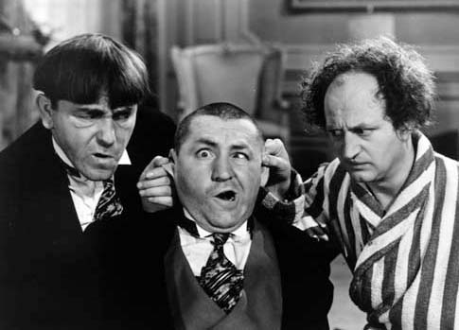
Any questions about your American History II NC Final Exam?

