Slide 1
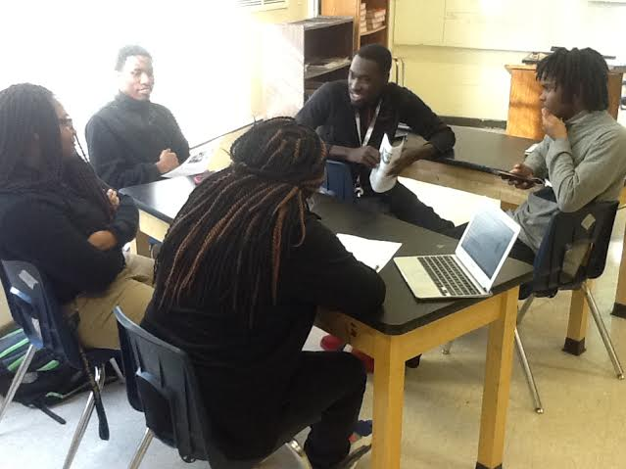
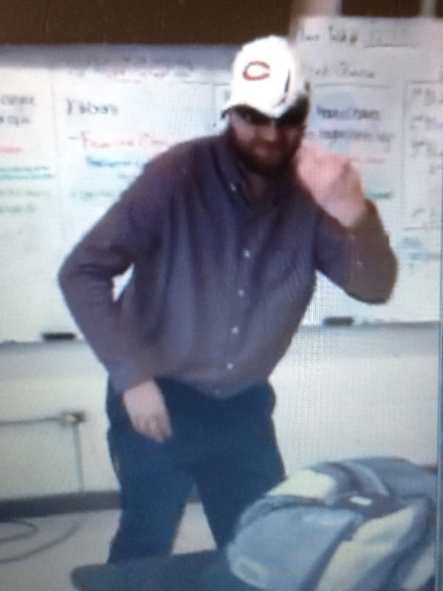
Let’s Finish the Semester Well
Expectations for the End of Semester (Reminders)
Be on time and prepared for class
Watch your language
Listen respectfully and participate in discussion
Headphones out, phones down.
Raise your hand and share your thoughts.
Stay engaged and prepare for the NC Final
Watch your attendance (don’t go over 10 days)
It’s been a great school year together…
let’s keep it that way for the last couple weeks!

