Slide 1
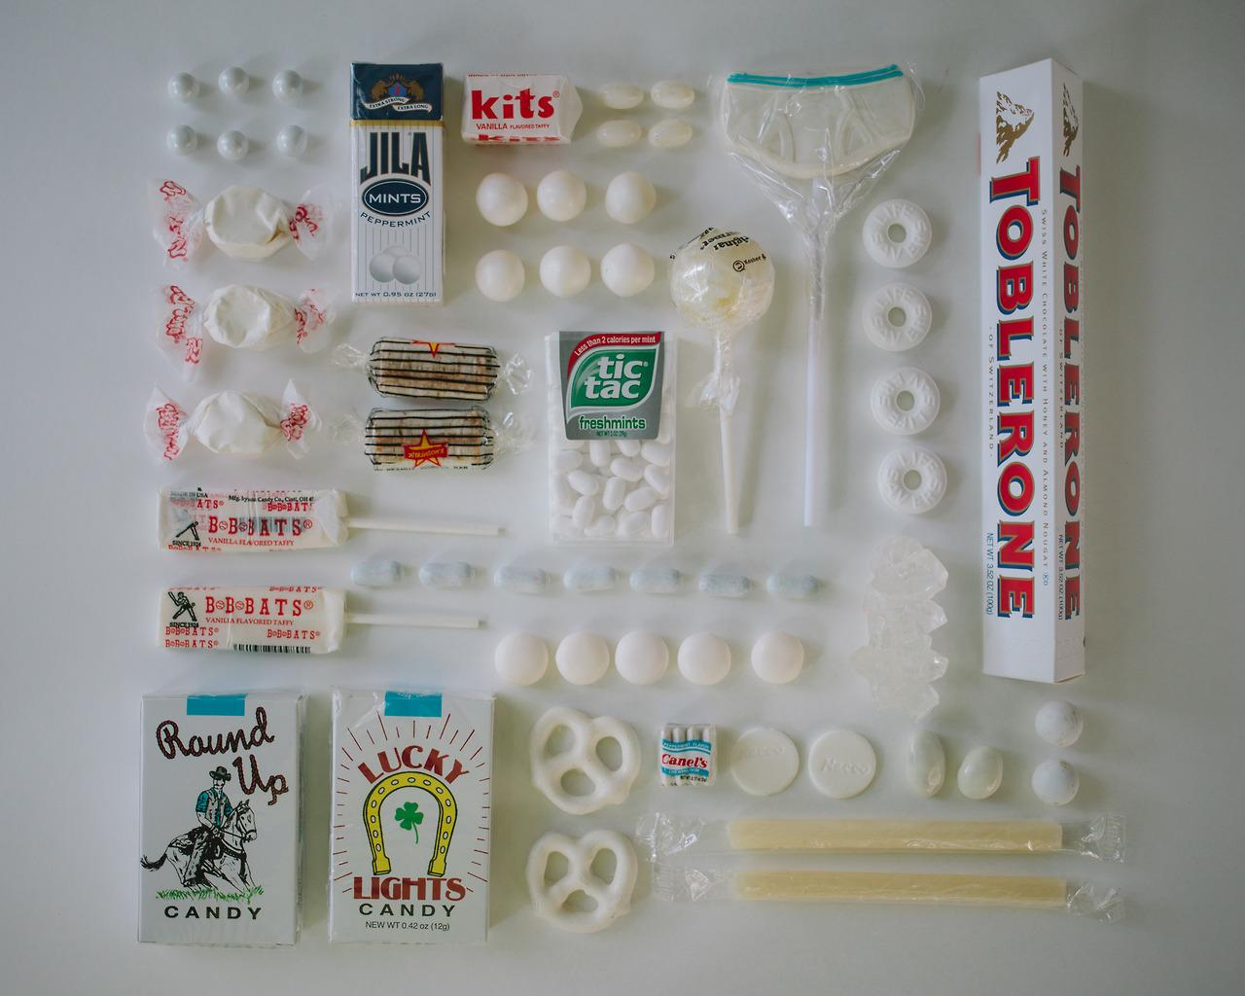
Carolina Candy Shop
Kiana Morgan
&
Annastasia Dale

Slide 2
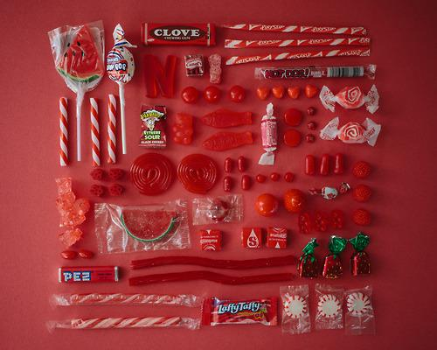
We will be selling...
CANDY!!
Chocolate
Taffy
Lollipops
Bubblegum
etc

Slide 3
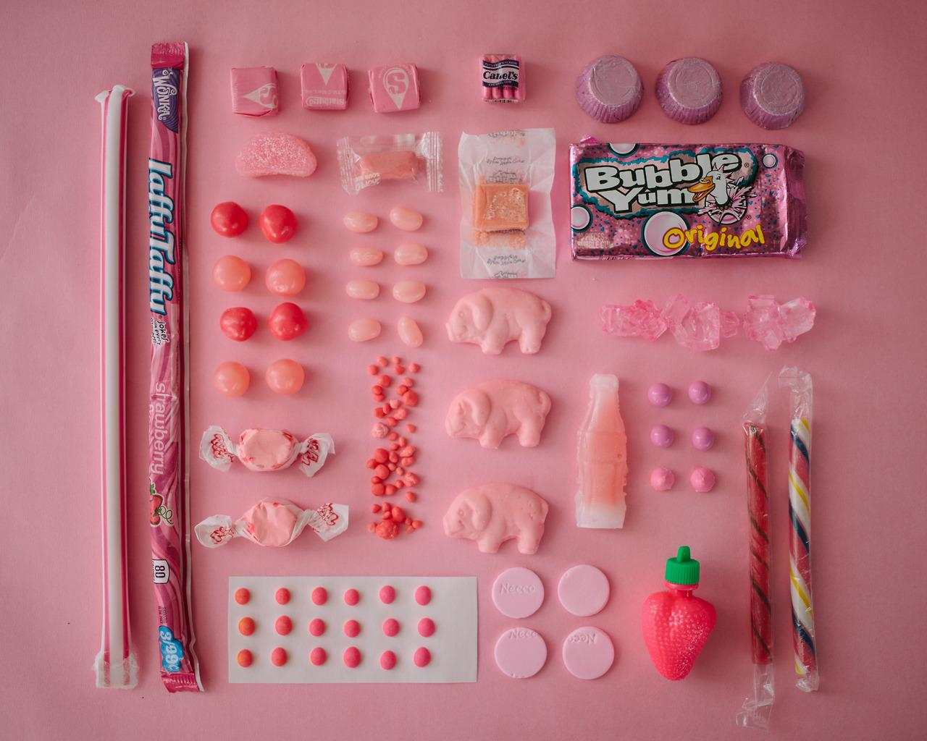
Candy will be sold...
in a shop.
We will be contacting Charlie Bucket Jr. (the son of the current owner of Willy Wonka’s former chocolate factory) to distribute candy to us.

Slide 4
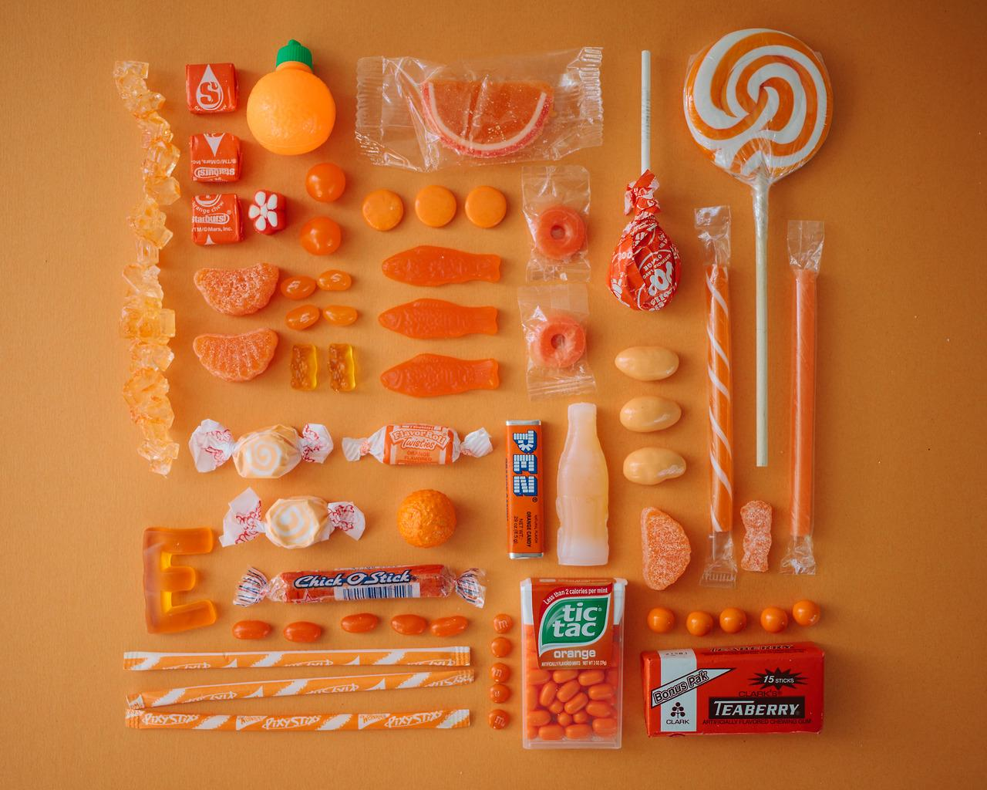
Find us at
the mall in Greenville located at 714 Greenville Blvd, SE, Greenville, NC, 27858
The mall is a place where people commonly go to. We would get some kind of exposure if we were at a mall where people can walk by and perhaps look around a new, “sweet” store.

Slide 5
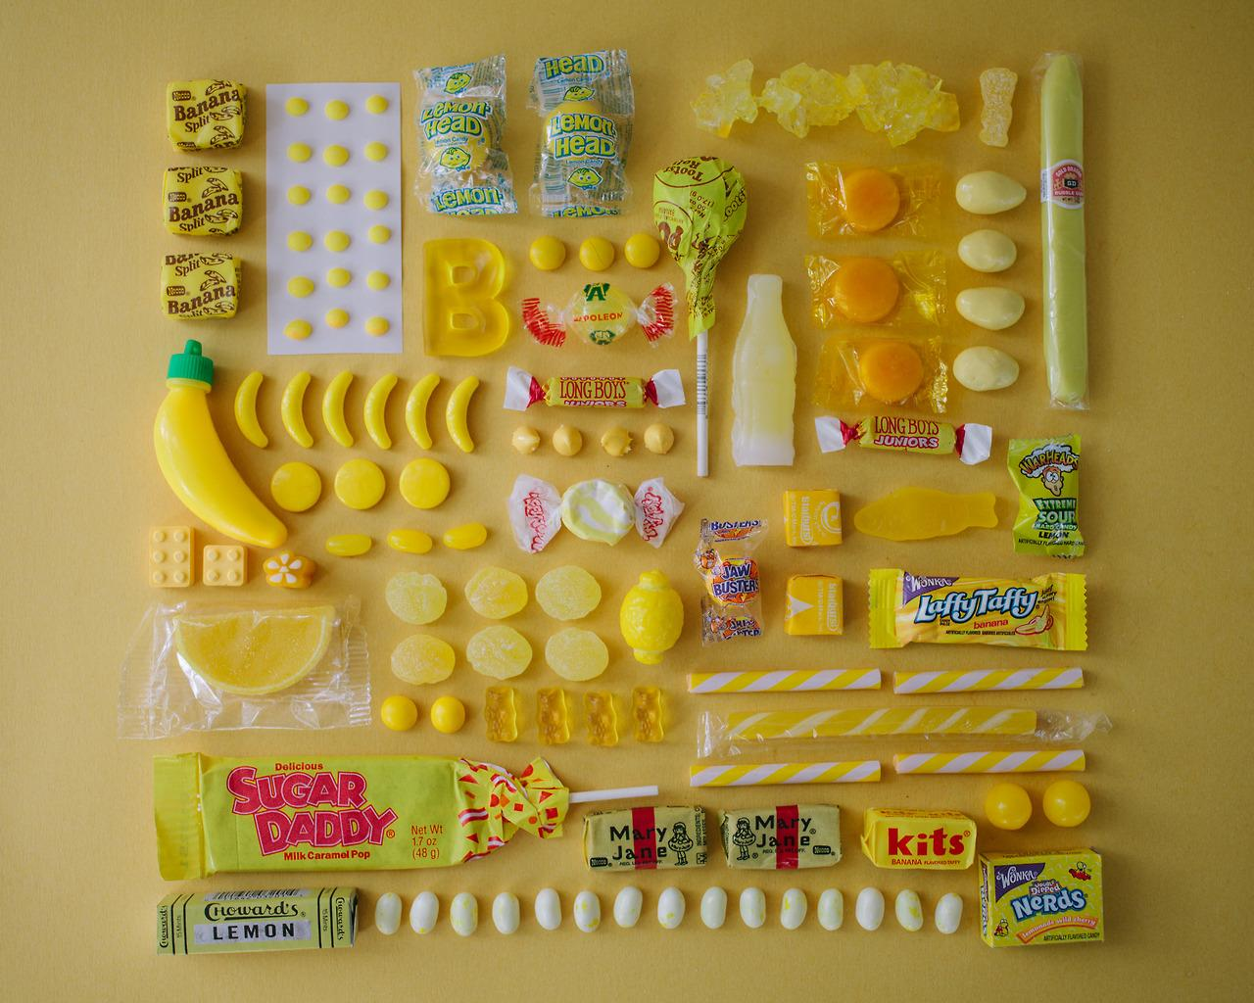
Our customers
People of all ages
  Children (mostly)
  Adults
  even the elderly
We are hoping to delight the tastebuds of many and bring joy to everyone.

Slide 6
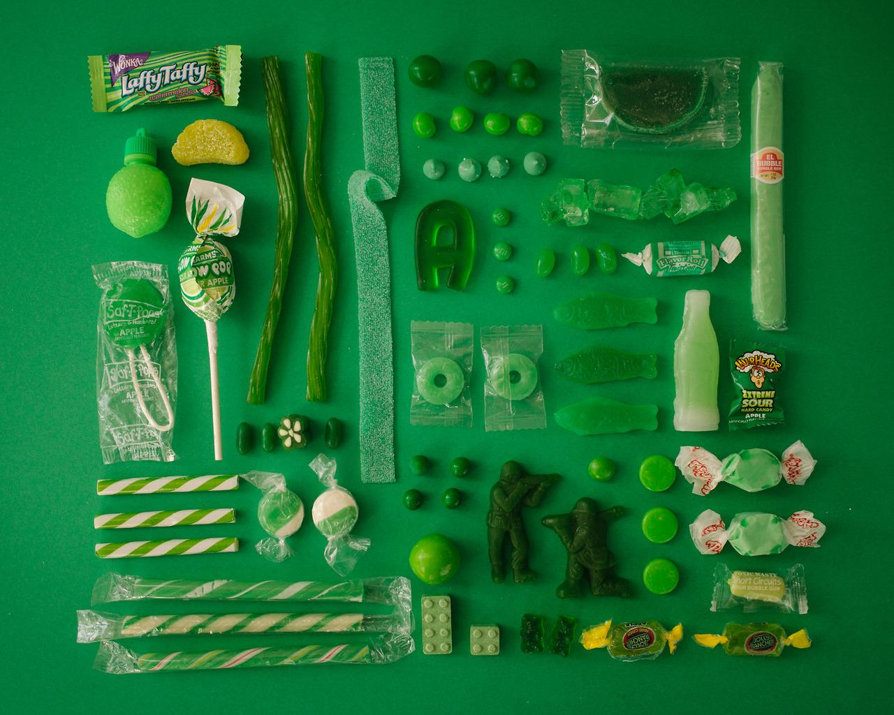
Advertisement
A banner! We will have someone (if not one of us) parade around the mall with a poster or banner to advertise our shop. This may strike curiosity in those who are not familiar with the shop and they may pay our shop a visit.

Slide 7
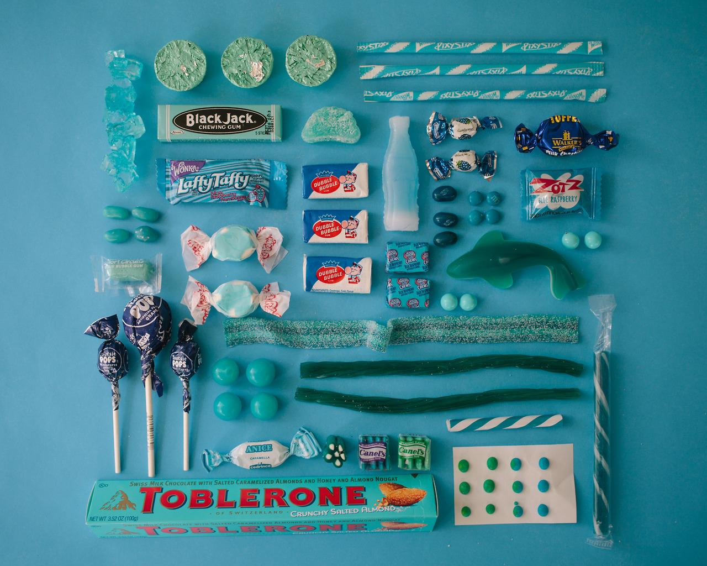
To start this Business
We are asking roughly for about $60,000.
This money will pay for:
Renting a retail store
purchasing the candy from Charlie
hiring employees (if we decide to do that)

Slide 8
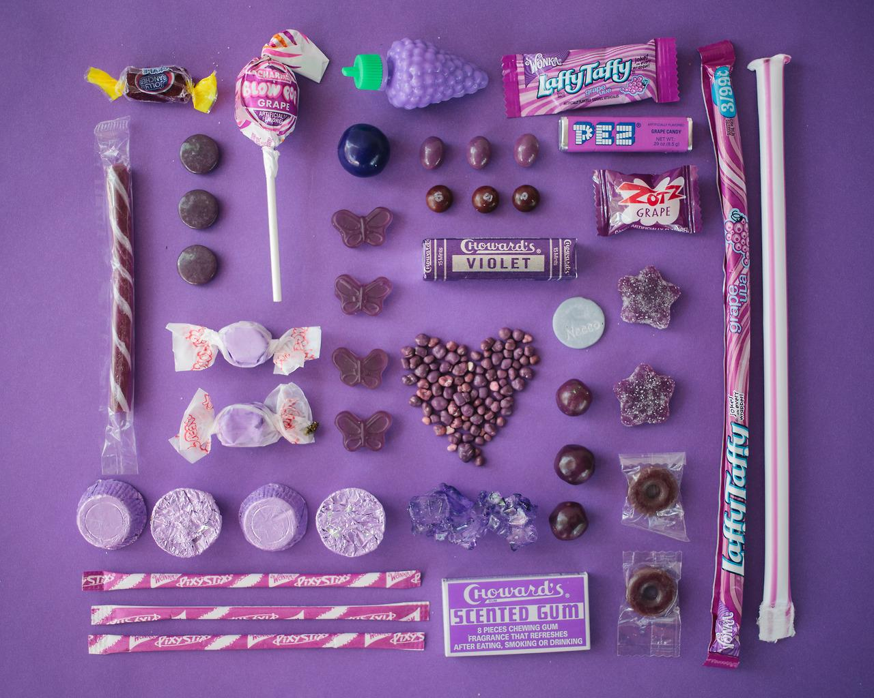
Why is this a good idea?
We want to bring happiness to people, and what better way to do that other than satisfying the people’s taste buds? What child wouldn’t like to tour a candy shop if only to have a glimpse of what happiness could be? Many people like candy or know someone who likes candy so the business is in itself.

Slide 9
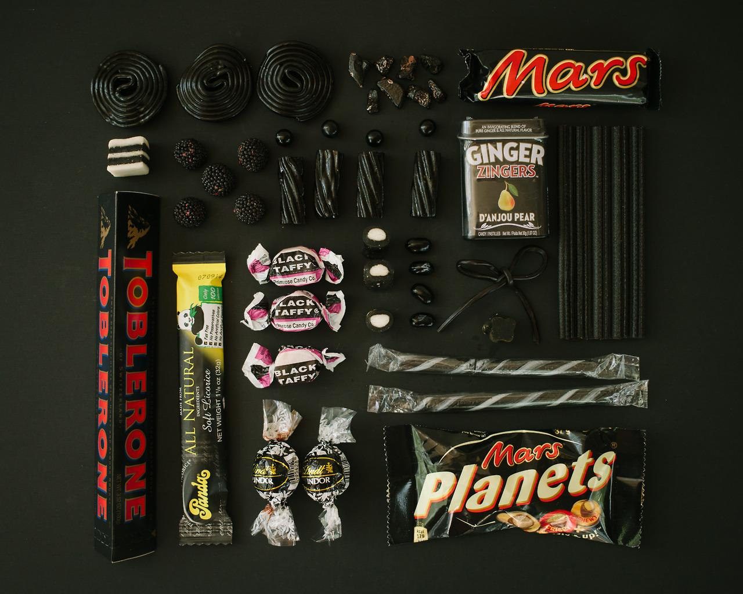
Thank You for your Time!

