Slide 1
A.D.D Gaming
By: Deandre Watson,Delonte’ Tappan, Anthony Rascoe

Slide 2
Products of Sale
We at A.D.D Gaming will be selling top quality games.They are cheap and durable.

Slide 3
How are we going to sell it?
We will be buying them from other countries then sell them in the U.S for better profit.

Slide 4
Where will we sell it?
We will be selling our products in the U.S.
Majority of games bought are from the U.S

Slide 5
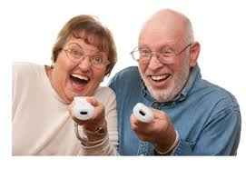
Who will be buying our products?
Anyone who wants to. But mainly kids and teenagers. Also grown-ups will be buying them. You are never too old to play games, not even if you are 101.

Slide 6
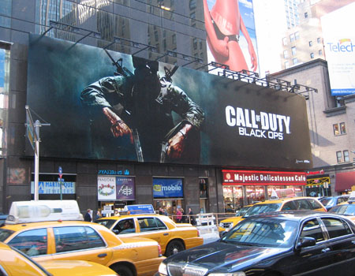
How will we advertise our products?
We will be using Billboards, because they are practically impossible to miss.

Slide 7
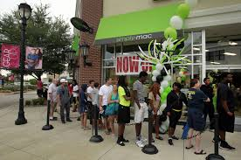
How much money we need to start our business.
About 100,000 dollars. 50,000 to get the store, 30,000 for rent. and 20,000 for inventory and employers.

