Slide 1
Grand Slam Baseball
By: Michael and Cody
To: Mr. G

Slide 2
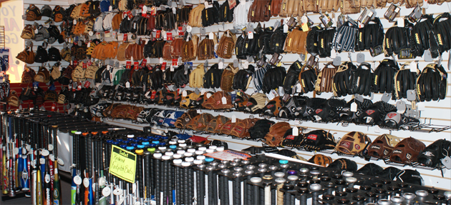
What are we going to sell?
In our store we will be selling baseball equipment. Like, baseball bats, baseball gloves, catching equipment, batting helmets, batting gloves, and baseball apparel.

Slide 3
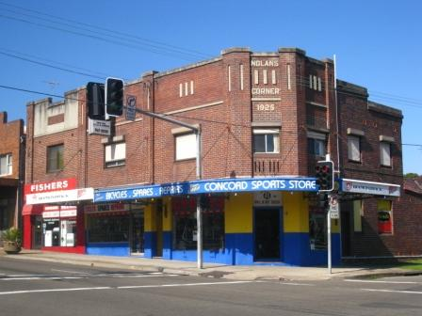
How are we going to sell it?
We are going to sell it by opening up a store. Also, we will have advertisements around the city to persuade customers to come and check out our store.

Slide 4
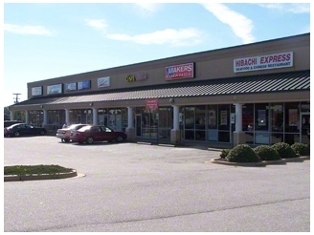
Where are we going to sell it?
We are going to open up our store in Greenville, N.C. We will open it up here because it is close to home and also it is a decent size city with many baseball players.

Slide 5
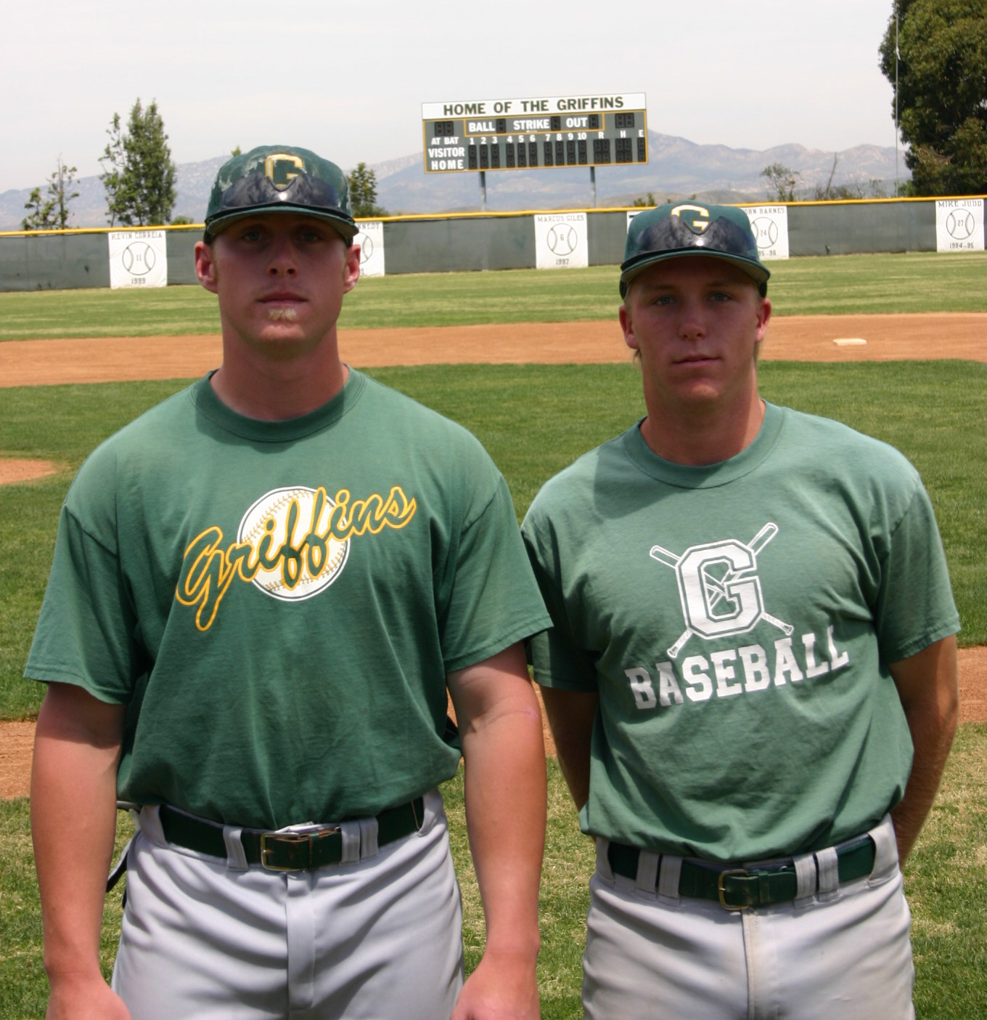
Who is going to buy it?
People that play baseball, people that are looking to play baseball, and coaches will also buy equipment from our store. These people will do this because they are looking to upgrade on their baseball equipment.

Slide 6
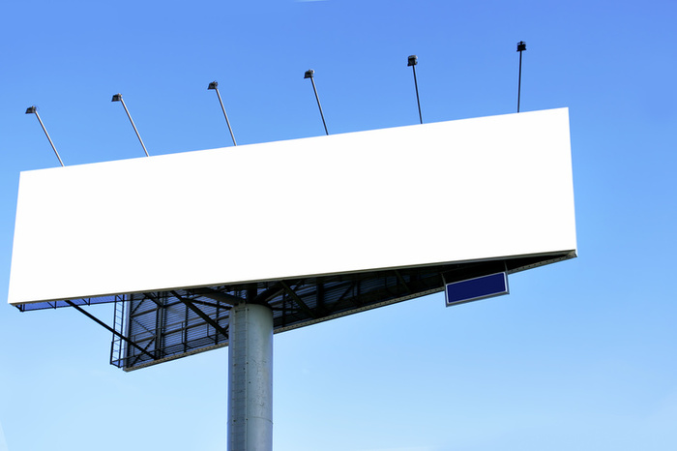
How will we advertise?
We will advertise it by making commercials and putting it on local sport channels. We will also use local billboards in our area to advertise our business. We will do this because it is the best way to reach the local sports customers.

Slide 7
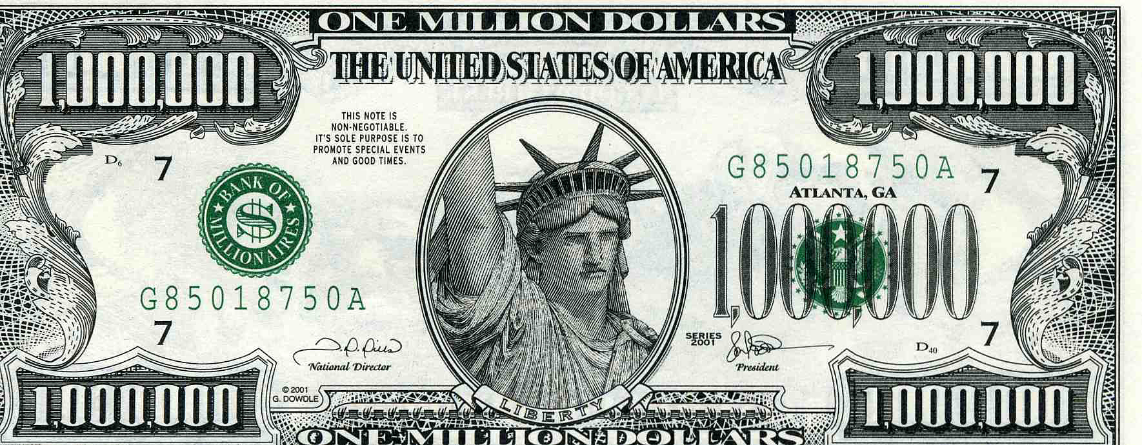
How much money will we need to start our business?
We will need to have about 1 million dollars to start up our store. The money will be used for rent, insurance, legal fees, business plan production, accounting fees, business plan software, loan closing cost, start up inventory, current assets, and long term assets.

