Slide 1
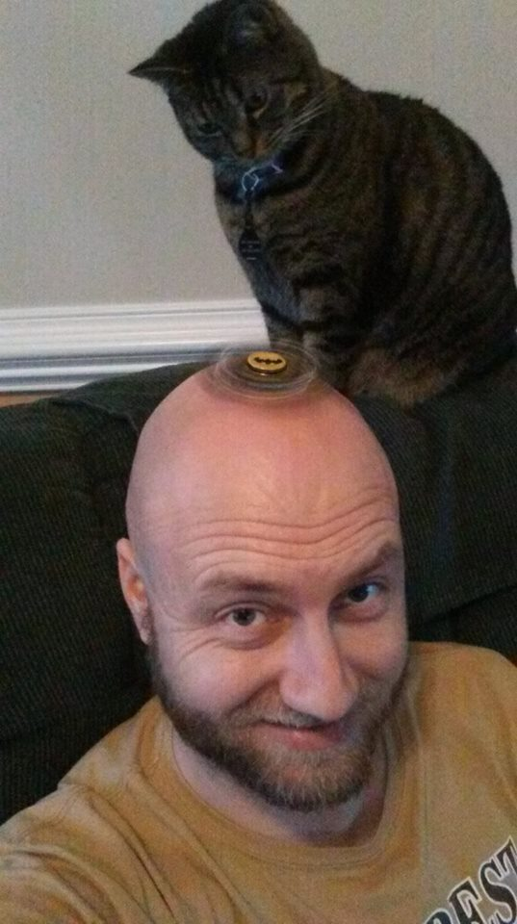
Mr. G’s Classroom Reminders

Slide 2
Be ready at the start of class.
Have assignments turned in
Be seated and ready for class
Go ahead and put cell phones away and take head phones out

Slide 3
Listen up and participate during classroom discussion.
Pause side conversations and give Mr. G or a classmate who is speaking your attention
Headphones and phones put away
Raise your hand to ask or answer questions
The main idea is to be respectful to your teacher and your classmates

Slide 4
Please write your first and last name on assignments when turning them in.

Slide 5
Please have cell phones put away.
During times of extended individual work (like taking chapter notes, etc.), feel free to use your phone and headphones for music if you like.
Otherwise, please have cell phones put away. If you are charging your phone, please make sure it is still put away and not out in the open on your table.
The key is we don’t want phones to be out and a distraction during class time.

Slide 6
Have fun! Participate and engage in class.
- Ask questions and share your ideas!
- We want learning to be student-driven!

Slide 7
Call Back to Focus Attention
Mr. G: “Students, I need your…”
Students: “Attention please!”
Mr. G: “Thank you very much.”
Students: “I got you Mr. G!”
*Now the class should be quiet and focused on instruction.*

