Slide 1
BLACK HYDE HUNTING
By: Cheese Burger and Calebo

Slide 2
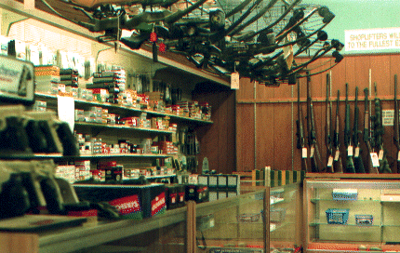
What are we going to sell?
We are going to sell hunting supplies and dog hunting supplies Supplies such as bows,arrows, ammo, clothing, dog collars, dog medicines, tracking and shock collars.

Slide 3
How are you going to sell it? Were?
Store in Askewvillie North Carolina
Put up in the store and let customer buy the items they want.
The reason why the store would be in Askewvillie is because there's no hunting supply store near Askewvillie. Also there is a lot of dog hunters in the area near Askewvillie

Slide 4
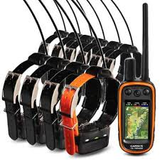
Who is going to by it ? Why?
Hunters and dog hunters they will buy from use because people in the near by towns haven’t got to go so far to go get hunting supplies

Slide 5
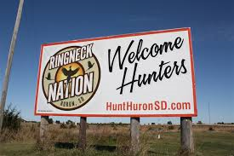
How will we advertise these products?
We will put Bill board up and down the Interstate and maybe put a could advertisements on commercials.

Slide 6
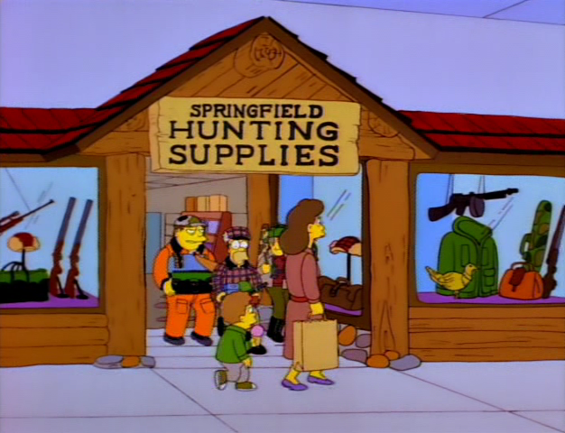
How much money will it take to start our business?
$171,523.36 will gets our business started to buy supplies to sell. Also to build a store to sell the items. To buy ammo and all the extra items.

