Slide 1
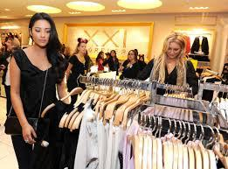
Business Plan: Outspoken Wonderz
Owner: Aaliyah Hannah

Slide 2
I. General Company Description
Our business will be in fashion design, and clothing. We will sell and manufacture different clothing for all junior sizes (00-14).
Mission Statement: Raising self-esteem for young female girls to strive to be anything they can become.
Company Goals and Objectives: Our goal is to have a healthy, successful company that is a leader in customer service and that has loyal customer following. Objectives are annual sales targets and some specific measures of customer satisfaction.
Business Philosophy: Making sure that all customers feel like they belong somewhere when they leave the store. Making sure young girls see that they are beautiful in whatever they wear.
To whom will you market your products? Our product is marketed to teenage girls and young adult women between the ages of 10-25.
Describe your industry. Our industry is going to grow tremendously. I foresee that our business will increase and have a store in every city and every mall. Every chance we get we will try to get sponsors that can help us.
Describe your most important company strengths and core competencies. What factors will make the company succeed? What do you think your major competitive strengths will be? What background experience, skills, and strengths do you personally bring to this new venture?
Legal form of ownership: Sole proprietor, Partnership, Corporation, Limited liability corporation (LLC)? Partner Ship, Hannah and Aaliyah are young adults and see how young females dress. They see how insecure they are and want to make a change.

Slide 3
Products and Services
Products and Services
Describe in depth your products or services: Inside our business we will sell clothes like jeans, dresses, tops and more. These clothing will boost self-esteem of young girls.
What factors will give you competitive advantages or disadvantages? Our advantage os that our clothes will not tear like other fashion stores. We will also sale clothes in various sizes and will have mutilpe of these sizes. They wil also come in various colors.
What are the pricing, fee, or leasing structures of your products or services? I prices vary from $10.99 to $25.99. This is a reasonable price for young teenagers and young adults.

Slide 4
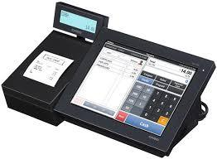
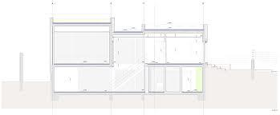
Space

Slide 5
Economics
Facts about your industry:
What is the total size of your market? My market size will be between small and large.
Current demand in target market. Young girls targeted to nice clothes in an updated style.
Trends in target market—growth trends, trends in consumer preferences, and trends in product development.
Growth potential and opportunity for a business of your size. Continue to Grow in how big the store is and how much clothes will be able to put into the store.
What barriers to entry do you face in entering this market with your new company?
High capital costs: $45.75
High production costs: $46.79
High marketing costs: $35.00
Consumer acceptance and brand recognition: $55.99
Training and skills: $6.95 /hr
Unique technology and patents: 45.56
Unions: $15.98
Shipping costs; $25.99
Tariff barriers and quotas: $116 /day
And of course, how will you overcome the barriers? By making sure our company have enough money to start off with and continue to make a profit. Saving money from the profit that hasbeen made from the clothing store.
How could the following affect your company?
Change in technology: Trying to keep up with the new technology and keep it up with it in our store.
Change in government regulations: Making sure that the government expet the place and make sure everything is under the rigt regulations.
Change in the economy:
Change in your industry:

Slide 6
Customers:
You may have more than one customer group. Identify the most important groups. Then, for each customer group, construct what is called a demographic profile:
Age: Teenage girls and young adults. Ages 10 to 25
Gender: Female
Location: Ahoskie North Carolina on Main Street where girls pass by and see outfits that look nice.
Income level: Low income
Education: Grade school till college
For business customers, the demographic factors might be:
Industry (or portion of an industry)
Location; On Main Street where majority girls will be located.
Size of firm: 2 sq ft.
Quality, technology, and price preferences: Low prices that fit for the teenage girls. You don’t want to have outrageous prices.

Slide 7
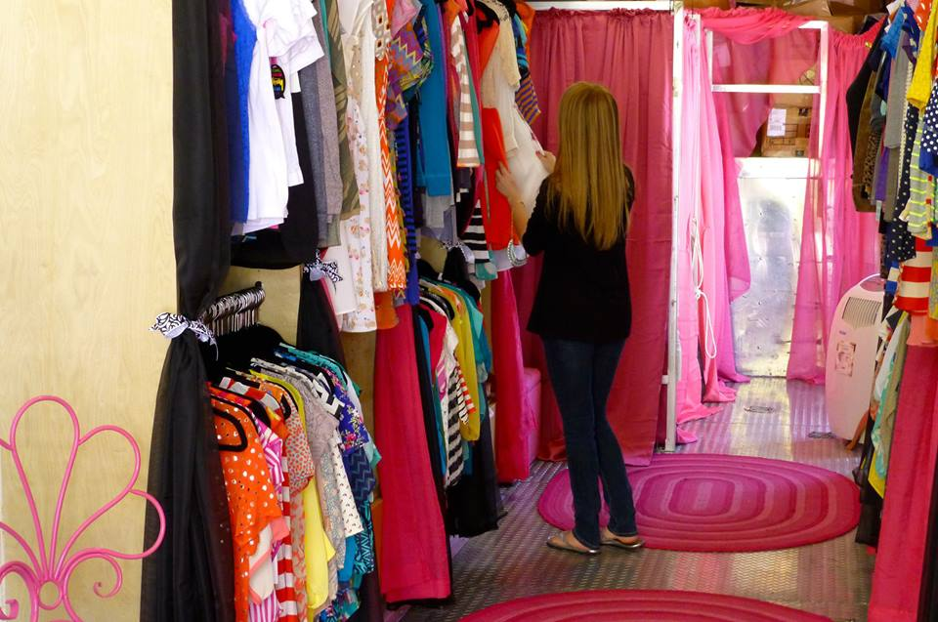
Competition
What products and companies will compete with you? Junior clothing
List your major competitors:
(Citi Trends,1317 E Memorial Dr, Ahoskie Nc, 27910)
Will they compete with you across the board, or just for certain products, certain customers, or in certain locations? Just certain products,
How will your products or services compare with the competition? Our clothes will have better quality across the board and cheaper.

Slide 8
FACTOR | Me | Strength | Weakness | Competitor A | Competitor B | Importance to Customer
Products
Price
Quality
Selection
Service
Reliability
Stability
Expertise
Company Reputation
Location
Appearance
Sales Method
Credit Policies
Advertising
Image

Slide 9
Distribution
Distribution Channels
How do you sell your products or services?
Direct (mail order, Web, catalog): Web, OUTSPOKEN_Wonderz@hughesnet.com, You can order from this website.
Wholesale: http://wholesalefashionmagazine.com/ Where we get our cloths from
\

