Slide 1
Quick Review Ch 4 – NC5
What issues caused conflict between the colonists and the British government?
How did the colonists attempt to form a government after declaring their independence?
Based on the Constitution, what are the goals of government?
Where did NC settlers come from?
What 3 parts did the NC Constitution consist of?

Slide 2
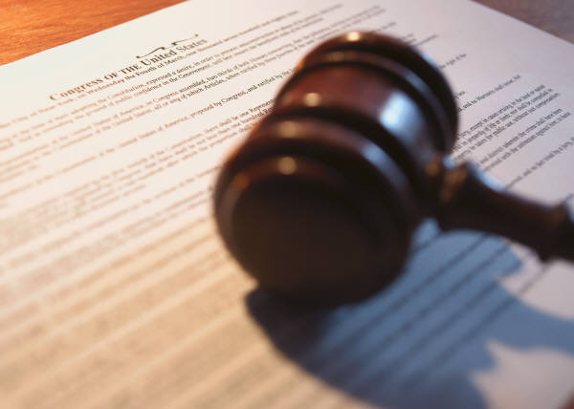
Ch. 6 Notes
The Bill of Rights

Slide 3
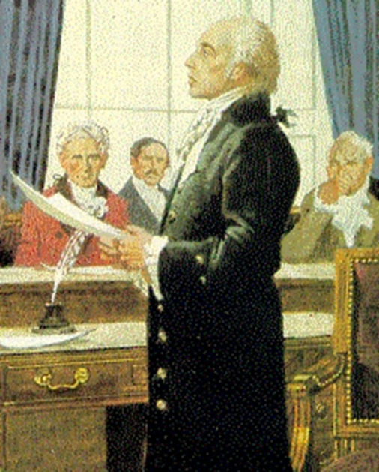
Section 1: Adding the Bill of Rights
Protecting citizens rights helped gain support for the Constitution
1791: the states approved the 10 amendments (Bill of Rights)

Slide 4
Section 2: Protections in the Bill of Rights
Protections of Individual Freedoms
  Religion, Speech, Press, Assembly, Petition

Slide 5

Protections Against Abuse of Power
  Right to Gun Ownership
  No Unreasonable Searches or Seizures
  Property Rights: Govt. must pay a fair price for your property

Slide 6
Protections of the Accused
  Right to…
    Remain silent, trial by jury, fair treatment

Slide 7
Section 3: Interpreting the Bill of Rights
Court Judges have the tough job of determining the meaning of citizen’s rights.
Local Court -> State Court -> Supreme Court
Supreme Court Decisions = Case Studies

Slide 8
Ch. 6 Review
What was the original purpose of the Bill of Rights?
In what ways does the Bill of Rights provide protection?
How is the exact meaning of citizen’s rights decided?

Slide 9

Ch. 6 Assessment
Page 182
Complete # 1 – 11
  Reviewing Key Terms
    Write out the sentence with correct term underlined.
  Comprehension and Critical Thinking
    Write out the question and your response.
    * Turn in for a grade when completed.

