Slide 1
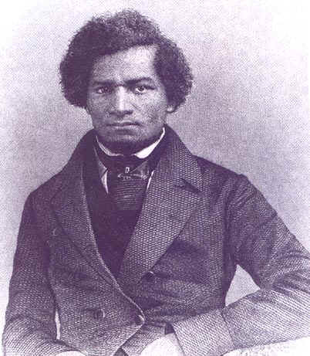
Unit 2: African-Americans in the New Nation (1763-1861)
African-Americans, both free and slave, struggle to find their way in the newly established United States of America.
Frederick Douglass: a former slave who escaped and became a fervent abolitionist in the north.

Slide 2

Quick Review of Ch. 5
African-Americans in the New Nation
What were the forces for freedom / for slavery in the years following the American Revolution?
In what ways did free blacks attempt to strengthen their communities?

Slide 3
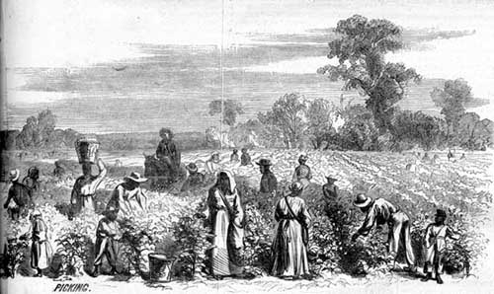
Chapter 6: Life in the Cotton Kingdom
(1793 – 1861)
Life for most slaves in the South revolved around agricultural production.

Slide 4
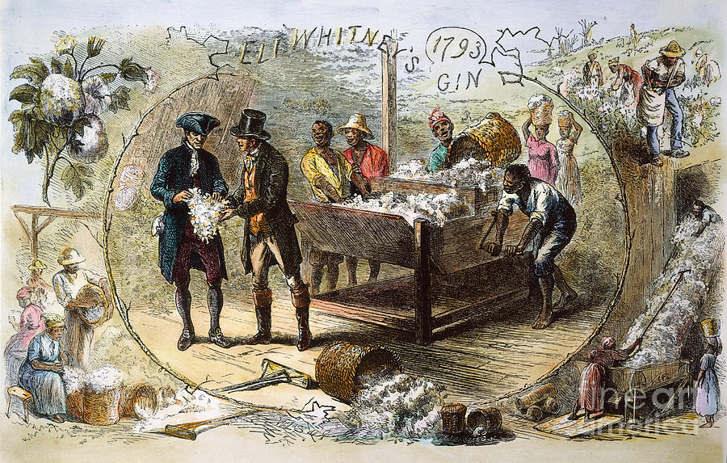
Section 1: The Expansion of Slavery
Eli Whitney invents the Cotton Gin in 1793
  Made it easier and more profitable to produce cotton
  Created an increase in demand for slave labor
  The key to the expansion of slavery in the south during the early 19th century
    The slave population increases dramatically between 1790 to 1860, mostly in cotton-producing states.

Slide 5
Section 2: Slave Labor in Agriculture
While Cotton was the ‘King’, slaves also labored in the development of other crops
  Tobacco: long growing season and required close attention
  Rice: hard work and required a large labor force
  Sugarcane: difficult and dangerous crop to work

Slide 6
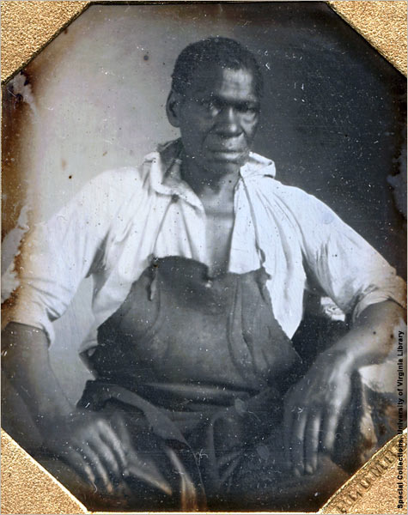
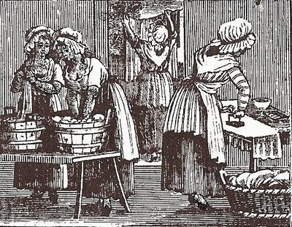
Section 3: Other Types of Slave Labor
While about 75% of slave workforce were field hands, the remaining 25% were house slaves, skilled slaves, and industrial slaves.
  House: cooks, maids, butlers, nurses, gardeners
  Skilled: carpenters, blacksmiths, millwrights
  Industrial: worked in factories

Slide 7
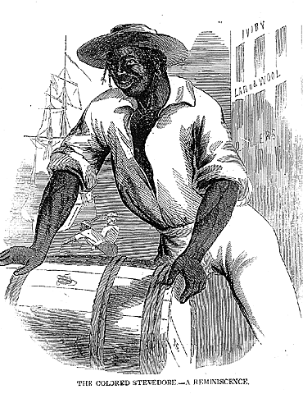
Section 3: Other Types of Slave Labor
While slaves lived under the threat of physical punishment, skilled slaves living in towns and cities generally faired better than field hands.
  They enjoyed a little more freedom and were able to earn money on their own after work hours.
  Urban masters often allowed their slaves to purchase their own freedom after a period of years to prevent them from running away.

Slide 8
Question for Thought
How do suspect slave owners decided which slaves would work in the field, in the house, or in the cities?

Slide 9
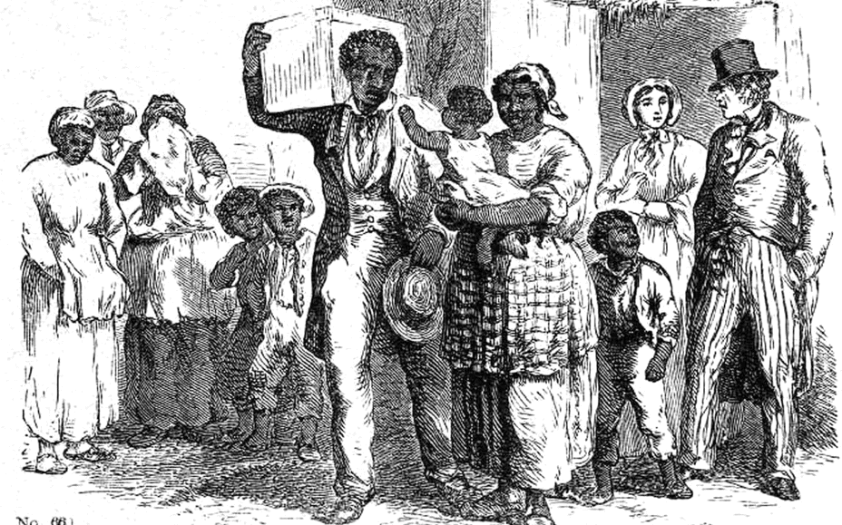
Section 4: Slave Life
Masters encouraged slave men and women to pair up for economic reasons
  However, their marriages and the families they produced had no legal standing.
This meant that families could (and often were) be broken up and sold to different locations.

Slide 10
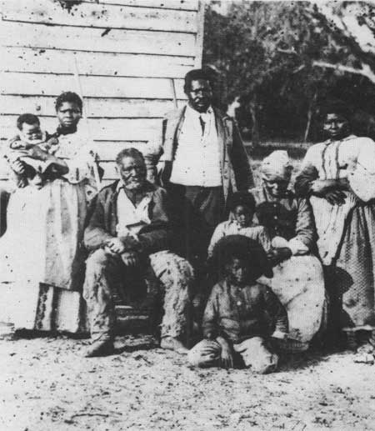
Section 4: Slave Life
Despite the hardships of life as a slave, the family was at the core of their community and parents did the best they could to raise their children and teach them how to survive.
  Examples of Hardships
    Women faced the danger
    of sexual exploitation
    Health Suffered due to…
      Poor diets
      Inadequate clothing
      Hard work

Slide 11
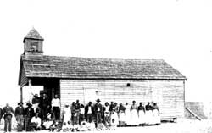
Section 5: The Socialization of Slaves
African-Americans developed ways of coping with slavery.
  Family: love and encouragement from loved ones
  Religion: looking to God for strength and having the hope of a better day to come
  Socialization: learning survival skills
    Watch what you say to white people
    Withhold information about other blacks
    Don’t allow slave owners to know the real you

Slide 12

Quick Review of Ch. 6
Life in the Cotton Kingdom
What was the effect of Eli Whitney’s invention, the Cotton Gin?
How would you compare life as a field slave to life as a skilled slaved?
In what ways did slaves learn how to deal with slavery?

