Slide 1
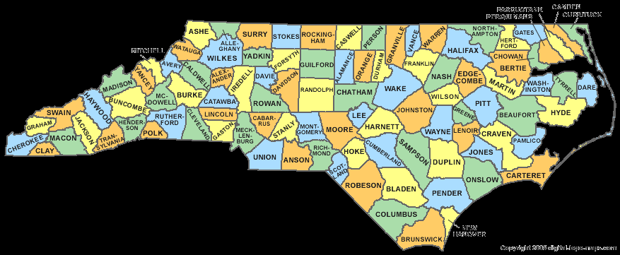
NC Chapter 5 Notes
Foundations of NC’s Govt.

Slide 2
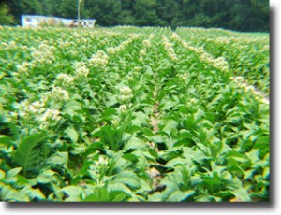
Section 1: NC’s Beginnings
Mid-1600’s
  English settlers begin moving south from VA to what is now NC
Why named ‘Carolina’?
  Latin for ‘Charles’ -> England’s King Charles II
Warmer climate + good soil = Large Plantations

Slide 3
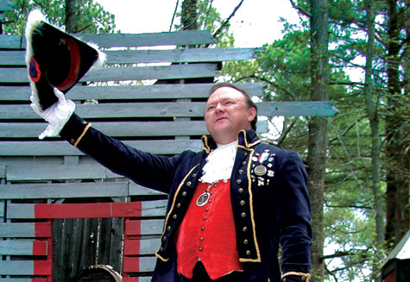
NC’s Involvement in the American Revolution
1774
  1st of 13 colonies to call an independent assembly
1776
  Issued the Halifax Resolves
    Document encouraging all colonies to declare Independence from England

Slide 4
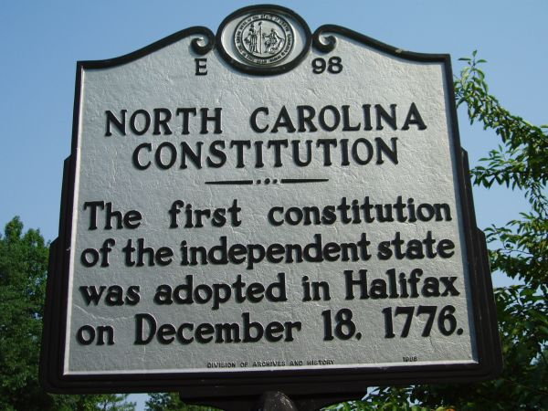
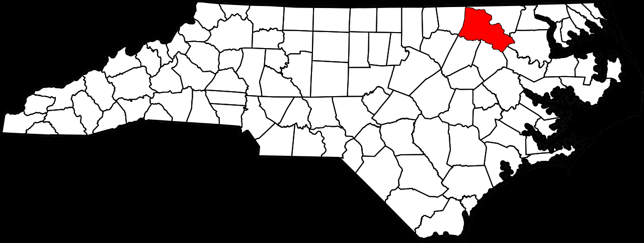
Section 2: NC’s Constitution
1776
  Elected delegates created a state constitution for NC

Slide 5
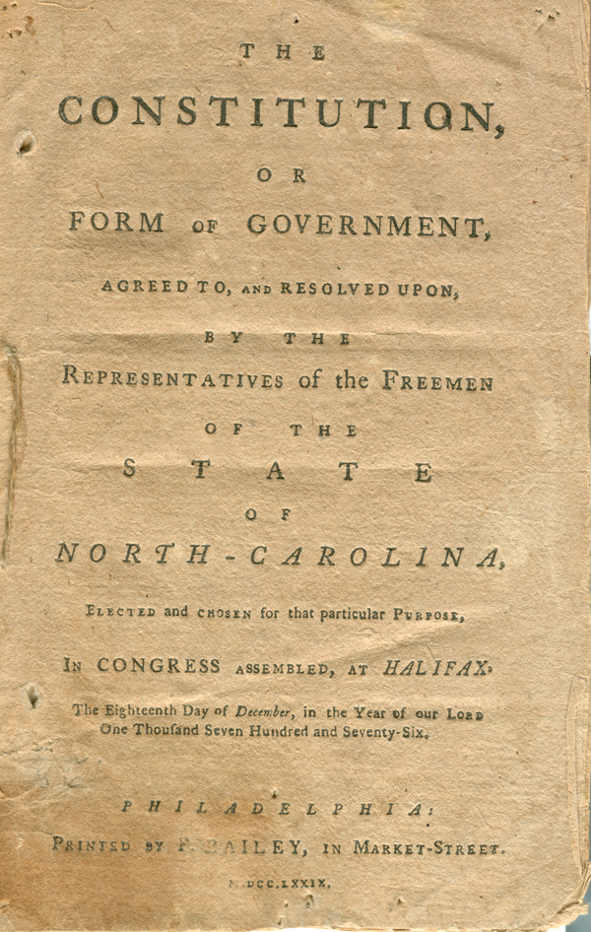
3 Parts of NC Constitution
Governor
Courts
Legislature
  Senate
  House of Representatives

Slide 6
Keys to NC Constitution
Limited the Governor’s Power
Outlined Rights
  Freedom of the Press
  Freedom of Worship
Outlined Responsibilities
  Public Education
    1789: UNC became the 1st public university in the US
  Created Local Govts: Cities, Towns, Counties

Slide 7

Amending NC’s Constitution
How to change NC’s constitution?
  1. By Constitutional Convention
    Convention makes proposal -> voters decide
  2. By Legislature
    General Assembly makes proposal -> voters decide

Slide 8

NC Constitution Rewritten
1868 -> After the Civil War
  Change: no longer have to own property to vote
1971 -> To Clarify the Language
  Change: Public school from 6 months to 9 months

Slide 9
NC5 Review
1. Where did NC settlers come from?
2. Where did the name ‘Carolina’ come from?
3. How were NC colonists involved in the American Revolution?
4. What 3 parts did the NC Constitution consist of?
5. What key topics were discussed in the NC Constitution?
6. What kind of changes have been made to the NC Constitution over time?

Slide 10

NC5 Assessment
Page NC5 - 18
Complete # 1 – 9
  Reviewing Key Terms
    Write out the sentence with correct term underlined.
  Comprehension and Critical Thinking
    Write out the question and your response.
    * Turn in for a grade.

