Slide 1
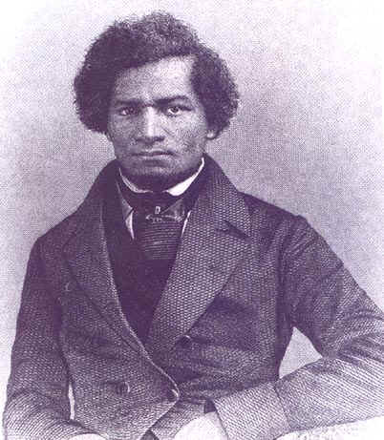
Unit 2: African-Americans in the New Nation (1763-1861)
Frederick Douglass: a former slave who escaped and became a fervent abolitionist in the north.

Slide 2

Quick Review Questions
Chapter 4: African Americans and the Struggle for Independence
In what ways were African-Americans involved in the American Revolution?
What factors influenced the ending of slavery in the North in the years following the Revolution?

Slide 3
Ch.5: African Americans in the New Nation (1783 – 1820)
During the early years of this new American nation, forces for black liberty contested the forces of slavery and inequality.

Slide 4

Section 1: Forces for Freedom
In the North
  Following the Revolutionary War, strong trends favored the emancipation of slaves.
    Economic Changes
    Evangelical Christianity
    Enlightenment Ideas of Natural Rights

Slide 5
Section 1: Forces for Freedom
In the South
  Resistance to emancipation because many whites were financially invested in the continuation of slavery
  However, new laws made it easier for owners to declare their slaves free and the possibility of self-purchase opened the door for southern slaves to gain their own freedom.
  Over time, a free black class emerged in the South (more in the upper South than the lower).
Upper South = Delaware and Maryland

Slide 6
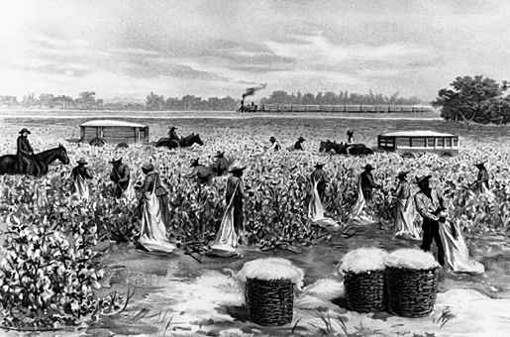
Section 2: Forces for Slavery
Factors that Strengthened the Continuance of Slavery in the US
  The US Constitution
    Clauses in the Constitution allowed for the continuation of slavery.
  Cotton
    Increase in demand for cotton = increase in demand for slaves
  Louisiana Purchase
    The country expands west, creating more
    territory for slavery to exist.
  Racism
    Whites gradually became more opposed to change and more committed to race-based arguments in favor of slavery.

Slide 7
Section 3: The Emergence of Free Black Communities
Free black communities developed institutions to help strengthen their communities.
  Mutual Aid Societies
    Similar to insurance companies, helping with medical costs and to support widows
  Black Freemason Lodges
    Secretive Organizations which united free black men
  The Church
    The core of the black community
  Black Schools
    With the support of the church and
    mutual aid societies, they produced a
    growing class of literate African-Americans

Slide 8
Discussion Question
Does the church still play an important role among African-American communities in modern times?

Slide 9
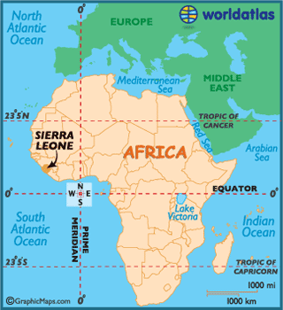
Section 4: Black Leaders and Choices
In the North
  Educated blacks began to address the failure of American society to treat blacks equally.
  Some even supported black migration from the United States back to West Africa.
Freetown, in Sierra Leone on the West Coast of Africa, was established as a refuge for former slaves.

Slide 10
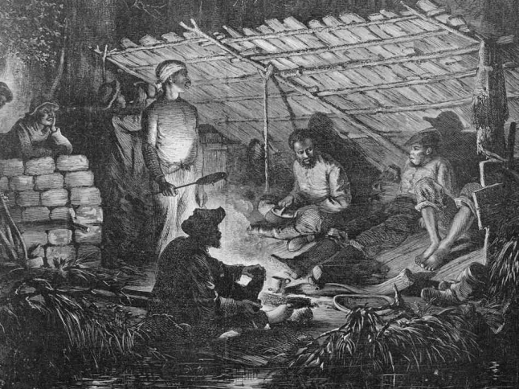
Section 4: Black Leaders and Choices
In the South
  Blacks Responded to Slavery in Different Ways
    Acquiescence = Reluctant Acceptance
    Day-to-Day Resistance (Breaking Tools)
    Open Rebellion (Slave Revolts)
  Slave uprisings deepened white’s fears of a race war and strengthened their support for continuing the institution of slavery

Slide 11
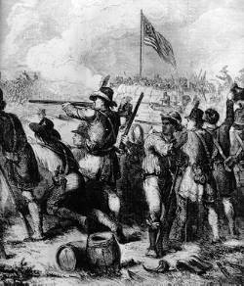
Section 5: War and Politics
British invasion of the United States during the War of 1812 renewed southern fears of slave revolt.
Nevertheless, black soldiers fought for the United States in important battles of the war.

Slide 12
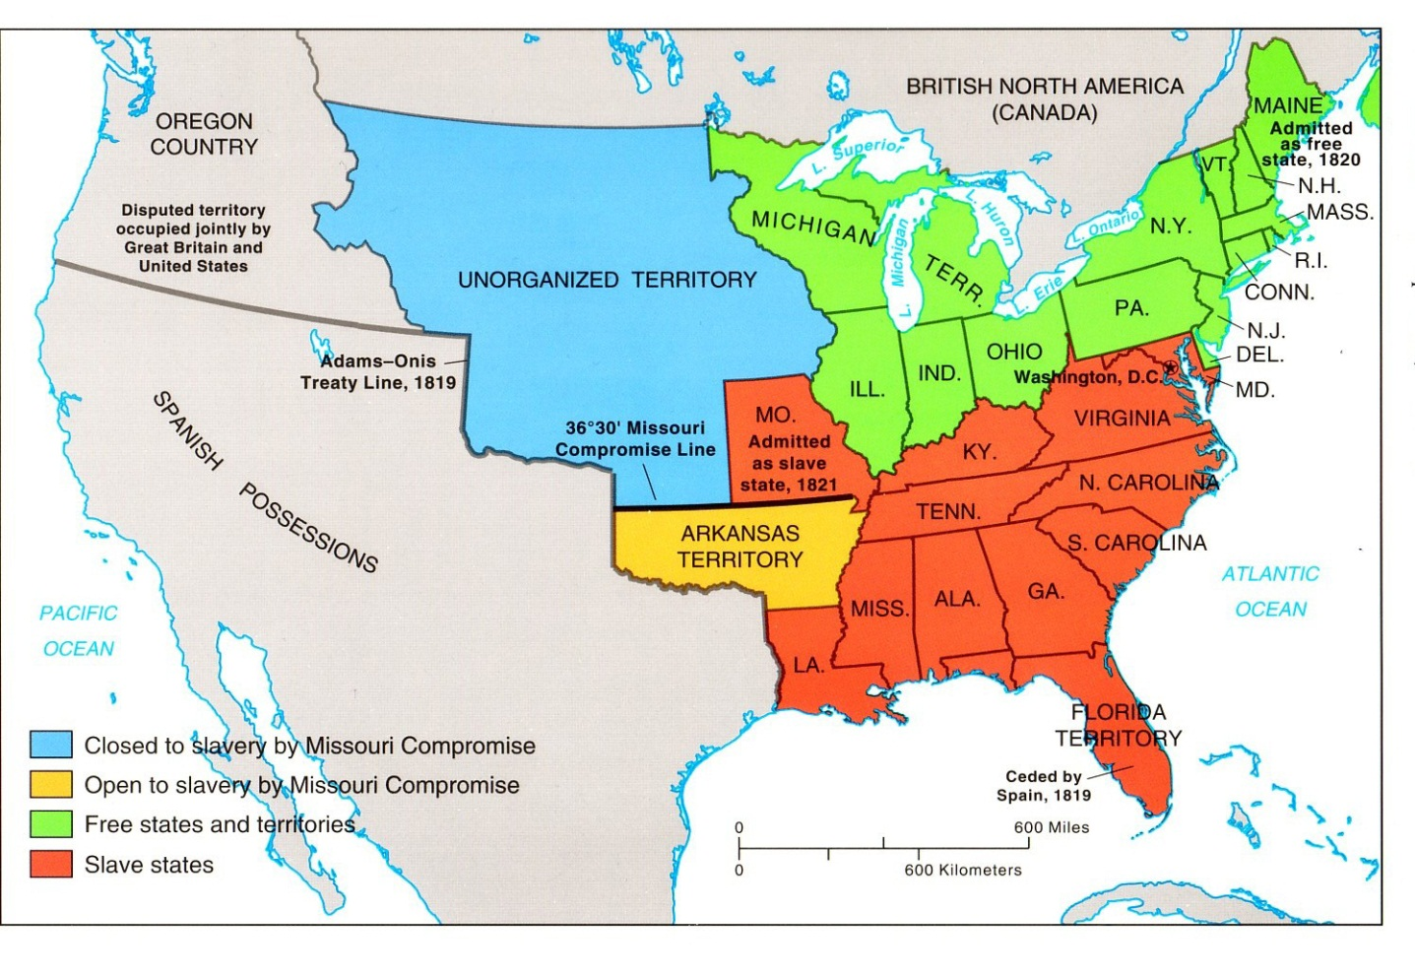
Section 5: War and Politics
The Missouri Compromise (1820)
  An effort to maintain balance between the North and South
  Allowed Missouri to enter as a slave state if Maine entered as a free state

Slide 13
Quick Review of Ch. 5
African-Americans in the New Nation
What were the forces for freedom / for slavery in the years following the American Revolution?
In what ways did free blacks attempt to strengthen their communities?
How did blacks, both free and slave, react to unequal treatment in the United States?
What was the Missouri Compromise and how does it reflect the relationship that existed between the North and South?

