Slide 1
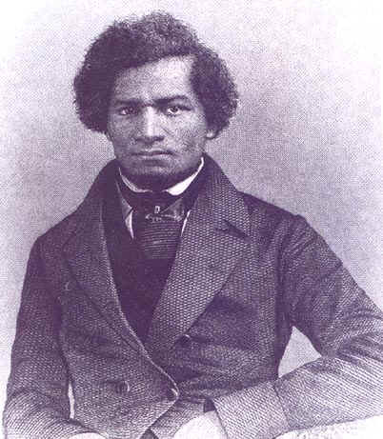
Unit 2: African-Americans in the New Nation (1763-1861)
African-Americans, both free and slave, struggle to find their way in the newly established United States of America.
Frederick Douglass: a former slave who escaped and became a fervent abolitionist in the North.

Slide 2
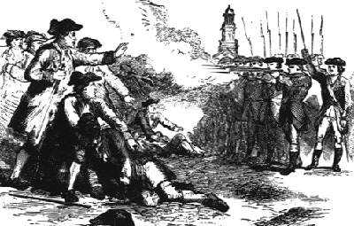
Ch 4: African Americans and the Struggle for Independence (1763 – 1783)
African-Americans did play a role in the American Revolution.

Slide 3
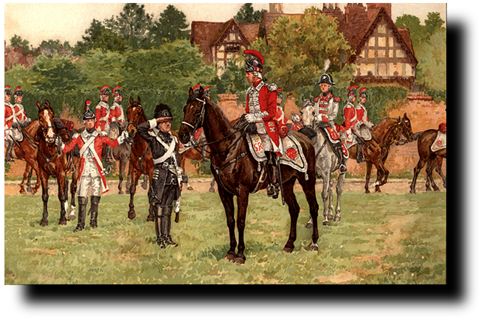
4.1 Notes
The Crisis of the British Empire, p. 111
1760s – British pass laws to limit American colonial expansion and raise money for England (after the French and Indian War) through increased taxes for colonists.

Slide 4
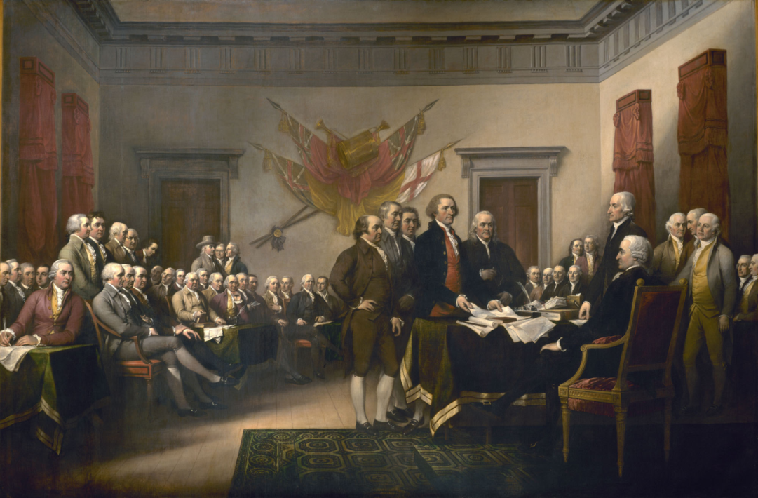
4.1 Notes
Crisis of the British Empire
1776 – Colonial Resistance to British Policies results in the Declaration of Independence
  American colonists want to be independent of British Rule and establish their own nation.

Slide 5
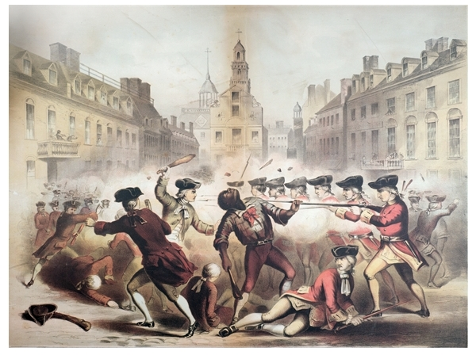
Key Question
In what ways were African-Americans involved in the American Revolution?

Slide 6
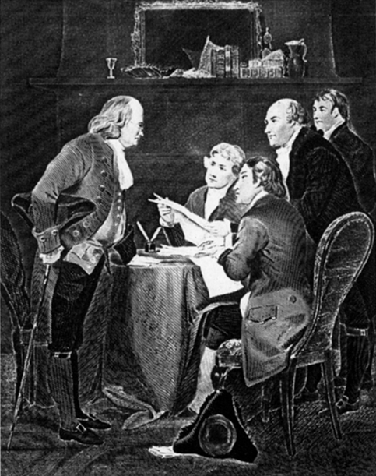
4.2 Notes
The Declaration of Independence and African-Americans, p.115
The Authors of the Declaration distinguished between the rights of whites and blacks.
We hold these truths to be self-evident, that all men are created equal… ???
Quick Discussion: Why do you think they viewed the rights of white and blacks differently?

Slide 7
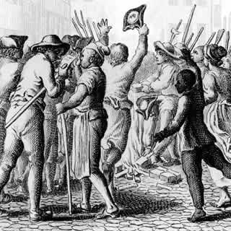
4.2 Notes
African Americans believed the Declaration of Independence logically included people of all races.

Slide 8
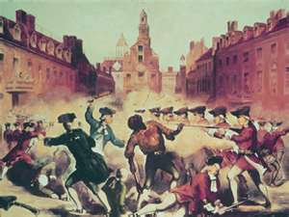
4.2 Notes
African Americans (such as Crispus Attucks) participated in the Revolutionary conflict
  Arguing against slavery and fighting against the British
Crispus Attacks
- A fugitive slave from Massachusetts who is believed to be the first one killed by British troops at the “Boston Massacre”. He and other angry colonists were harassing the British troops when they opened fire.

Slide 9
Question
Many of the men who supported the Declaration of Independence, also owned slaves. What do you think about that? What does that tell us about colonial America?

Slide 10
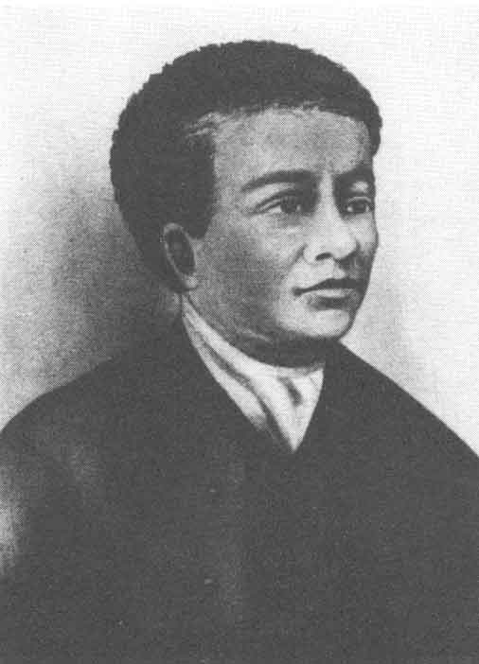
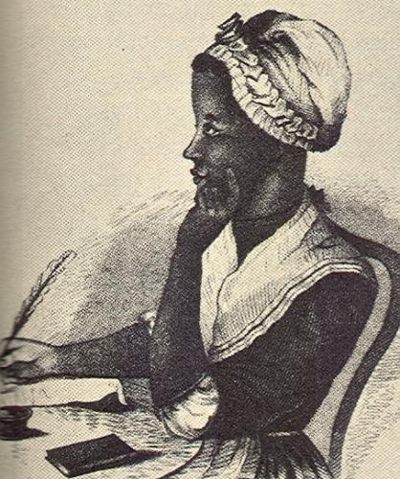
4.3 Notes
Black Enlightenment, p.119
The Enlightenment influenced America’s 1st Black Intellectuals
  Phillis Wheatley (Poet)
  Benjamin Banneker (Mathematician)
Enlightenment: an 18th century intellectual movement which stressed using human reason.
They both believed that one could not claim to support the highest principles of the Enlightenment and, at the same time, deny the basic equality of whites and blacks.

Slide 11

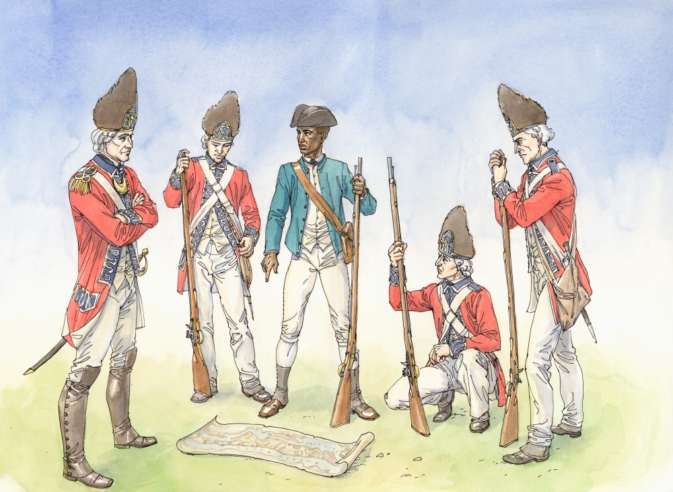
4.4 Notes
African Americans in the War for Independence, p.123
African Americans fought on both sides of the War for Independence
  Whichever side they believed best offered them freedom

Slide 12

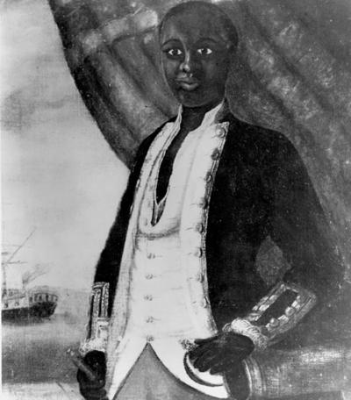
4.4 Notes
African Americans in the War for Independence
Loyalist (Loyal to England) vs. Patriots
  Some African-Americans accepted the British offer of freedom to escaped slaves who would join the British forces.
  When military necessity forced Colonial forces to recruit black soldiers, some African-Americans used the opportunity to press for their own freedom.

Slide 13
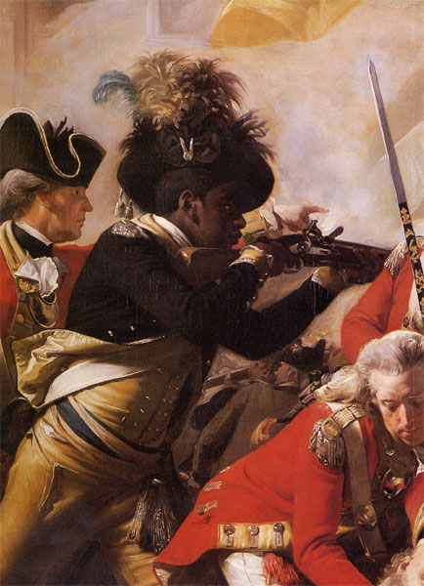
4.4 Notes
African-Americans in the War for Independence
Key Concept: Black men fought in almost every major battle of the American Revolutionary War.

Slide 14
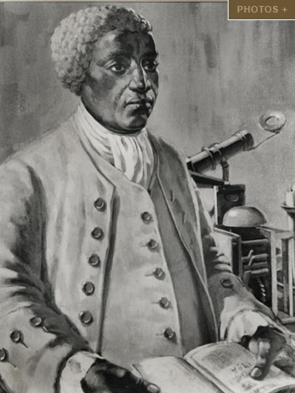
4.5 Notes
The Revolution and Emancipation, p. 127
Emancipation = the freeing of enslaved African-Americans
Economic, Religious, and Intellectual Factors Encouraged Northern Emancipation
  Economic: the North is not
  dependent on slave labor.
  Religious: Quakers led anti-slavery
  Societies .
  Intellectual: the willingness of
  African-Americans to fight for the
  Patriot cause encouraged northern
  States to emancipate (free) slaves.
By the late 1700s most northern States had begun the process of abolishing slavery.

Slide 15
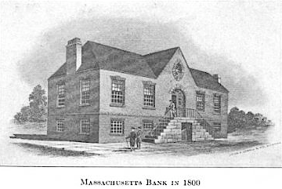
4.5 Notes
The Revolution and Emancipation
Freedom brought with it economic uncertainty and hardship for African-Americans, but that did not stop blacks from embracing the opportunities freedom presented.

Slide 16

Quick Review Questions
Chapter 4: African Americans and the Struggle for Independence
In what ways were African-Americans involved in the American Revolution?
How might whites and blacks have viewed the Declaration of Independence differently during the time in which it was written?
What factors influenced the end of slavery in the North in the years following the Revolution?
Why could life still be difficult for blacks even after emancipation?

