Slide 1
Review Game
What’s on the ppt?
Chapters 1 - 3

Slide 2
‘What’s on the ppt?’ Rules
2 Teams are Competing
1 Teammate will have his / her back turned to the ppt
Teammates will have 30 seconds to try to describe what is on the ppt, but YOU CAN’T SAY ANY OF THE WORDS ON THE PPT
If the Teammate can guess what’s on the ppt, your team get’s a point!
Whoever ends with the most points wins!

Slide 3
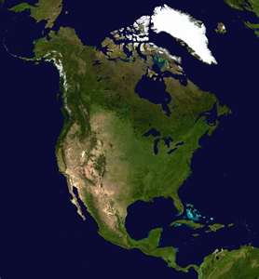
Example
The word is ‘North America’
Teammates can not say ‘North’ or ‘America’
Also, no rhyming or starts with ‘N’

Slide 4
Africa

Slide 5
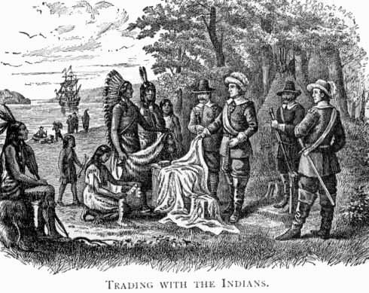
Islam

Slide 6
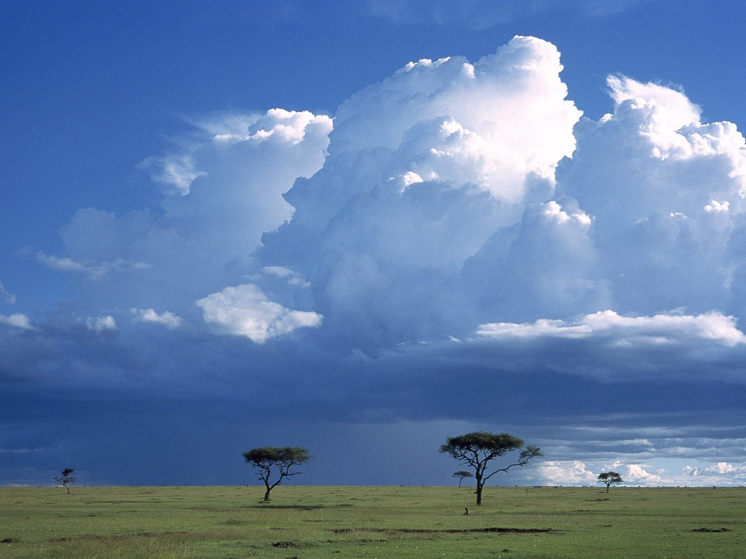
Diverse Geography

Slide 7
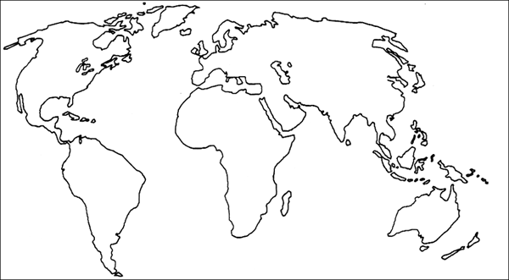
European Exploration

Slide 8
Local Religion

Slide 9
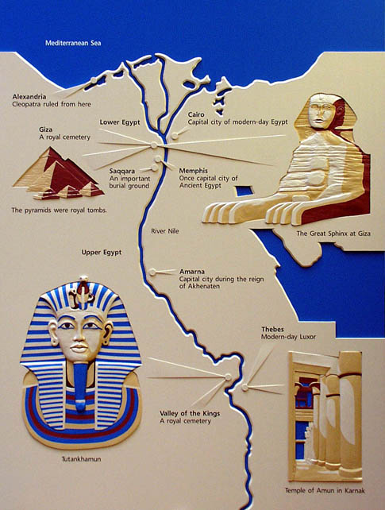
Ancient Egypt

Slide 10
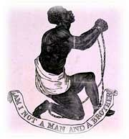
Chattel Slavery

Slide 11
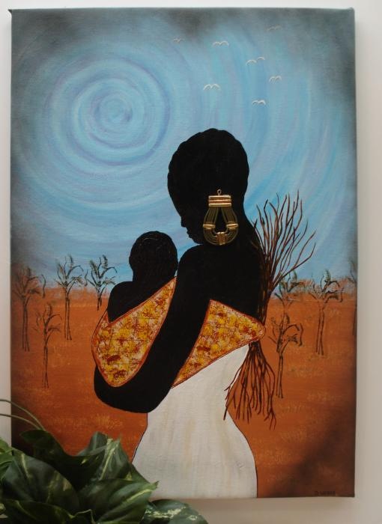
Matrilineal

Slide 12
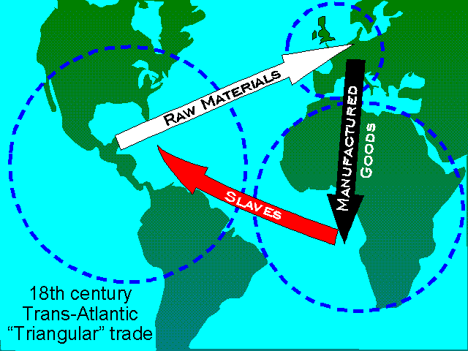
Triangular Trade Systems

Slide 13
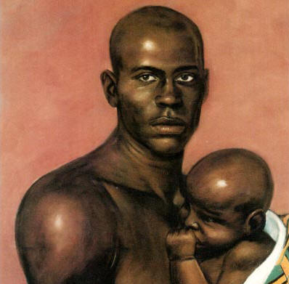
Patrilineal

Slide 14
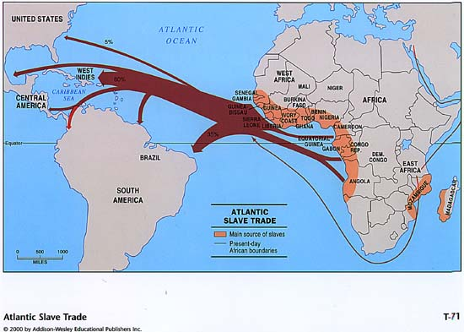
Atlantic Slave Trade

Slide 15
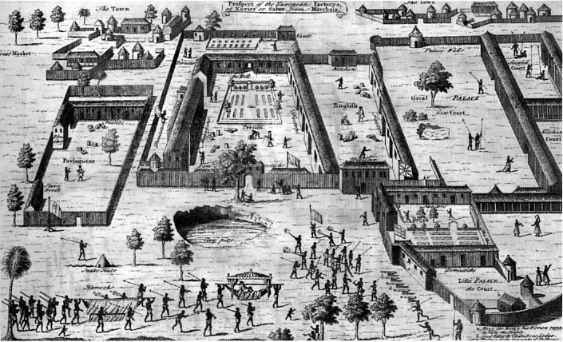
Factories

Slide 16
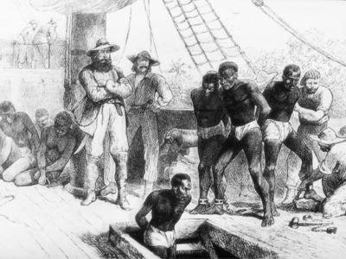
Middle Passage

Slide 17
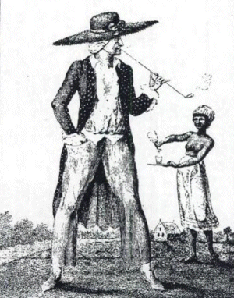
Planters

Slide 18
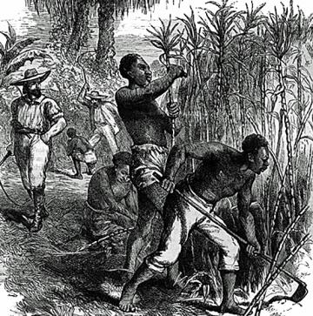
Seasoning

Slide 19
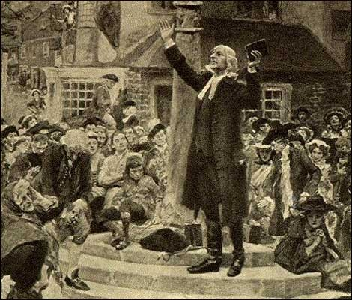
Great Awakening

Slide 20
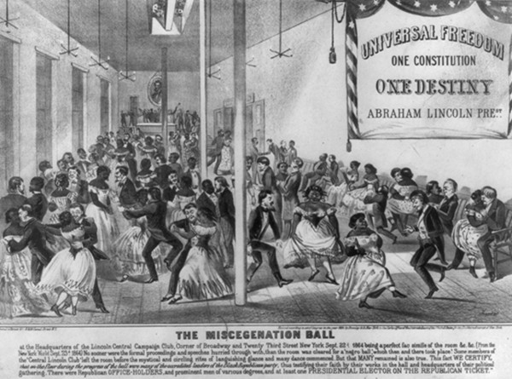
Miscegenation

Slide 21
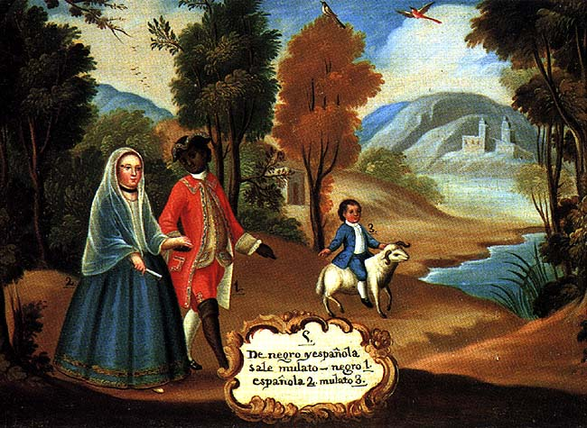
Mulattoes

Slide 22
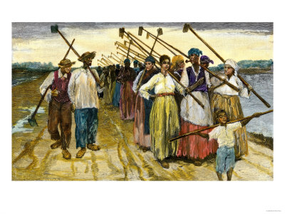
Gang System

Slide 23
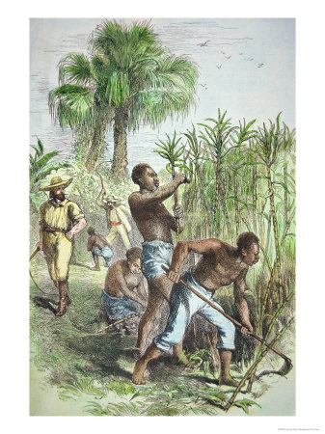
Drivers

Slide 24
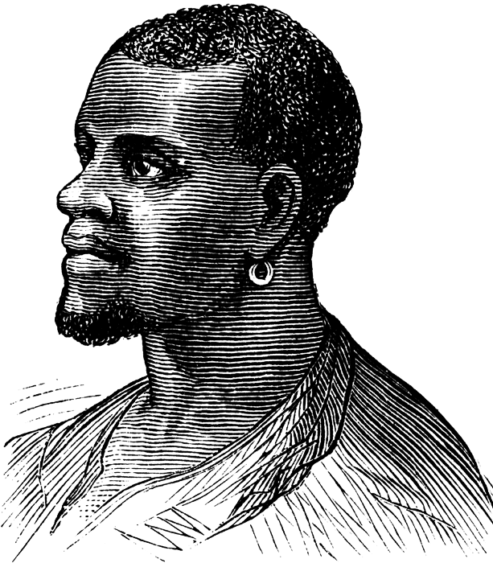
African-American Culture

Slide 25
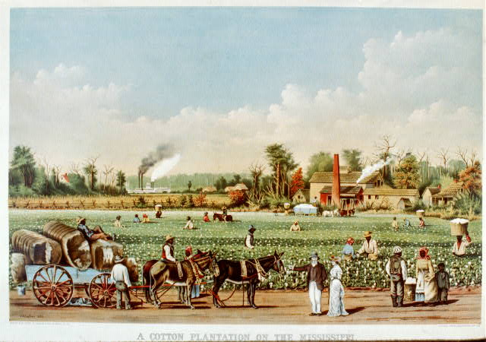
Plantation

Slide 26
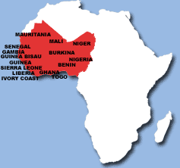
West Africa

Slide 27
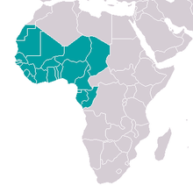
Wealthy Trade Networks

Slide 28
Agricultural Slaves

Slide 29
Resistance to Slavery

