Slide 1
Review Game
What’s on the ppt?
Chapters 1 - 3

Slide 2
‘What’s on the ppt?’ Rules
2 Teams are Competing
1 Teammate will have his / her back turned to the ppt
Teammates will have 30 seconds to try to describe what is on the ppt, but YOU CAN’T SAY ANY OF THE WORDS ON THE PPT
If the Teammate can guess what’s on the ppt, your team get’s a point!
Whoever ends with the most points wins!

Slide 3
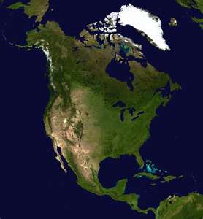
Example
The word is ‘North America’
Teammates can not say ‘North’ or ‘America’
Also, no rhyming or starts with ‘N’

Slide 4

Diversity

Slide 5
Immigrants

Slide 6
Demography

Slide 7
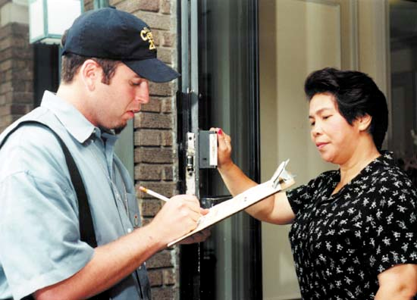
Census

Slide 8
Service Job

Slide 9
Baby Boom

Slide 10
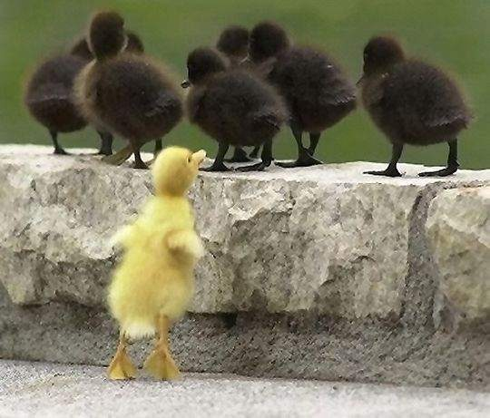
Discrimination

Slide 11

Values

Slide 12
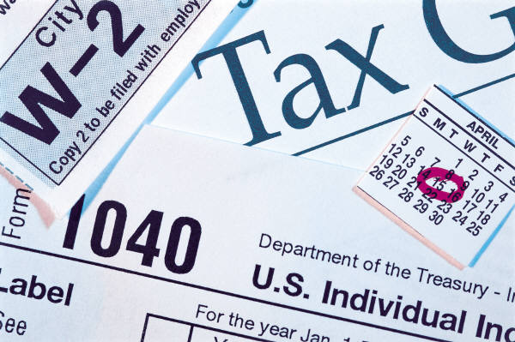
Taxes

Slide 13
Economy

Slide 14
Equality

Slide 15
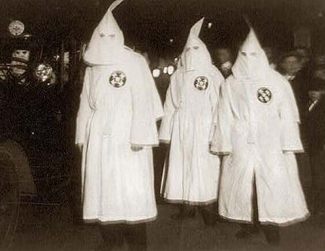
Racism

Slide 16
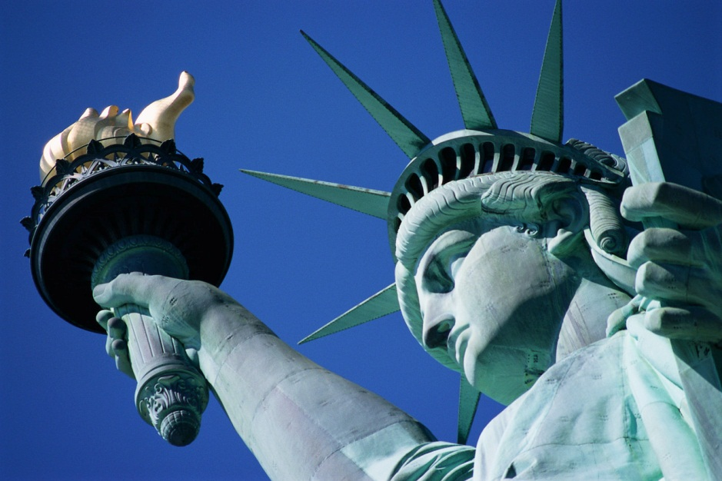
Freedom

Slide 17
Consumer

Slide 18

Socialization

Slide 19
Market

Slide 20
Justice

Slide 21
Monarchy

Slide 22
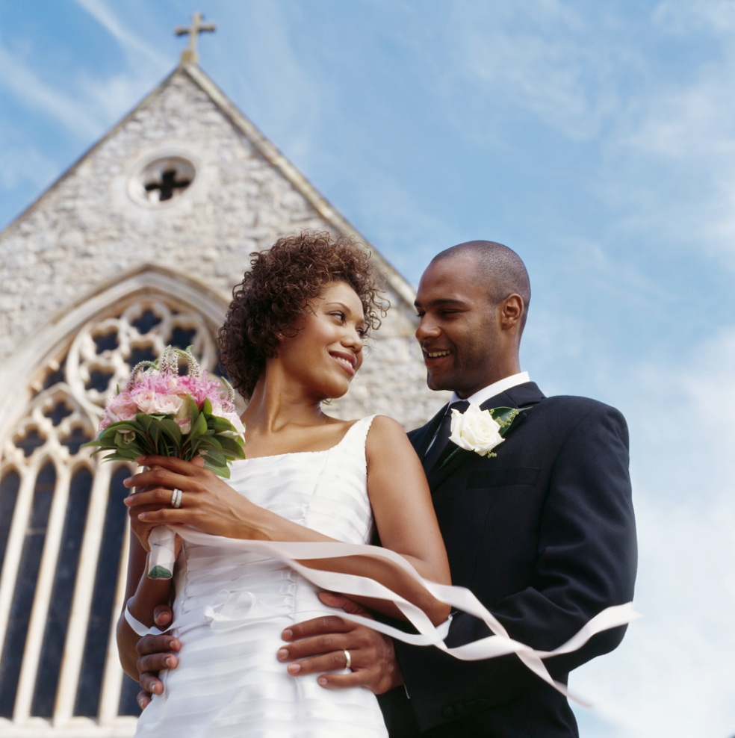
Social Institutions

Slide 23
Political Socialization

Slide 24
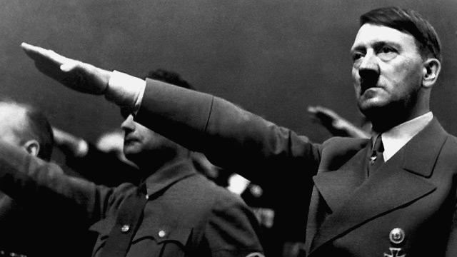
Dictatorship

Slide 25
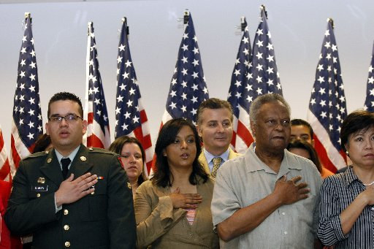
Citizen

Slide 26

Alien

Slide 27
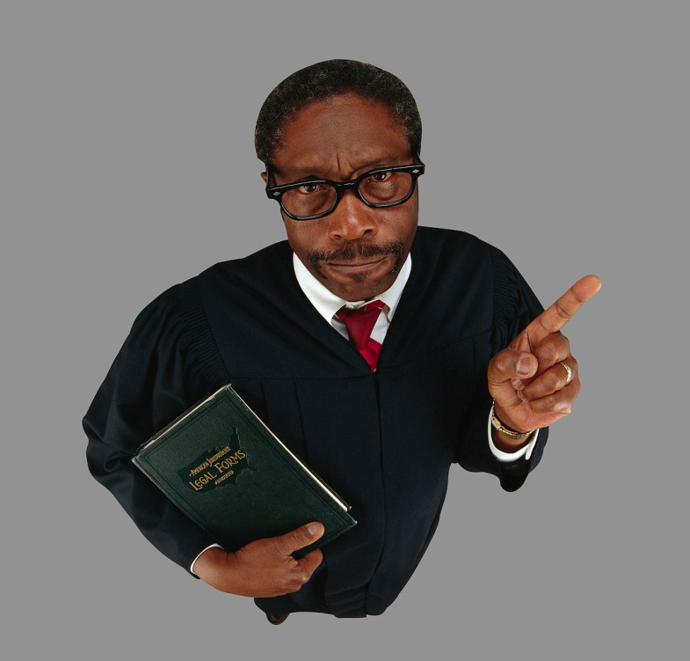
Rule of Law

Slide 28
Democracy

Slide 29
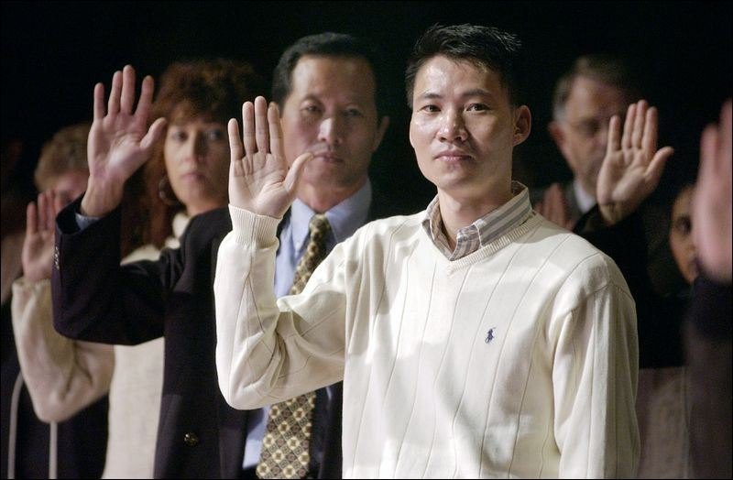
Naturalized

Slide 30
Representatives

Slide 31

Asian American

Slide 32
Jury

Slide 33

Rights of Citizens

Slide 34

Patriotism

Slide 35
Candidate

Slide 36

Social Roles

Slide 37

Hispanic Americans

Slide 38

Cultural Mosaic

Slide 39
Duties of Citizens

