Slide 1

Quick Review: Ch. 1 - 2
What have you learned about West African history and culture so far?
What have you learned about the Atlantic Slave Trade so far?

Slide 2
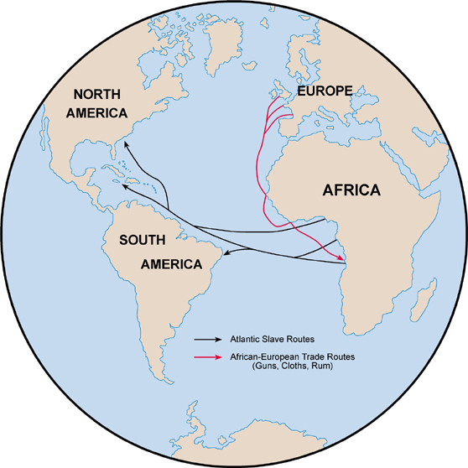
Unit 1: From West Africa to the Early Americas (Ancient Times – 1763)
The Atlantic Slave Trade brings West Africans to the Colonies of the Americas.

Slide 3
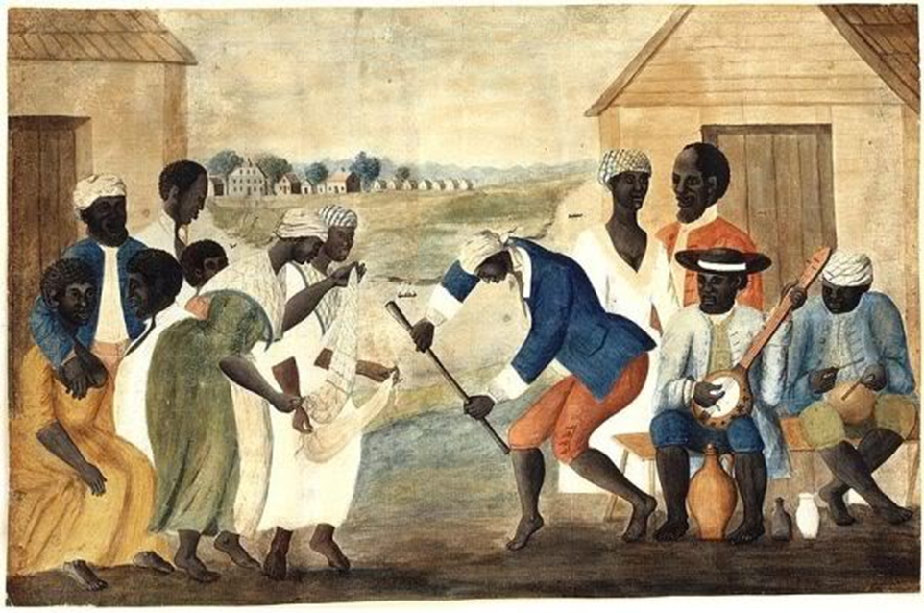
Chapter 3: Black People in Colonial North America (1526 – 1763)
African-American culture begins to develop throughout plantations in colonial America.

Slide 4
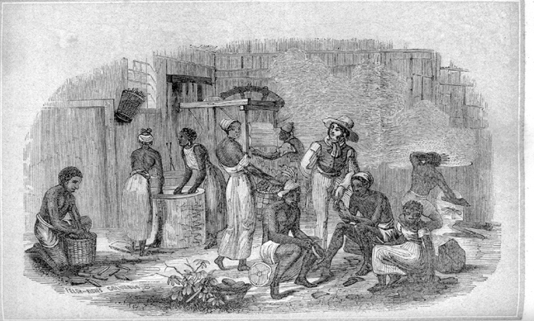
Section 3
The Peoples of North America
During the 17th and 18th Centuries
African immigrants -> African-American People

Slide 5
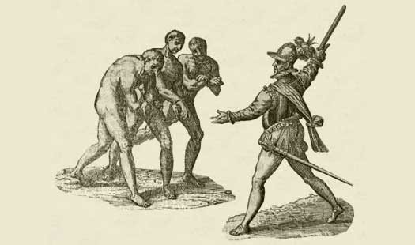
Section 1
The Peoples of North America
African-American Culture Takes Shape
Shaped by the cultures of:
  Africans
  American Indians
  Spanish
  British
Think About It: What shapes the culture of our class?

Slide 6
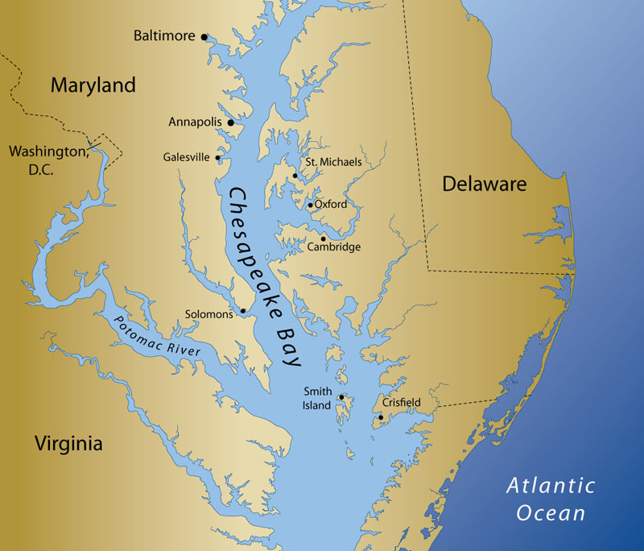
Section 2
Africans Arrive in the Chesapeake
Africans arrive in Virginia and Maryland.
British settlers establish chattel slavery
  Slaves are legally considered private property
Discussion Q: What are some things that you consider to be your own property? Now imagine that a person could once be considered to be the property of another person. How does this help you better understand how the institution of slavery operated in the Americas long ago?

Slide 7
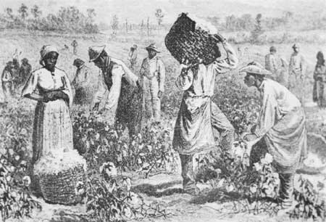
Section 2
Africans Arrive in the Chesapeake
By the end of the 17th century, almost all blacks were agricultural slaves.

Slide 8
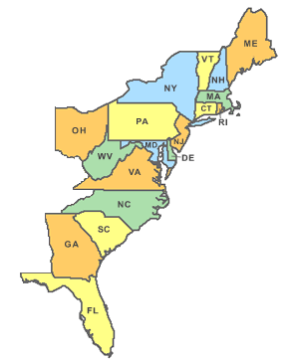
Section 3
Plantation Slavery, 1700 – 1750
By 1750, the majority of slaves work on plantations in the South:
  Delaware, Maryland, Virginia, North Carolina, South Carolina, Georgia

Slide 9
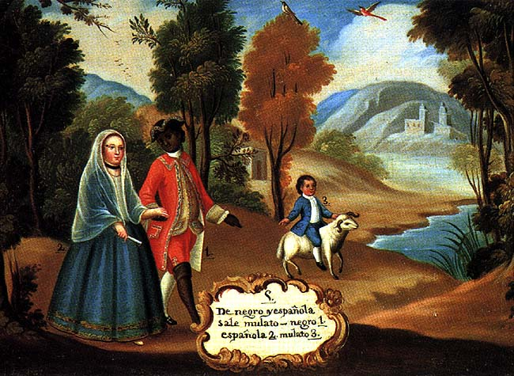
Section 3
Plantation Slavery, 1700 – 1750
Miscegenation and creolization led to a distinct, African-American People.
  Miscegenation: interracial sexual contact
  Creolization: process of cultural exchanges that led African parents to have African-American children.
Mulattoes: those of mixed African and European ancestry

Slide 10
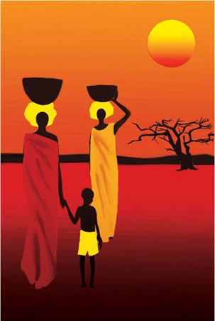
Section 4
‘The Origins of African-American Culture’
African Americans kept key parts of African Culture
  Importance of Extended Family
  African Religious Ideas
  African Music
  Folk Tales, Proverbs, and Riddles
Discussion Q: Do you see any influences of African culture in African-American culture today?

Slide 11
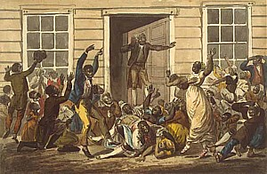
Section 4
‘The Origins of African-American Culture’
Great Awakening (1730s)
  Religious revival in the colonies
  Many African-Americans converted to Christianity

Slide 12
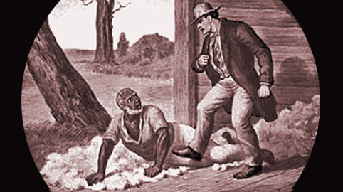
Discussion Question
Why do you think some slave owners might have been afraid of slaves becoming Christians?

Slide 13
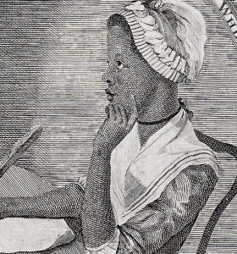
Section 4
‘The Origins of African-American Culture’
African-American Culture Impacted White Colonial Culture
  Language (Speech Patterns)
  Food (W. African Traditions)
  Work (The Gang System)
  Architecture (African-style Woodcarvings)

Slide 14
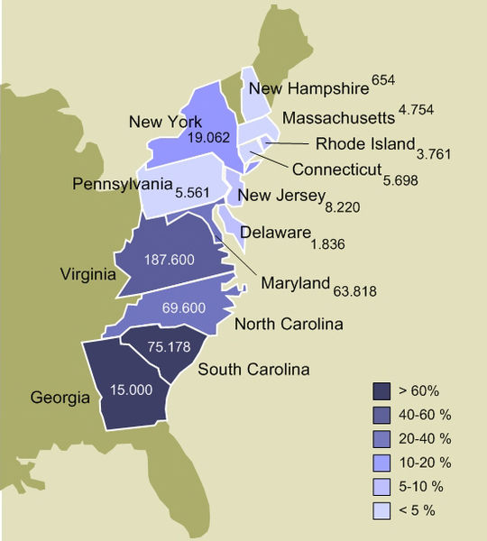
Section 5
Slavery in Colonial America
Northern Colonies
  Fewer Slaves and Less Oppressive than in Southern Colonies
  Why?
    Religious Views
    Cooler Climate
    Plenty of White Workers
    Diversified Economy
      Not reliant on Slave Labor
Map of Slavery in 1770

Slide 15
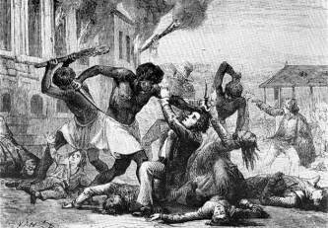
Section 5: Slavery in Colonial America
Many Blacks Resisted Slavery in Different Ways
  Work Partially
  Try to Escape
  Rebel Against Owners
  Kill Owners

Slide 16
Quick Review Questions
Ch. 3: Black People in Colonial North America
What factors shaped the early development of African-American culture?
Why didn’t slavery take hold in northern colonies the way it did in the southern ones?

