Slide 1
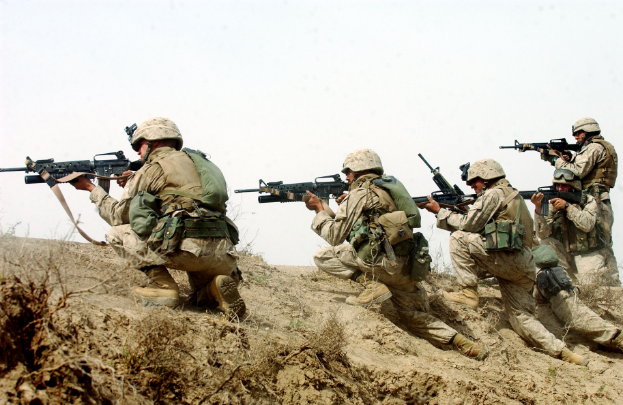
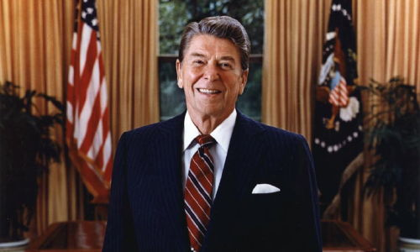
Unit 10: Changing and Enduring Issues (1980 – Present Times)
With the Cold War ending and the constant development of advanced technology, Americans look to meet the challenges of an ever-changing world.

Slide 2
Quick Review of Ch. 28
What was the Conservative Resurgence?
How did it affect domestic policy?
How did it affect foreign policy?

Slide 3
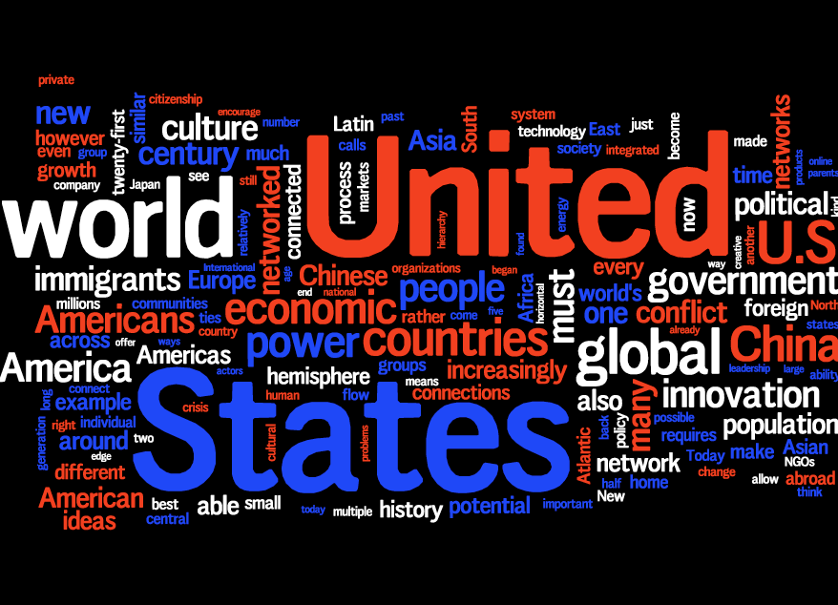
Chapter 29: Into a New Century (1992 – Today)
Chapter Focus
What political, social, technological, and economic trends have shaped American life since 1990?

Slide 4
Chapter 29: Into a New Century (1992 – Today)
Chapter Summary
One of the most important technological advances of the twentieth century was the development of computers, which affected business, industry, and science. Computers, satellites, and the Internet created an "information age," that allowed anyone to have access to information quickly. Computers and other technology have increased global businesses, as well as increased jobs in the service sector and decreased organized labor.
William Jefferson Clinton positioned himself as a "New Democrat," a moderate position that helped him win the 1992 presidential election with promises of social and economic opportunity. Clinton successfully introduced new laws involving medical leave and waiting periods for buying handguns, but failed to win support of healthcare reforms. In the mid-term election of 1994, Republicans won control of the House of Representatives, but an economic boom helped Clinton to win reelection two years later.
The 2000 presidential election between Al Gore and George W. Bush resulted in such a close vote that a recount was needed and the Supreme Court had to intervene. Bush's priorities were tax cuts to stimulate the economy, as well as addressing education and the needs of senior citizens. On September 11, 2001, a foreign enemy attacked the United States for the first time since Pearl Harbor when terrorists crashed planes into the World Trade Center and the Pentagon causing the U.S. to declare war on terrorism. The war on terrorism helped Bush win reelection in 2004.

Slide 5
Section 1: The Computer and Technology Revolutions
Technology Changes American Life
The invention of the microchip leads to the development of personal computers, which transforms businesses, research and American life
Advances in biotechnology, the use of living organisms in the development of new products, produces a higher level of healthcare than ever before
Developments in agricultural technology lead to more productive farms, while less people are needed to work the farm
A Communications Revolution
Computers, cell phones, e-mails, and instant messaging become the tools of the “information age”
Satellites orbiting the Earth increase
the speed of global communication.
In the 1990s the Internet begins to
reach the general public, making
communication and access to
information almost instantaneous.

Slide 6
A Changing American Economy
Due to technological advances…
Less and less Americans work on assembly lines or on farms.
More and more Americans work in service industries (such as lawyers, teachers, doctors, salespeople)
The Impact of Globalization
Advanced communications has made it easier
for companies to do global business
More products and services available
to more people, often at lower prices
Economic problems in one part of
the world can be felt in other parts of
the world
Globalization: the process by which national economies, politics, cultures, & societies become integrated with other nations around the world.

Slide 7
Discussion Question
How do you think continued advancements in technology might change life in America over the next 20 years?

Slide 8
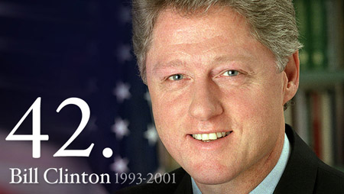
Section 2: The Clinton Presidency
Taking office in 1993, President Bill Clinton (himself a Democrat) tries to balance a middle road between the limited role for government supported by Republicans and the traditional Democratic reliance on government programs to address social problems.

Slide 9
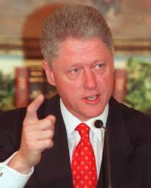
The Clinton Presidency
Clinton’s Domestic Policies
Family Medical Leave Act (ex: guaranteed unpaid leave at work for giving birth)
Increased minimum wage and access
to college loans
Brady Bill strengthened gun control
Scandals, Impeachment and Trial
Questions about investments Bill and wife Hillary Clinton had made in a real estate company, Whitewater Development Corporation
Bill Clinton is found guilty of having an
affair with a White House intern, something
he had lied about under oath.
The House of Representatives attempted
to impeach (remove) Clinton, however the
Senate decided against impeachment.
“I did not have sexual relations with that woman” - Clinton

Slide 10
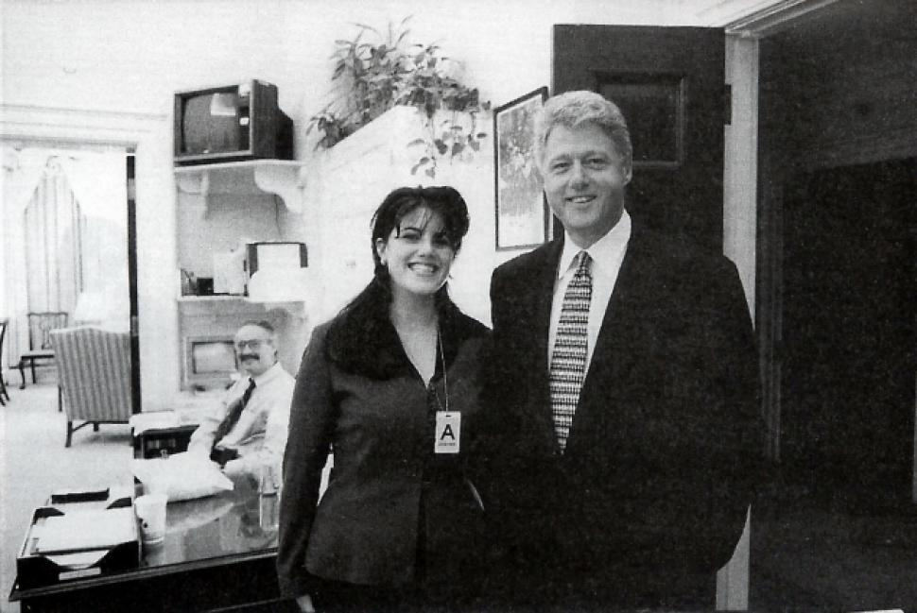
Discussion Q
Did President Clinton deserve to be impeached (removed from office)? Why?
White House Intern Monica Lewinsky and President Bill Clinton.

Slide 11
Section 3: Global Politics and Economics
In the 1990s, the U.S. was both a promoter of global trade & an example for newly industrialized nations to follow.
As more nations participated in economic globalization, the U.S. adjusted its own policies to ensure it remained an economic powerhouse.
U.S., Canada & Mexico form the
North American Free Trade
Agreement (NAFTA) in 1994
Involvement in the World
Trade Organization (WTO)

Slide 12
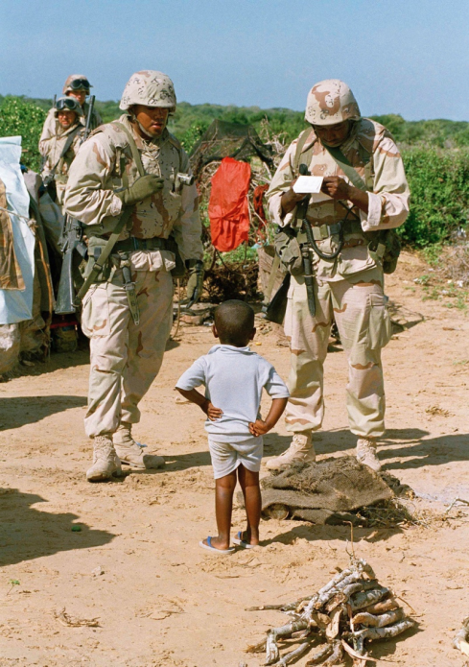
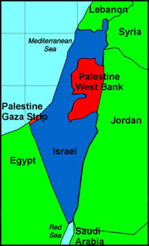
Americans on the Global Stage
U.S. Forces offer aid to war-torn Somalia and Haiti
Attempts to encourage peace agreements between Israel and Palestinians, although with little success
Osama bin Laden forms the group al Qaeda, with the goal of ending American involvement in Muslim countries. They begin carrying out terrorist attacks on Americans around the world.

Slide 13
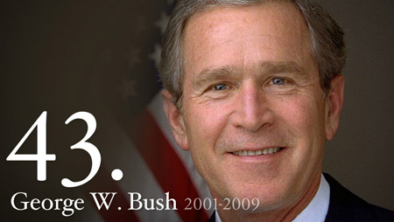
Section 4: The George W. Bush Presidency
Republican George W. Bush wins an extremely close presidential election in 2000. However, not long after being in office, the September 11, 2001 terrorist attacks on American soil would move the nation in a new direction and come to define Bush’s time in office.

Slide 14
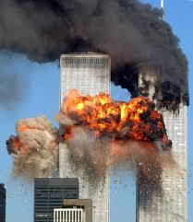
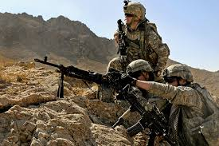
The United States is Attacked
On September 11, 2001, Osama bin Laden’s al Qaeda network orchestrated the high-jacking of commercial airplanes that were flown into the World Trade Center, the Pentagon, and a Pennsylvania field, leaving over 3,000 Americans dead.
America’s War on Terrorism
The U.S. invades Afghanistan where many al Qaeda terrorists had been trained
U.S. forces invade Iraq and overthrow Saddam Hussein’s government, believing him to be a threat to peace and that he had Weapons of Mass Destruction (WMD)
However, many criticized Bush after WMD were not found in Iraq and the expenses of the war in Iraq increased the federal deficit.

Slide 15
Section 5: Americans Look to the Future
Immigration continues to shape the nation
Latinos and Asians make up the largest numbers of new immigrants to the U.S.
As the year 2000 kick-started a new millennium, Americans looked back at a century of great change and technological progress. Looking forward, immense challenges remain. However,
the U.S. faces the 21st century
with strength and optimism,
looking to the nation’s greatest
resource… the American
people.

Slide 16
Discussion Q
What challenges / achievements do you think lie ahead for the United States of America?

Slide 17
Quick Review of Ch 29
What political trends have shaped American life since 1990?
Social trends… ?
Technological trends… ?
Economics trends… ?

