Slide 1
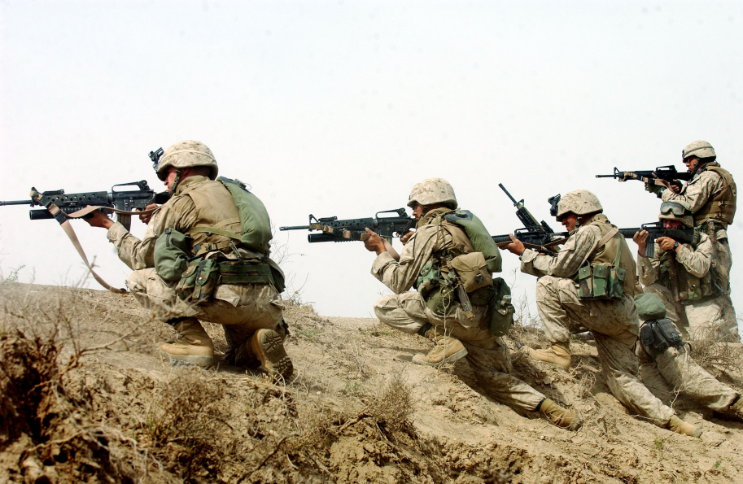
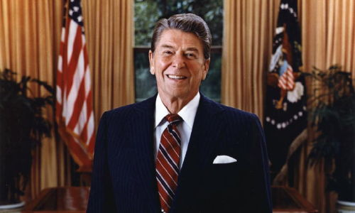
Unit 10: Changing and Enduring Issues (1980 – Present Times)
With the Cold War ending and the constant development of advanced technology, Americans look to meet the challenges of an ever-changing world.

Slide 2
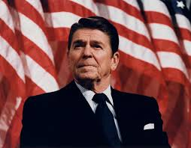
Chapter 28: The Conservative Resurgence (1980 – 1993)
Chapter Focus: What was the conservative resurgence, and how did it affect the domestic and foreign policy of the United States?

Slide 3
Chapter 28: The Conservative Resurgence (1980 – 1993)
Chapter Summary
In the end of the twentieth century, the two major political parties in the United States were labeled as Republican and conservative, or Democrat and liberal. In the late 1970s, liberal policies were criticized for causing problems and a rise in the conservative movement occurred. President Ronald Reagan's background as an entertainer gave him an easy communication style that helped him win the presidential election of 1980. Reagan implemented many economic policies based on supply-side economics or "Reaganomics," the idea that if taxes are reduced the economy will grow. Reagan easily won reelection, and used his power to appoint several conservative Supreme Court judges and get George H.W. Bush elected as his successor. The rising cost of Social Security, the education system, and a new disease, Acquired Immunodeficiency Syndrome (AIDS), were some of the many new problems that arose in the United States in 1980s.

Slide 4
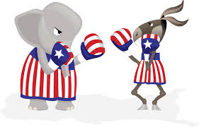
Section 1: The Conservative Movement Grows
Liberal (Democrat) vs. Conservative (Republican) Viewpoints
Issue | Liberal Viewpoint | Conservative Viewpoint
Role of Government in the Economy | More government involvement to lessen extreme economic inequalities - social programs - government regulation | Limited government involvement to stimulate economic growth - reducing taxes - less government regulation
Foreign Policy | International diplomacy to combat communism | Actively fighting against communism

Slide 5
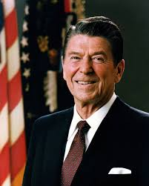
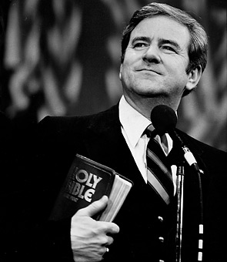
The Conservative Movement Gains Strength
Many lost confidence in the Democratic Party during the difficulties of the Vietnam War, the oil crises of the 1970s, a struggling economy, & the Iran Hostage Crisis.
In 1979 the Moral Majority is founded by Reverend Jerry Falwell.
An organization committed to traditional family values, which leads to an increase in conservative / Republican voters.
In 1980 Ronald Reagan is elected President. He is charismatic and clear about his opposition to big government, support for a strong military, and faith in traditional values.
Ronald Reagan
Jerry Falwell

Slide 6
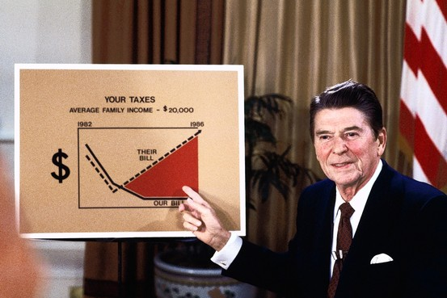
Section 2: The Reagan Revolution
Reaganomics Guides the Economy
Supply-Side Economics: if taxes are reduced, people will work more and have more money to spend, causing the economy to grow
Deregulation: less government control over industry, so businesses will be more efficient and profitable
While the federal government still struggled with a large budget deficit and national debt, by 1983 the economy was improving, helping Reagan’s popularity and leading to his easy victory for reelection in 1984.

Slide 7
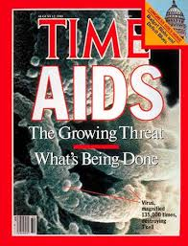
Confronting Challenging Issues
Despite growing optimism during the 1980s, the nation continued to face tough problems.
The rising cost of Social Security
Concerns over student’s low scores on standardized tests
In 1981, the threat of a new disease emerged, Acquired Immunodeficiency Syndrome (AIDS)

Slide 8
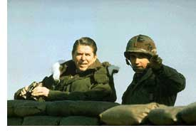
Section 3: The End of the Cold War
Reagan felt that the Vietnam War had caused the U.S. to lose its way in the battle of democracy vs. communism.
Reagan’s Solution?
Achieve peace through military strength
Build new nuclear missile systems and fund secret operations against the Soviet Union and its allies around the world.
This initially caused more tension
between the U.S. and Soviet Union,
but eventually Reagan’s policies
helped to end the Cold War.

Slide 9
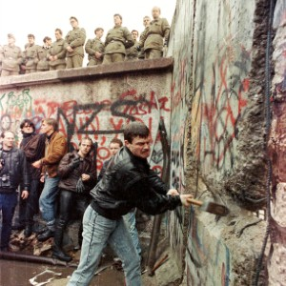
The Cold War Ends
Reagan and Mikhail Gorbachev, the President of the Soviet Union as of 1985, work together.
The Soviet Union’s economy had collapsed, leading to Gorbachev’s new policies
Glasnost: “a new openness”
Perestroika: reforming the Soviet system; moving away from a state-controlled economy
Reagan and Gorbachev meet and work towards improved relations
The Berlin Wall Comes Down
In 1989, the fall of East Germany’s
communist government and tearing
down of the Berlin Wall symbolized
the end of the Soviet Union and the
end of communism across much of
Eastern Europe.

Slide 10
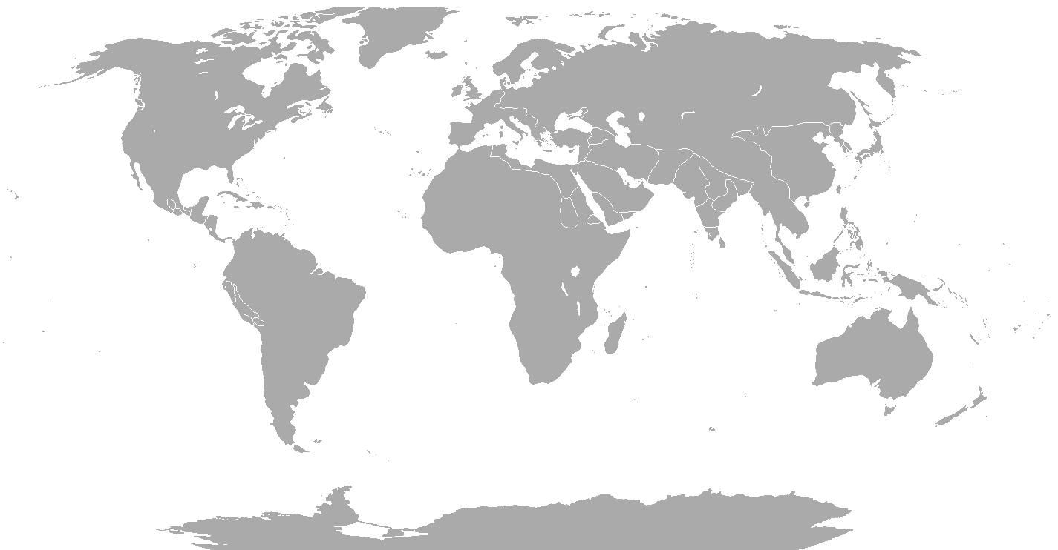
Section 4: Foreign Policy After the Cold War
When the Soviet Union collapsed, the U.S. was the only superpower left ready to take a leading role in world affairs. Many hoped this would be a new era of peace, but instead the 1980s and 1990s experienced dangerous regional conflicts and international crises.

Slide 11
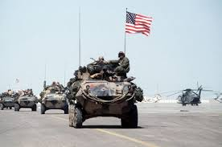
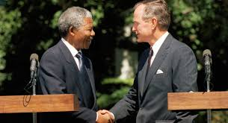
A New Role in the World
Key Marks of President Bush’s Foreign Policy
Arrested several international drug lords in Latin America
Condemned China’s harsh crackdown on pro-democracy protesters
Supported Nelson Mandela and South Africa’s movement towards democracy
Military intervention to protect human rights in Somalia
The Persian Gulf War. In Operation Desert Storm, American forces led a successful attack on Iraqi troops to liberate Kuwait.

Slide 12
Quick Review of Ch. 28
What was the Conservative Resurgence?
How did it affect domestic policy?
How did it affect foreign policy?

