Slide 1
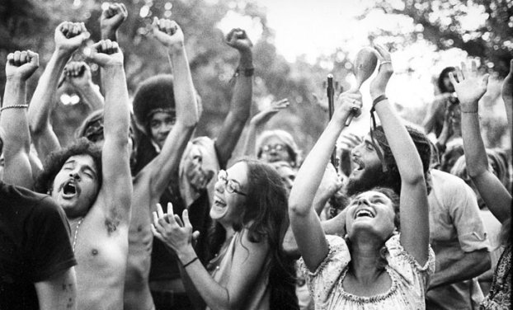
Unit 9: Challenges and Changes (1960 – 1980) Part II
The 60s and 70s are marked by challenges to traditional American values and a loss of confidence in political leaders.

Slide 2
Quick Review of Chapter 26
What was the Counterculture? How did it impact American society?
What were the causes and effects of the Women’s Movement of the 60s & 70s?
In what ways did minority groups (other than blacks) work towards greater equality?
What was the impact of the Environmental Movement?

Slide 3
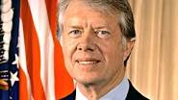
Chapter 27: A Crisis in Confidence (1968 – 1980)
Nixon, Ford, and Carter all face major challenges as the President of the USA.
Summary of Chapter 27
President Richard Nixon believed in giving most power to the states, but did establish some strong federal agencies while in office. Nixon tried to win support of conservative southerners to expand his popularity. When Nixon was linked to the break-in of Democratic Party headquarters and subsequent cover-up, the investigation and scandal forced him to resign. When Gerald Ford became President he was criticized for pardoning Nixon and failing to solve inflation and other economic troubles. Jimmy Carter portrayed himself as a "common" President, but his inexperience hurt him when he had to deal with inflation and an energy crisis. Cultural and demographical changes in the 1970s had long-lasting effects on politics and society in the United States.
Nixon (1969 – 74)
Ford (1974 – 77)
Carter (1977 – 81)

Slide 4
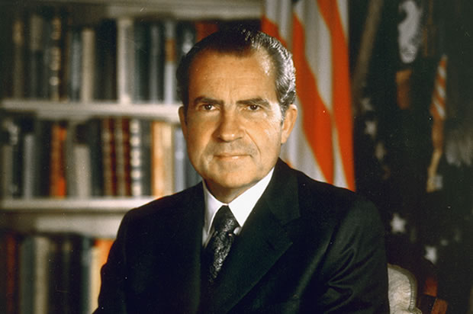
Section 1: Nixon and the Watergate Scandal
Nixon’s Policies as President
Claimed to be the spokesperson for Middle Americans, the “non-demonstrators” who “give life to the American Dream” as he put it.
Southern Strategy: as a Republican, he tried to win over blue-collar workers and southern whites, both of whom had traditionally voted for Democrats.
Popular Foreign Policy:
gradually withdrew troops
from Vietnam
Visited the Soviet Union and
China to improve relations

Slide 5
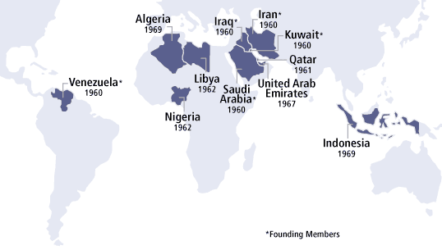
Section 1: Nixon and the Watergate Scandal
Challenges of Nixon’s Presidency
Stagflation: the US economy experienced both recession and inflation at the same time
Caused by the costs of the Vietnam War and the rise of foreign competition that decreased American jobs
Skyrocketing oil (gas) prices when the Organization of Petroleum Exporting Countries (OPEC), a group of mostly Arab countries, refused to sell oil to Israel’s allies, which included the USA
Members of OPEC

Slide 6
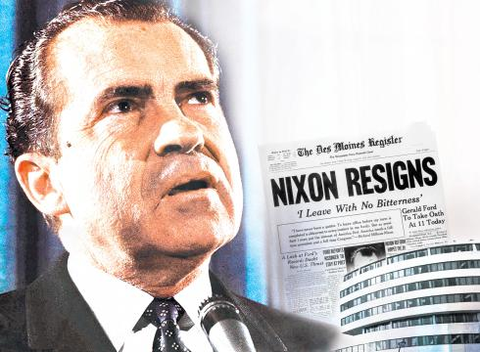
Section 1: Nixon and the Watergate Scandal
The Watergate Scandal Brings Nixon Down
June 1972: associates of Nixon are arrested for breaking into the Democratic Party headquarters at the Watergate complex, in D.C., and trying to plant recording devices.
April 1973: Nixon denies knowledge of the Watergate break-in or any cover-up attempt.
June 1973: Nixon is accused of authorizing a cover-up.
August 1974: Recorded tapes from the White House show that Nixon ordered a cover-up of the Watergate break-in. Rather than face impeachment, Nixon becomes the first U.S. President to resign.
The Watergate Scandal greatly damaged the American people’s sense of trust in the government and political leaders.

Slide 7
Discussion Question
Did Nixon deserve to be forced out of office? Why?

Slide 8
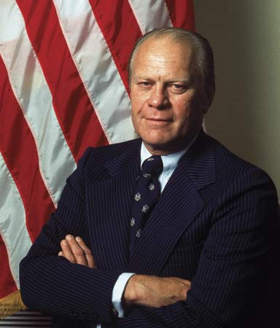
Section 2: The Ford and Carter Years
President Gerald Ford Faces Political & Economic Woes
Before resigning, Nixon appointed Ford as president
Ford pardons Nixon, leading some to criticize Ford’s decision
Ford attempts to regain the public’s trust and improve the economy, but has little success.
Foreign Affairs: Despite continued improvements with China and the Soviet Union, S. Vietnam fell to the communist north.
He leaves the office (1974 – 77) with
the economy still suffering and the
American people’s distrust of
government still high.
Did Ford get a fair chance to prove himself as President?

Slide 9
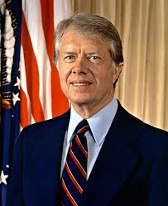
Jimmy Carter Barely Defeats Ford to Become President in 1977
2 Keys to Carter’s Victory
Ran as an “outsider” from Georgia with no ties to the “corruption” of Washington, D.C.
As a former Sunday School teacher, he gained the support of conservative Christian fundamentalists
The Challenges Continue
Carter’s Lack of Experience in
D.C. Hurt Him (He didn’t have
political connections.)
Severe Inflation (rising prices),
especially the cost of gas,
continued to hurt the economy
Why did many people want to elect an “outsider” to become President?

Slide 10
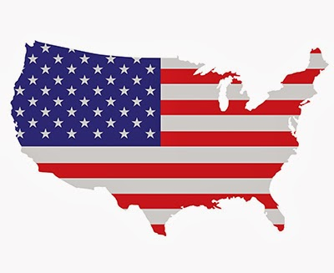
Section 3: Foreign Policy Troubles
While Ford continued in Nixon’s steps of détente (flexible diplomacy) with foreign nations that didn’t exactly see eye to eye with the U.S., Carter changed courses and put more of a focus on pushing for human rights in other nations.
Effects of Carter’s Foreign Policies
Didn’t improve relations with the Soviet Union
Voiced disapproval of countries who wrongly oppress or imprison their people, reaffirming the U.S. as a nation which stood for freedom and justice.
What’s more important, maintaining good relations or standing up for human rights?

Slide 11
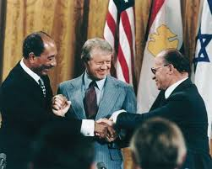
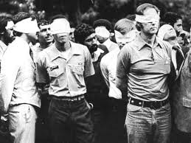
Success & Setback in the Middle East
Success: The Camp David Accords (1978)
Carter helped negotiate a historic
peace agreement between the nations
of Egypt and Israel
Setback: The Iranian Hostage Crisis (1979 – 81)
Americans at the U.S. Embassy in Iran are taken hostage when Iran’s new, anti-American government came to power during the Iranian Revolution
Carter tries but is unable to secure
the American hostages release (They
were released on the day Ronald
Reagan is inaugurated as President.)
Why has it been so difficult to maintain a lasting peace between Israel and it’s neighbors in the Middle East?

Slide 12
Quick Review
What are your thoughts on President Nixon?
What are your thoughts on President Ford?
What are your thoughts on President Carter?

