Slide 1
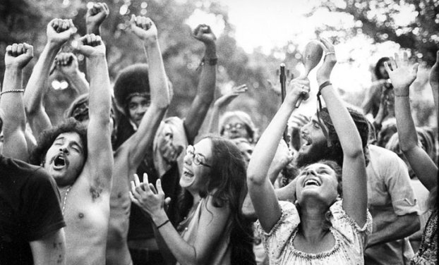
Unit 9: Challenges and Changes (1960 – 1980) Part II
The 60s and 70s are marked by challenges to traditional American values and a loss of confidence in political leaders.

Slide 2
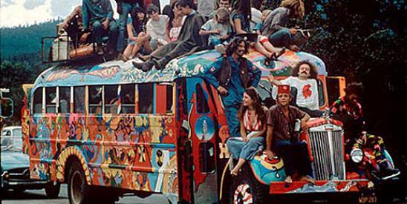
Chapter 26: An Era of Protest and Change (1960 – 1980)
Many younger Americans began to question the traditional values of their parents during the 1960s. This set the stage for various movements, including…
The Women’s Rights Movement
Latinos, Native Americans and Asian Americans Fight Against Discrimination
The Environmental
Movement

Slide 3
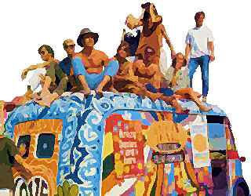
Section 1: The Counterculture
The Civil Rights Movement and Protests against the Vietnam War set the stage for a Counterculture, a resistance to traditional thinking and living in America.
Trademarks of the Counterculture of the 1960s
Increased Distrust of Authority: “Don’t trust anyone over 30.”
Valued Youth and Freedom of Expression
Hippies promoted peace, love and freedom
Experimenting with new styles of dress and music, sexuality , and recreational use of drugs
The Counterculture created a large generation gap, a lack of understanding and communication between the older and younger generations.

Slide 4
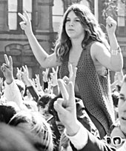
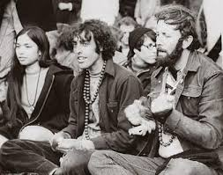
Discussion Question
What do you think of the young people of the 60s who challenged traditional beliefs and openly experimented with “sex, drugs, and rock-and-roll”? Were they brave or foolish? Your thoughts?

Slide 5
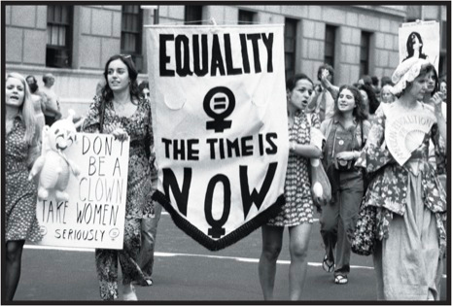
Section 2: The Women’s Rights Movement
The Women’s Movement of the 60s & 70s was characterized by feminism: the theory of political, social and economic equality for women.
Many women opposed the idea of the ideal American family consisting of the man in the workforce and the woman being a housewife.
Often those women who did
work outside of the home found
their employment opportunities
to be limited.

Slide 6
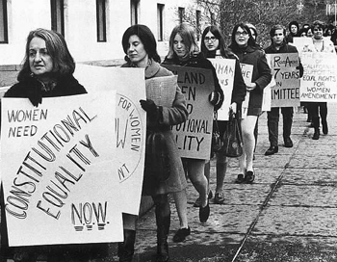
Women Find Their Voices
The National Organization for Women (NOW)
Established in the 60s, the group set out to break down barriers of discrimination in the workplace and in education
Attacked stereotypes of women in the media
Called for more balanced roles in marriages
2 Major Priorities
Pass the Equal Rights
Amendment (ERA) to the
Constitution, guaranteeing
gender equality under the law
Protect Reproductive Rights,
especially the right to an abortion

Slide 7
Lasting Effects of the Women’s Movement
Women’s roles and opportunities expanded
Women gained legal rights in the workplace and the right to have an abortion (Roe vs Wade, 1973)
Sparked an important debate about gender equality that still continues today
Interesting Data
1950: 30% of women work
2000: 60% of women work
What are your thoughts about the Women’s Movement of the 60s & 70s?

Slide 8
Section 3: The Rights Revolution Expands
Latinos, Native Americans, & Asian Americans engaged in their own struggles for equality during the 1960s and 70s.
Cesar Chavez, the most influential Latino activist, fought for rights for farm laborers
The American Indian Movement (AIM) focused on securing land, legal rights and self-government for Native Americans
The Immigration and
Nationality Act Amendments
in 1965 aided Asian immigrants.
Cesar Chavez spoke for the United Farm Workers (UFW).

Slide 9
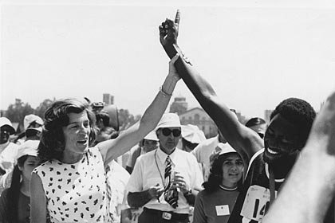
New Rights for Consumers and the Disabled
Activists also worked to protect the rights of consumers and Americans with disabilities.
The National Traffic and Motor Vehicle Safety Act of 1966 made safety belts standard equipment in all cars.
In 1961 the Panel on Mental Retardation was established to explore ways the government can help people with intellectual disabilities.
Should the government require people in vehicles to wear seatbelts? Why?
Eunice Shriver’s athletic camps for the disabled eventually became the Special Olympics.

Slide 10
Section 4: The Environmental Movement
The “rights revolution” of the 60s & 70s also influenced people’s right to a clean and safe environment.
Impacts of the Environment Movement
In 1970, April 22 was established as “Earth Day” in the United States to help create awareness
In 1970 Congress created the Environmental Protection Agency (EPA)
The Clean Air Act (1970)
The Clean Water Act (1973)
The Endangered Animals Act
(1973)
How do you feel about the local environment in Bertie?

Slide 11
Quick Review
What was the Counterculture? How did it impact American society?
What were the causes and effects of the Women’s Movement of the 60s & 70s?
In what ways did minority groups (other than blacks) work towards greater equality?
What was the impact of the Environmental Movement?

