Slide 1
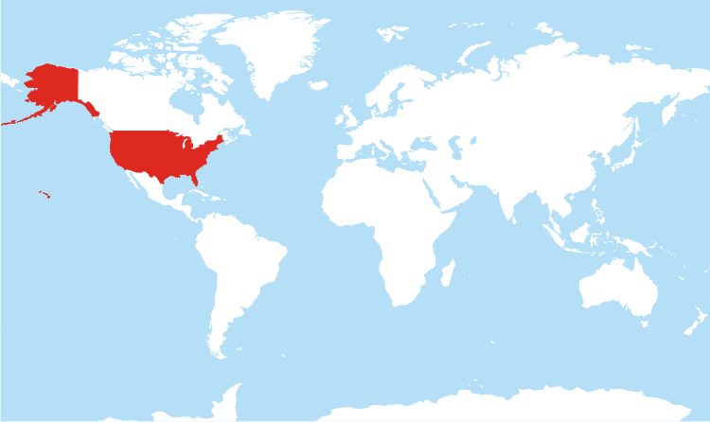
Unit 9: The United States and the World
Unit Focus: What role does / should the United States play in our global society?

Slide 2

Ch. 24 Review
What actions does the US government take to achieve it’s foreign policy goals?
What are the different types of foreign policies that governments can pursue?

Slide 3
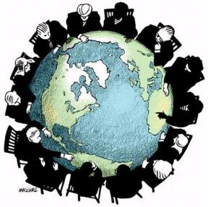
Ch. 25: One Nation Among Many

Slide 4
Section 1: The Nations of the World
Different Kinds of Nations
Former Colonial Powers
  Powerful nations who ruled weaker territories
  Ex: England use to rule over colonial America
Former Colonies
  A territory that use to be ruled by a more powerful nation
  Ex: Mexico used to be ruled by Spain

Slide 5

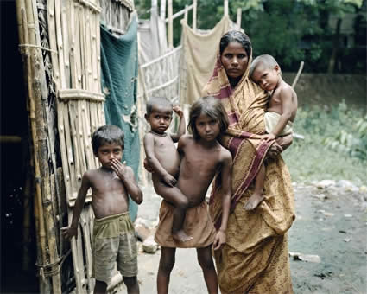
Different Kinds of Nations Continued
Developed Nations
  Have a higher standard of living
  Modern Technology = more goods and services
Developing Nations
  Most people are poor
  Not enough jobs or schools

Slide 6
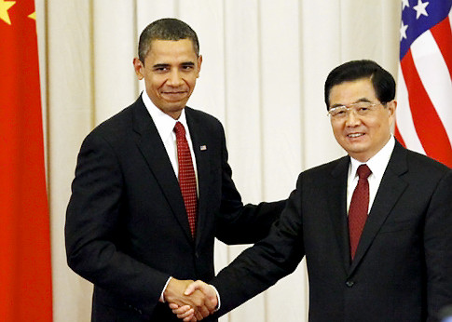
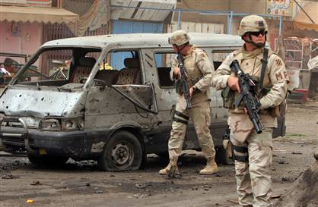
Section 2: Relations Among and Within Nations
*Main Concept*
  Nations can get along or they can fight.

Slide 7
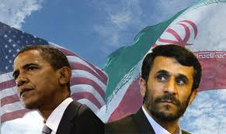
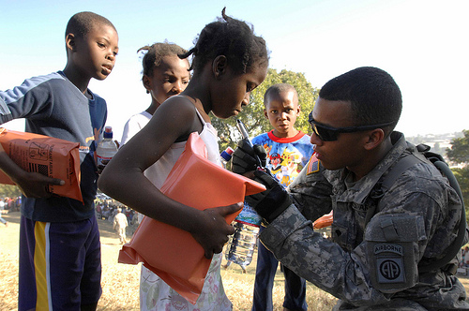
Conflict vs. Cooperation
Conflict over…
  Beliefs and Values
  Territory and the Environment
  Racial and Ethnic Differences
  Political Power
    Ex: The US is against Iran having Nuclear Power.
Cooperation
  Economic Trade
  Providing Aid to the Needy
  Promoting Peace
    The US tries to help bring peace between Israel and the Palestinians.

Slide 8

Section 3: The Challenge of Interdependence
Interdependence
  Two or more nations are dependent on each other to promote peace and prosperity.
*Key Concept*
  The United Nations (UN) provides a way for the nations of the world to work together to solve global problems.

Slide 9
Ch. 25 Discussion Questions
What are the differences between a developed country and a developing country?
What are the main ways in which nations can have conflict / cooperation?
Can you think of any recent examples of conflict / cooperation between nations?

Slide 10

Ch. 25 Assessment
Page 694-695
Complete # 1 – 13, 16 and EOC Test Practice # 1 and 2
  Reviewing Key Terms
    Circle the correct answer or write out the answer and staple it to your ? sheet.
  Comprehension and Critical Thinking
    Write out the answer and staple it to your ? sheet.
  Activities
    Write out the answer and staple it to your ? sheet.
  EOC Test Practice
    Circle the correct answer.
    * Turn in for a grade when completed.

