Slide 1
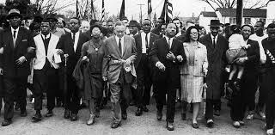
Unit 8: Challenges and Changes (1945 – 1975)
Part I
In the decades following WW2, the United States experienced changes and faced challenges such as the Civil Rights Movement, the Cold War, and Divided Opinion on the Vietnam War.

Slide 2

Quick Review of Ch. 23 - 24
What were the causes, some of the main events, and the effects of the civil rights movement?
What is your impression of President Kennedy and his policies?
What is your impression of President Johnson and his policies?

Slide 3
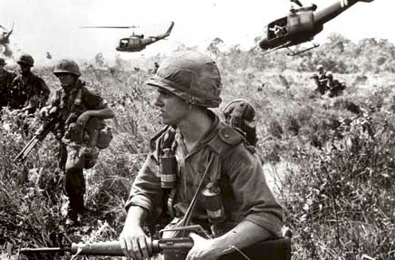
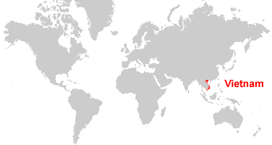
Chapter 25: The Vietnam War Era
(1954 – 1975)
In an attempt to prevent the spread of communism, the U.S. sends its military to the country of Vietnam in East Asia. The U.S.’s involvement in the Vietnam War will lead to divided public opinion and frustration in America for many years to come.

Slide 4
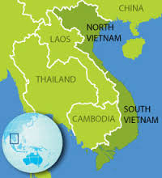
Section 1: Origins of the Vietnam War
During the 1950s, Vietnam was divided into North Vietnam, ruled by communist forces, and South Vietnam, ruled by an anticommunist government supported by the U.S.
As it became clear that there would be a war to unite Vietnam under a communist government, the U.S. decided to give it’s support to South Vietnam.
Why was Vietnam so important to the U.S.?
- According to the domino theory, the U.S. believed that if Vietnam fell to communism, other nearby countries (Japan, the Philippines, Australia) would be the next to fall.

Slide 5
Section 1: Origins of the Vietnam War
The U.S. Stands Against Communism in Vietnam
As a member of the Southeast Asia Treaty Organization (SEATO), the US provided economic and military aid to S. Vietnam with the goal of containing communism.
In 1961 President Kennedy began sending Special Forces troops to advise / fight alongside the S. Vietnamese Army against N. Vietnamese forces.
By 1964, President Johnson began committing U.S. troops to S. Vietnam to fight a war against N. Vietnam.

Slide 6
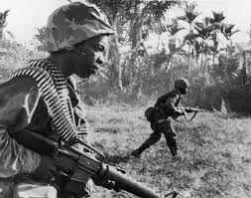
Section 2: U.S. Involvement Grows
As President Johnson began to shift U.S. military efforts in Vietnam into high gear, many Americans believed it would be a quick victory for superior American forces.
However, American leaders and soldiers soon realized they were fighting a very determined and very elusive enemy (The Viet Cong). Frustration began to build as there was no quick victory in sight.

Slide 7
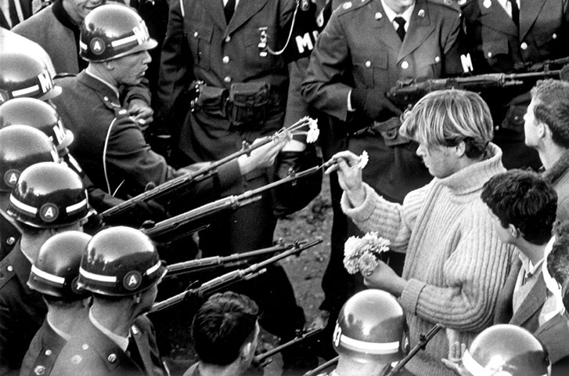
Section 2: U.S. Involvement Grows
The Vietnam War Begins to Have Negative Effects Back in the U.S.
It weakened the economy
  Heavy govt. spending, rising prices, and inflation forced Johnson to raise taxes.
It divided the American people
  Supporters of the War vs. Protestors of the War
It damaged the nation’s morale
  American troops dying overseas in
  a questionable war that could last for
  years discouraged the nation.

Slide 8
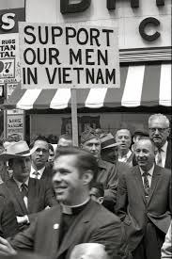
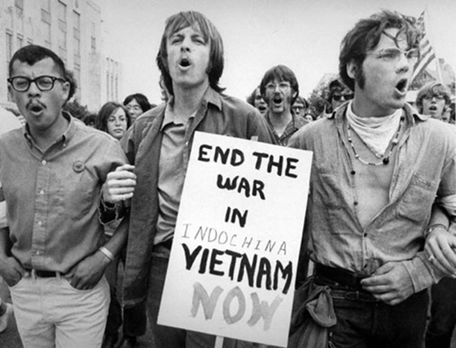
Section 3: The War Divides America
President Johnson sent more troops to Vietnam in order to win the war, but with each passing year, more soldiers died and victory seemed far away.
As Americans argued whether the U.S. should be in Vietnam or not, the war caused a deep and emotional divide in American society that would take years to heal after the war ended.

Slide 9
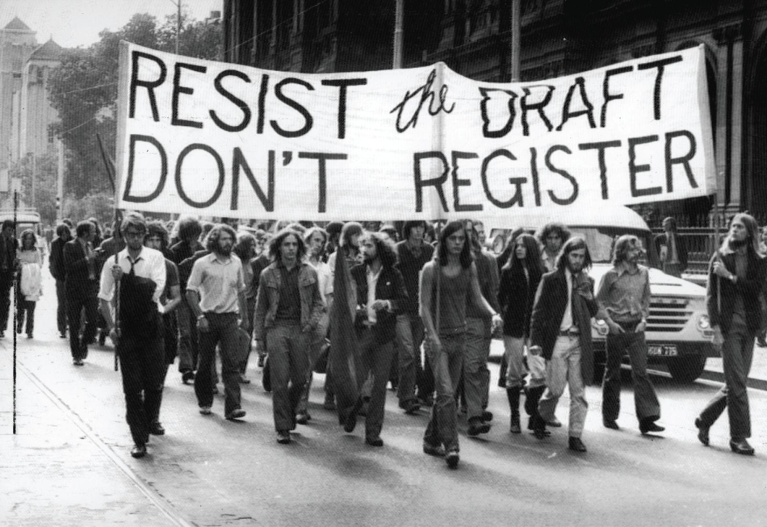
Section 3: The War Divides America
The government drafted more than 1.5 million men into military service. The draft became increasingly unpopular.
College campuses across America became the centers of antiwar movement as students and professors protested the war.
More Americans became frustrated with the war as they watched its lack of progress on television news reports.

Slide 10
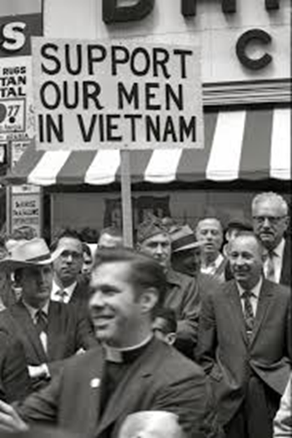

Quick Discussion
What arguments do you think supporters of the Vietnam War might have made?
What arguments do you think protestors of the Vietnam War might have made?

Slide 11
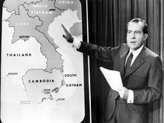
Section 4: The War’s End and Impact
As the U.S. military failed to defeat N. Vietnamese forces and public opinion became increasingly anti-war, President Nixon promised to withdraw American troops through ‘peace with honor’.
According to the Paris Peace Accords of 1973, the U.S. agreed to remove it’s troops and the war came to an end. However, by 1975 the North and South were at war again. This time the North won and united Vietnam as a communist nation.

Slide 12
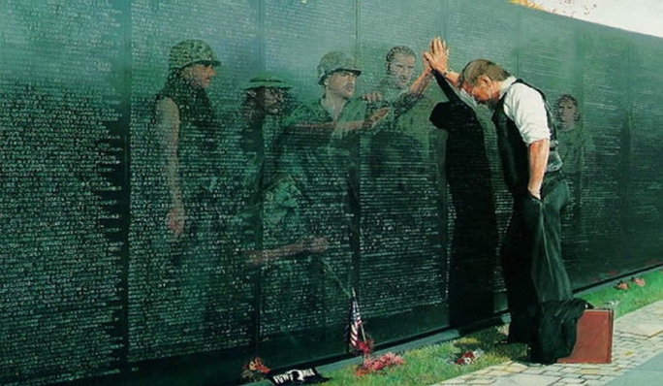
Section 4: The War’s End and Impact
The Vietnam War Had a Lasting Impact
S.E. Asia Suffers Further Turmoil
  Communism spreads to nearby Cambodia and Laos.
Veterans Return Home to Mixed Reactions
  Because American opinion was divided over the war, many American veterans did not receive appreciation for their sacrifice and service when they returned home.
Vietnam Changes American Politics
  In 1973, Congress passed the War Powers Act, which required the President to consult with Congress within 48 hours of committing American troops to a foreign conflict.
  Vietnam made Americans more
  suspicious of foreign commitments
  and less likely to intervene in the affairs
  of other countries.

Slide 13
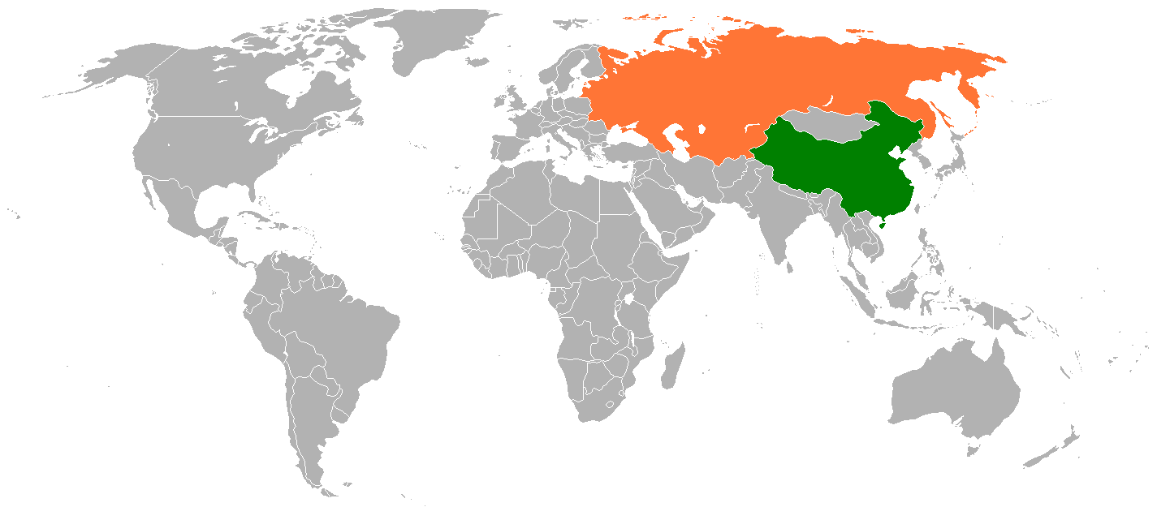
Section 5: Nixon and the Cold War
Following the Vietnam War and the growing unwillingness of many Americans to go to war to prevent the spread of communism, President Nixon developed a new approach to the Cold War. He attempted to improve and redefine American relations with the two major powers of global communism, the Soviet Union and China.
Soviet Union
China

Slide 14
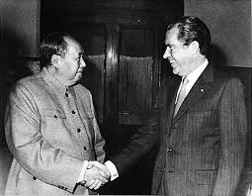
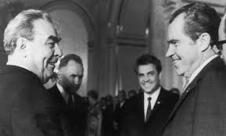
Section 5: Nixon and the Cold War
Improving Relations with China
  1972: Nixon became the first U.S. President to visit China
  1973: American companies establish a thriving trade with China
  1979: the U.S. and China established full diplomatic relations
Improving Relations with the Soviet Union
  1972: Nixon visits Moscow, Russia, resulting in an important agreement, the signing of the Strategic Arms Limitation Treaty. While it didn’t end the arms race , it was an important step toward that goal.
Nixon visits China.
Nixon visits the Soviet Union.

Slide 15
Quick Review of Ch. 25
Why was the U.S. involved in the Vietnam War?
How would you describe the Vietnam War?
What effects did the war have on the U.S. and American society?

