Slide 1
Expectations for African-American Studies Final Exam
Test Created by Mr. Gay
Around 85 Questions (MC and T/F)
Similar to Test Questions You Have Had Throughout This Semester
3 Essay Question Responses
Will Cover a Variety of Key Concepts from Early Af-Am History to Modern Af-Am History
Final Exam Grade Equals 25% of Final Grade

Slide 2
Essay Questions Choose three of the following topics and then write at least a 1 - 2 paragraph response for each one.
1. Can you explain how African heritage has impacted the development of African-American culture?
2. Can you discuss the realities of slavery in the United States and how it impacted the lives of African-Americans?
3. Can you discuss the ways that African-Americans have contributed to the development of the nation throughout the history of the United States?
4. Can you discuss the struggles and victories African-Americans have faced over the years in their pursuit of equality?
5. Choose one famous African-American we have discussed in our class and explain their impact on African-American History.

Slide 3
How will essays be graded?
Essay Grading Criteria
Does your response accurately answer the question?
Did you use examples to support your answer?
Is it at least 1 - 2 paragraphs and well written?
Is the grammar and spelling mostly correct?
Does the sentence structure fit together to form a well-organized paragraph(s)?

Slide 4
How should I prepare for my final exam?
Review the class notes from this semester.
Practice outlining / writing your essay responses.
Use the study sheets we create in class to quiz yourself and your classmates.
Participate in class review activities and games.
Ask Mr. Gay if you want to look over your past tests while in class.
Review todaysmeet.com content.
Look for you tube videos that
summarize Af-Am History. (There are
some on the class website.)

Slide 5
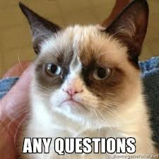
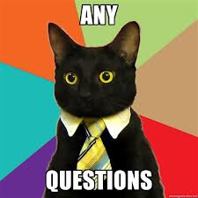
Any questions about your final exam?

