Slide 1
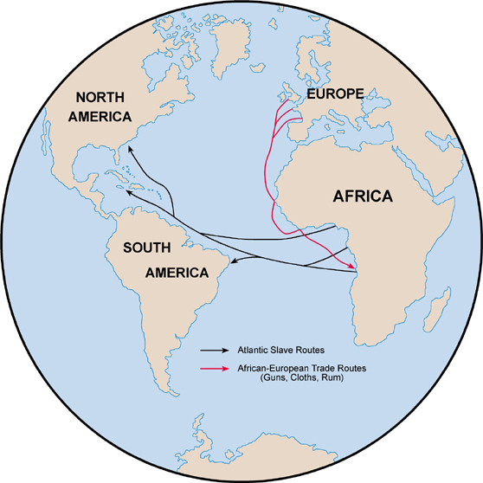
Unit 1: From West Africa to the Early Americas (Ancient Times – 1763)
The Atlantic Slave Trade brings West Africans to the Colonies of the Americas.

Slide 2
Quick Review Questions
Ch. 1 Africa
How would you describe the continent of Africa?
Why are we focusing on West Africa for African-American studies?
How would you describe West African culture?

Slide 3
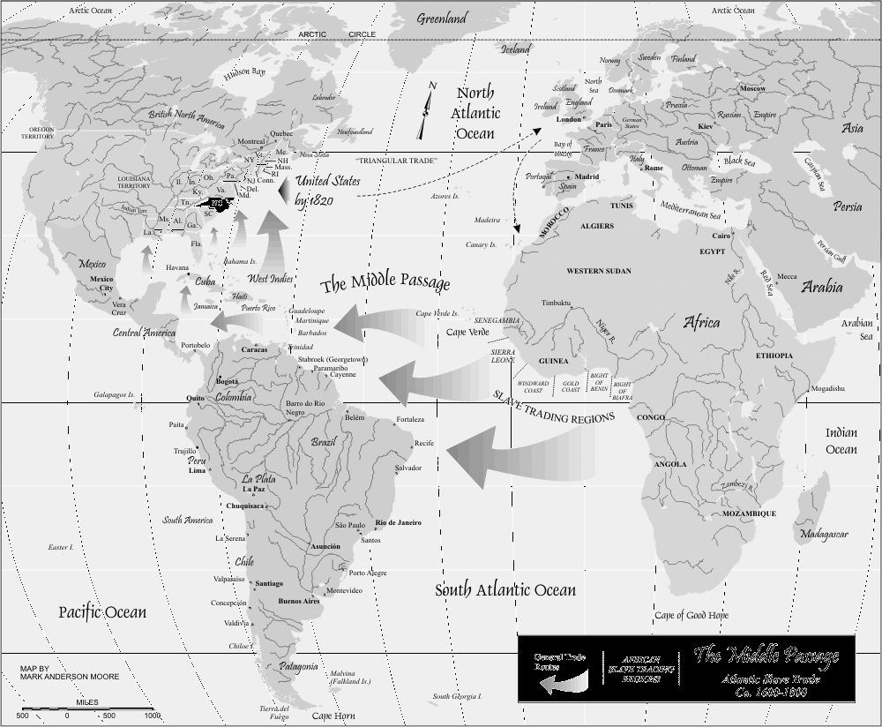
Ch. 2 Middle Passage
1450 - 1809
Enslaved African’s traveled the ‘Middle Passage’ across the Atlantic Ocean, removing them from Africa and taking them to the Americas.

Slide 4
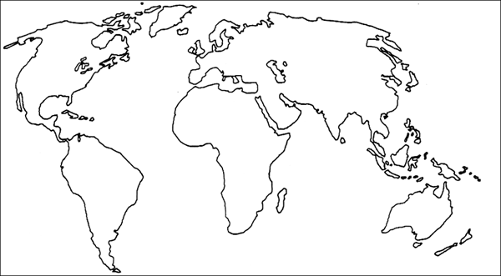
Section 1: European Exploration and Colonization
Before Europeans arrived, there was already a wealthy slave trade in West Africa, fueled by the demand for slaves in Muslim countries.

Slide 5

Section 1: European Exploration and Colonization
Atlantic Slave Trade – began due to Western Europe’s expansion into Africa in the 15th century and the discovery of the New World

Slide 6
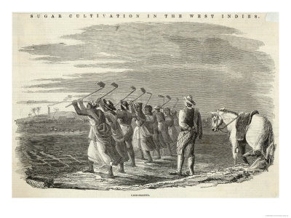

Section 1: European Exploration and Colonization
The cultivation of sugar in the New World = increased need for African slaves to work the plantations

Slide 7
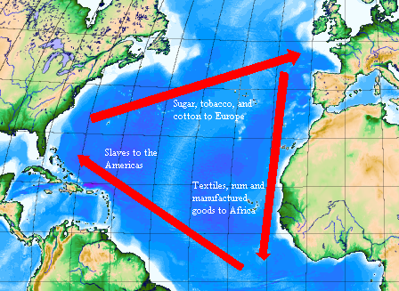
Section 1: European Exploration and Colonization
The Triangular Trade System Develops
  3-Sided Trade
    European Goods traded for West African Slaves
    West African Slaves traded for American Goods
    American Goods traded for European Goods
Discussion Q: How do you imagine people during this time justified trading people as slaves for goods such as rum or tobacco?

Slide 8
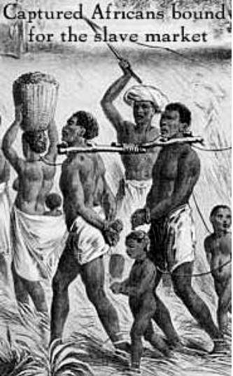
Section 2: From Capture to Destination
Who were the slaves?
  Sometimes African armies enslaved those from other tribes that they conquered.
  Sometimes slavers captured isolated families or individuals.
  Captured slaves were then sold to slave traders headed for the New World.

Slide 9
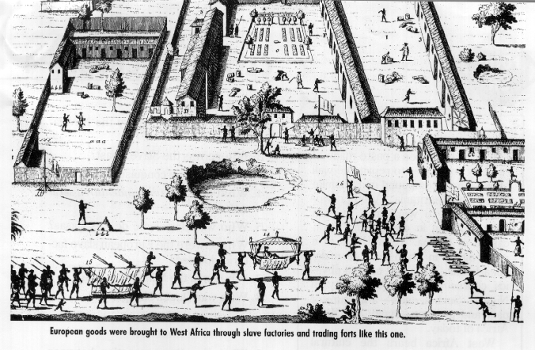
Section 2: From Capture to Destination
Captured slaves were marched to coastal factories where they were processed, checked for disease and physical defects, before transportation to the Americas.
Discussion Q: What does this tell us about how slave traders viewed their slaves?

Slide 10
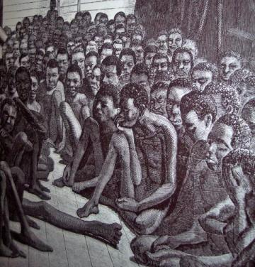
Section 2: From Capture to Destination
Middle Passage – the journey for slaves from Africa across the ocean to the Americas
Conditions on ships were horrible
  Slaves were cramped together
  Many died from disease
  Some revolted against the slave traders
  Some preferred suicide by jumping
  Women were often sexually abused
Discussion Q: How do you think this kind of experience impacted the African slaves who survived?

Slide 11
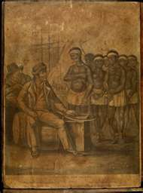
Section 3:Landing and Sale in the West Indies
As slave ships arrived, crews tried to make the slaves look as strong and healthy as possible
Quick Question
Why would they do that?

Slide 12
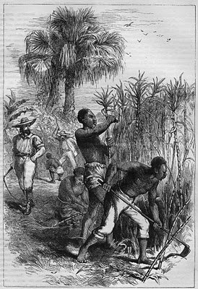
Section 3:Landing and Sale in the West Indies
Once sold, slaves had to endure seasoning, a disciplinary process designed to turn them into compliant and effective laborers
  Seasoning = a period of up to two years in which plantation owners attempted to break slaves into the routines of plantation work
Often a trained slave would be put in charge of seasoning new slaves.

Slide 13
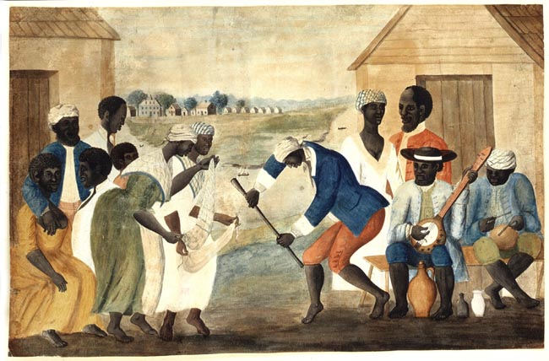
Section 3:Landing and Sale in the West Indies
Despite the hardships, slaves still kept parts of their culture and built relationships with fellow slaves.

Slide 14
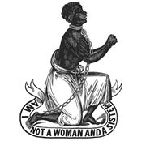
Section 3:Landing and Sale in the West Indies
Early 1800’s – moral and economic factors led to the end of the Atlantic slave trade
  Moral Factors: it was cruel and religiously immoral
  Economic: England became more invested in industry (Industrial Revolution) and less dependent on slave trade.

Slide 15
Quick Review Questions
Ch. 2: Middle Passage
How did European exploration and the discovery of the Americas impact Africa?
How would you describe the ‘Middle Passage’?
What was ‘seasoning’?
Why did the Atlantic Slave Trade eventually end?

