Slide 1
Review Game
What’s on the ppt?
Chapters 22 - 23

Slide 2
‘What’s on the ppt?’ Rules
2 Teams are Competing
1 Teammate will have his / her back turned to the ppt
Teammates will have 30 seconds to try to describe what is on the ppt, but YOU CAN’T SAY ANY OF THE WORDS ON THE PPT
If the Teammate can guess what’s on the ppt, your team get’s a point!
Whoever ends with the most points wins!

Slide 3
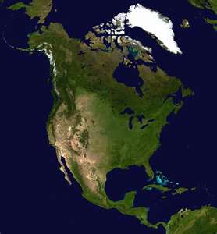
Example
The word is ‘North America’
Teammates can not say ‘North’ or ‘America’
Also, no rhyming or starts with ‘N’

Slide 4

Diversity

Slide 5
Economy

Slide 6
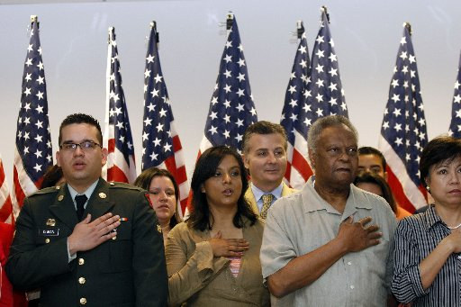
Citizen

Slide 7
Candidate

Slide 8

Registration

Slide 9
Propaganda

Slide 10
Interest Group

Slide 11
Democracy

Slide 12
Suffrage

Slide 13
Split Ticket

Slide 14
Democrats

Slide 15
Closed Primary

Slide 16
Republicans

Slide 17

Campaign Manager

Slide 18
Precincts

Slide 19

Electoral College

