Slide 1
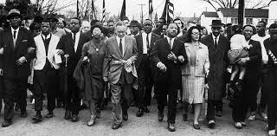
Unit 8: Challenges and Change (1945 – 1975) Part I
In the decades following WW2, the United States experienced changes and faced challenges such as the Civil Rights Movement, the Cold War, and Divided Opinion on the Vietnam War.

Slide 2
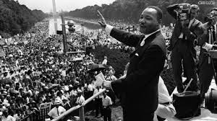
Chapter 23: The Civil Rights Movement (1945 – 1975)
The postwar period brought prosperity to many, but most African-Americans were still treated as second-class citizens. The civil rights movement fought to gain racial equality and challenge the nation to live up to its ideal that all are created equal.

Slide 3
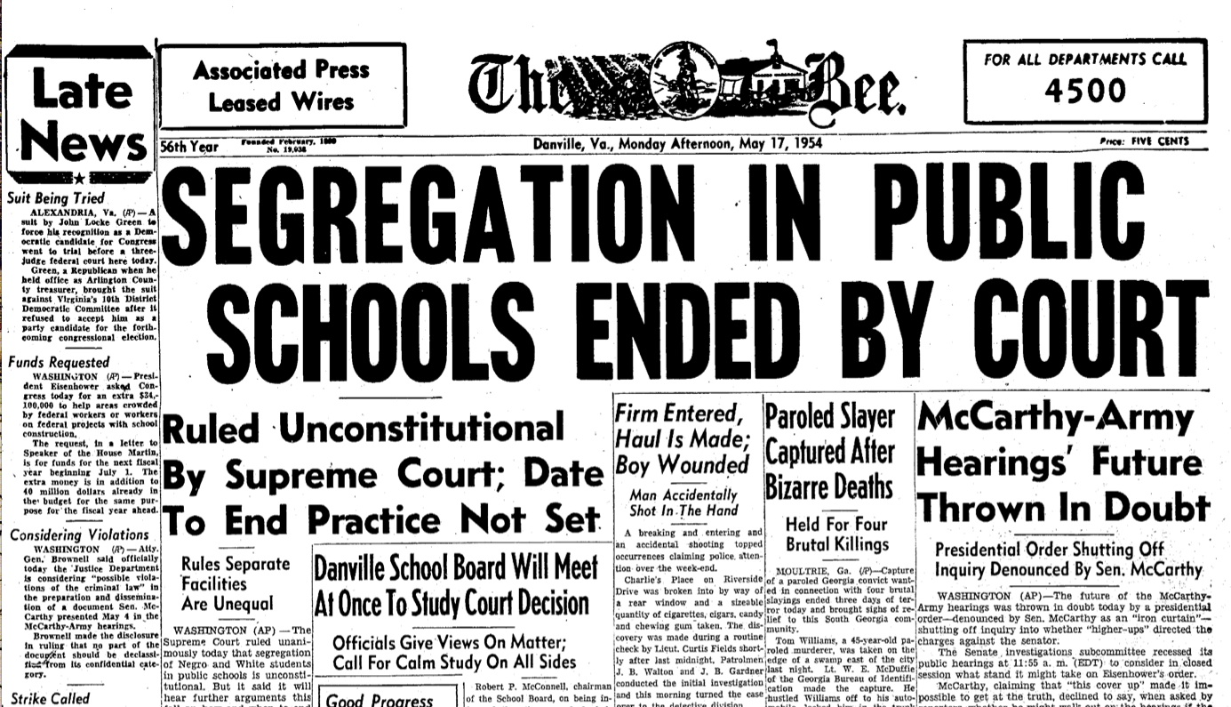
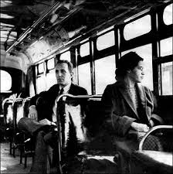
Section 1: Demands for Equality
By the late 1940s, segregation and discrimination had pushed many blacks to the breaking point, as many began to fight for civil rights.
Example of Change Beginning to Happen
In 1948 the U.S. Military Ended It’s Policies of Segregation
In 1954, the Supreme Court ruled in ‘Brown vs. Board of Education’ that segregation in public schools was unconstitutional
In 1955, Rosa Parks simple act of refusing to give up her bus seat to a white man ignited the Montgomery (Alabama) Bus Boycott that would grab the nations attention

Slide 4
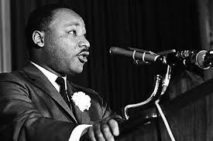
Section 1: Demands for Equality
It was during the Montgomery Bus Boycott that a certain Baptist minister by the name of Martin Luther King Jr. became one of the leading spokespersons for civil rights.
King argued that due to continued segregation and oppression, African-Americans had no choice but to protest. However, he called for the protests to be nonviolent, urging blacks to follow the Christian doctrine of love, not hate.

Slide 5
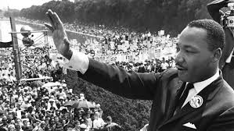
Quick Discussion
Why do you think Martin Luther King Jr. stressed ‘nonviolent’ protest during the civil rights movement?

Slide 6
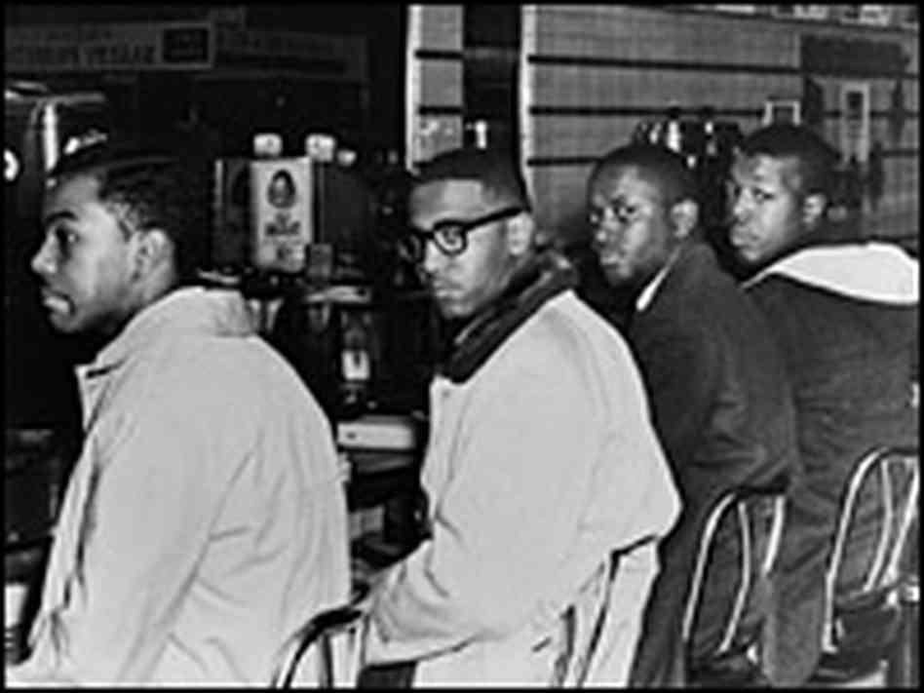
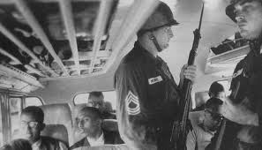
Section 2: The Movement Gains Ground
Supporters of the Civil Rights Movement Protested in Different Ways
Sit-ins: black protestors would simply sit down in a segregated location, such as a restaurant, beach, or library
Freedom Rides: African-Americans defied segregation codes, sitting in the front of the bus and using “white only” restrooms in bus stations
During the March on Washington in 1963, close to 250,000 demonstrators gathered to support the cause of civil rights. It was during this gathering that Dr. King delivered his famous ‘I Have a Dream Speech’.
Greensboro Four Sit-In at Woolworth’s Diner

Slide 7
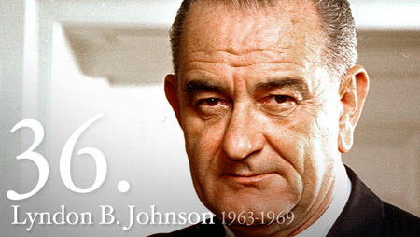
Section 2: The Movement Gains Ground
Supporters of the civil rights movement gained a significant victory when President Johnson signed the Civil Rights Act of 1964.
What did the Civil Rights Act of 1964 achieve?
Banned segregation in public accommodations (restaurants, hotels, libraries, etc.)
Allowed the Justice Department to prosecute someone who violated the civil rights of others
Outlawed discrimination in employment on the basis of race, color, national origins or sex
Established the Equal Employment Opportunity Commission (EEOC), responsible for enforcing provisions and investigating charges of job discrimination

Slide 8
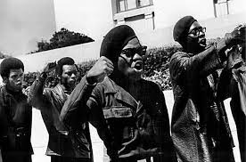
Section 3: New Successes and Challenges
During the 1950s and 1960s, the civil rights movement made great strides forward. Yet racial injustice was not fully gone. This frustration led some African-Americans to embrace more radical and sometimes violent methods of protest. African-Americans achieved further successes, but for some the radicalism of the times left a bitter legacy.

Slide 9
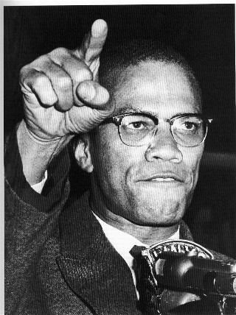
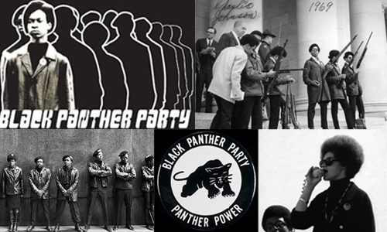
Section 3: New Successes and Challenges
Well Known Radical Voices for Black Progress
Malcolm X
Argued that nonviolent protest was not effective
Supported black separation from whites
*(However, towards the end of his life before his assassination by rival black leaders,
he began to advocate for peaceful change and cooperation between races.)*
The Black Panther Party
Became the symbol of young militant African-Americans
Organized armed patrols of urban neighborhoods to protect
people from police abuse
Created anti-poverty programs, such as free breakfasts for
poor black children
Their militancy often led to violent confrontations with police

Slide 10
Discussion Question
What are your thoughts about Malcolm X? The Black Panther Party?

Slide 11
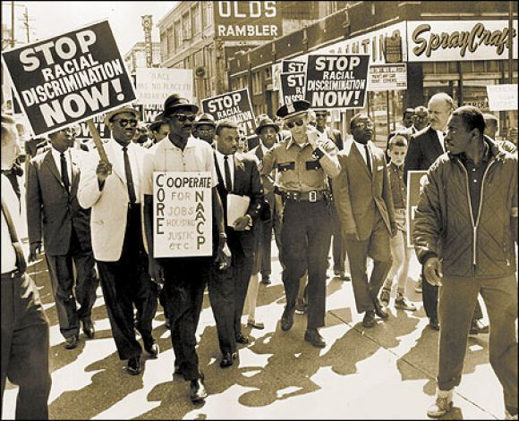
Section 3: Success and Challenges
Significant Gains of the Civil Rights Movement
Ended laws that supported segregation and discrimination
Removed barriers to voting and political participation
Poverty rates fell and more blacks graduated from high school
Controversial Issues That Remained
Racism and the social and economic gap between blacks and whites
Forced integration of schools and attempts to increase African-American representation in the workforce created controversy and debate

Slide 12
Quick Review of Ch. 23
What were the causes, some of the main events, and the effects of the civil rights movement?

