Slide 1
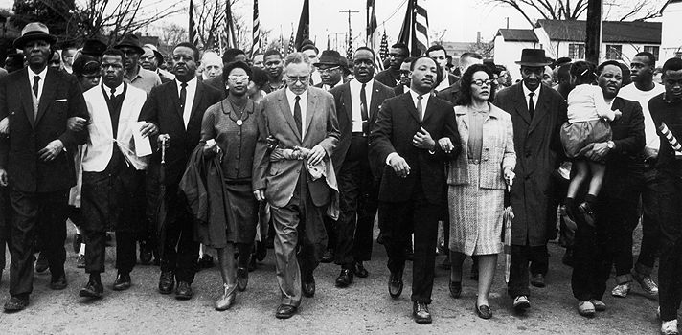
Unit 7: The Black Revolution
(1954 – Present)
The movement for equality and civil rights during the 1950s and 1960s drastically impacts the lives of African Americans and the development of American Society in the years to come.

Slide 2
Quick Review of Ch. 21 - 23
What key events / legislative acts / people characterize the Civil Rights Movement of the 1950s and 60s?
In what ways did African-Americans respond to frustrations they faced in the 1960s and 70s?
Why have the majority of African-American voters tended to lean towards the Democratic Party over the last 30 or so years?

Slide 3

Chapter 24: African Americans in the New Millennium
African-Americans continue to strive for progress within the black community and the expression of black culture and identity.

Slide 4

Section 1: Progress and Poverty
After the triumphs of the civil rights era, many African Americans made great strides in overcoming economic and educational disadvantages.
In recent decades many African-Americans have made increases in job opportunities, income, and wealth.
  However, the average wealth for blacks still remains far below that for whites.

Slide 5
Section 1: Progress and Poverty
Continuing Battles for the Black Community
Poverty: In early 2000s the black poverty rate was around 24%. Many in poverty live in crime-infested inner city neighborhoods, or in economically depressed rural areas.
Single Parent Homes: In 2000, about 53% of African-American children lived in families with only one parent.
Incarceration: Growing inner-city crime during the 1980s and 1990s has led to an increase in the imprisonment of poor young black men.
Health Concerns: Cancer and HIV / AIDS are currently among the greatest threats to black health. Both occur more often in the black population than in the population as a whole.
Quick Discussion: What do you think are the primary causes of these struggles?

Slide 6
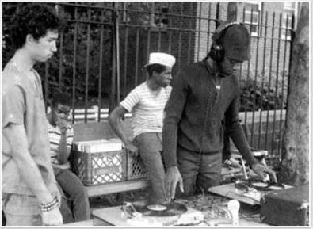
Section 2: African Americans at the Center of Art and Culture
Originating from the poverty-stricken South Bronx neighborhoods in New York City during the early 1970s, Rap / hip-hop music emerges as a form of black expression and influences music across the world.
Did you know?
- Rap’s roots lie in long traditions of street boasting, the preaching style of black clergy, and in Afro-Caribbean rhythmic traditions.
Rap pioneer Kool Herc using turntables.

Slide 7
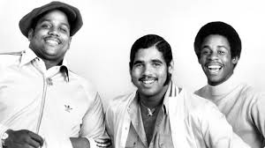
Quick Discussion
In 1979 the Sugar Hill Gang released the first commercial rap hit song and popularized the term ‘hip-hop’.
Any guess as to the name of the song?

Slide 8
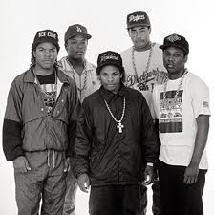

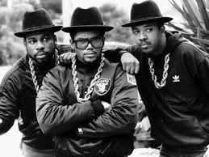
Section 2: African-Americans at the Center of Art and Culture
Development of Rap Music
Rap music went mainstream during the 80s and 90s as music producers recognized it could make a large profit.
The rise of ‘gangsta rap’ (ex: NWA’s Straight Outta Compton album in 1988) shocked many with controversial sexist and violent lyrics
Hip hop has spread across the world: Ex: France, Africa, the Caribbean, and South America
RunDMC
NWA
French Rapper
Regis Fayette-Mikano

Slide 9


Quick Discussion
What do you think is the importance of rap / hip hop to the black community?
Was going mainstream a good / bad thing for hip hop music?
What is your opinion on ‘gangsta rap’?

Slide 10
Section 2: African-Americans at the Center of Art and Culture
In the 80s and 90s, Afrocentricity gained media and academic attention while African-American Studies matured into an established discipline. (That’s why we are taking this class!)
Afrocentricity is…
A philosophy of culture with an African-centered perspective.
In other words, examining culture and history with a focus on African civilization rather than European civilization.

Slide 11
Section 3: Religion
Religion remains central to the African-American experience, as black churches have continuously taken an active role in responding to the problems and challenges of their communities.
Especially in inner-city communities, many local black churches strive to combat…
  Prostitution
  Drug Dealers
  Alcoholism
  Juvenile Violence

Slide 12

Quick Discussion
If you attend a church, in what ways does your church attempt to support the well-being of your community?

Slide 13
Section 3: Religion
Tension in the Church
  Although most black churchgoers are women, the vast majority of visible church leaders are men. For some this has caused conflict.
Black Muslims
  Although still a relatively small movement among African-Americans, Islam has been gaining converts. (Estimated 1.5 million black American Muslims)

Slide 14

Section 4: Black Identity in the Twenty-first Century
Did you know?
  The 2000 U.S. Census revealed that, for the first time, Hispanics had replaced African-Americans as the nation’s largest minority group.
The 2000 census was also the first time respondents could choose more than one race for themselves, acknowledging the difficulty of defining racial identity.

Slide 15

Section 4: Black Identity in the Twenty-first Century
Contemporary Issues Facing Black Identity
  Mixed-race marriages are more common among younger generations and seems likely to increase.
  The feminist and gay rights movements have challenged traditional ideas of racial identity.

Slide 16

Quick Discussion
What do you think are some of the most important issues facing African-American communities during your generation?
Any ideas as to what important issues African-Americans in future generations might face?

