Slide 1
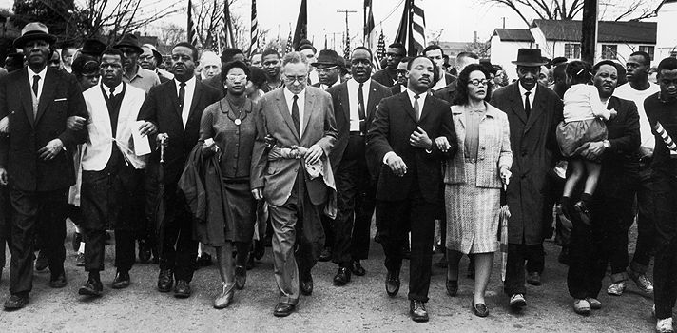
Unit 7: The Black Revolution
(1954 – Present)
The movement for equality and civil rights during the 1950s and 1960s drastically impacts the lives of African Americans and the development of American Society in the years to come.

Slide 2
Quick Review of Ch. 21 - 22
What key events / legislative acts / people characterize the Civil Rights Movement of the 1950s and 60s?
In what ways did African-Americans respond to frustrations they faced in the 1960s and 70s?

Slide 3
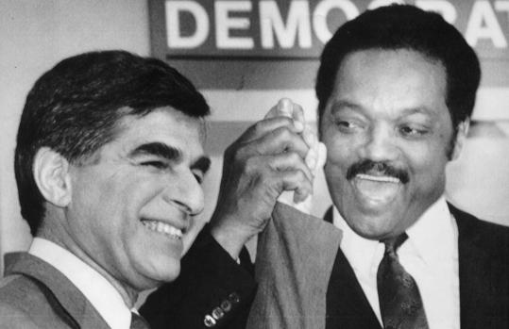
Chapter 23: Black Politics (1980 – 2004)
This chapter explores the complexity, contradictions, ironies, and tensions between race-conscious progressive politics and conservative backlash politics from 1980 to the opening years of the new millennium.

Slide 4
Section 1: The Conservative Reaction
In 1980, Republican Ronald Reagan was elected President, marking a political shift to the right (more conservative politics).
  Reagan’s administration did not support expanded civil rights, sought to reduce welfare programs (affecting many black families), and opposed affirmative action.
Black conservatives played a role in the Republican Party, but had little real power.

Slide 5
Section 2: Civil Rights
The Reagan and Bush presidential administrations opposed ‘new civil rights law’, especially affirmative action programs, arguing it created new unfairness and white resentment of minorities.
Affirmative Action became a focal point for debate about inequality in America and the role of the government in its elimination.
So… What is Affirmative Action?
Meanwhile, African-Americans during the 1980s used their power in the Democratic Party to promote civil rights legislation.

Slide 6

Section 2: Civil Rights
What is Affirmative Action?
  Policies intended to actively remedy historical discrimination and racial inequality by increasing the number of minority students, employees, or elected officials to correspond to the percentage of the relevant minority population.
  In other words, if a state has a large population of blacks, then companies in that state should reflect more black employees. Colleges in that state should accept more black students.
  Its government regulation to ensure minorities (blacks) are gaining educational and economic opportunity.
Quick Discussion: How could one argue for or against Affirmative Action?

Slide 7
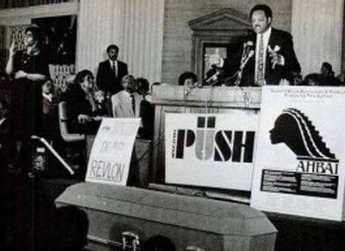
Section 3: Jesse Jackson and the Rainbow Coalition
During the 1980s Jesse Jackson emerged as a leading political spokesman for blacks.
He founded People United to Save Humanity (PUSH), an organization which worked to promote affirmative action, improve education and help register black voters.

Slide 8
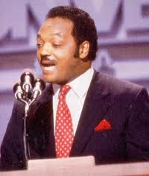
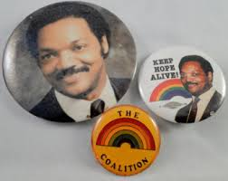
Section 3: Jesse Jackson and the Rainbow Coalition
In 1983 and 1987, Jackson sought the Democratic Party’s presidential nomination by appealing to what he called a ‘rainbow coalition’ of diverse people who he felt were under-represented.
  Blacks, white workers, liberals, Latinos, feminists, students, and environmentalists
Although he was unsuccessful, his attempts marked the increasing role of blacks in American politics.

Slide 9

Section 4: Policing the Black Community
Many African-Americans argued that police used racial profiling and bias against black men.
No incident caused more anger and debate on this issue than the Rodney King Incident in 1991.
  LA Police officers pulled King from his car and beat him (which was caught on tape) after a high-speed chase.
  When a jury found the officers not guilty, protest riots broke out in south-central LA
    Mostly white jury saw police imposing
    justice and maintaining law and order.
    Black Americans saw injustice, police
    repression, and racism.
A federal court jury later found 2 of the officers guilty. A civil court jury also ordered the city of LA to pay King $3.8 million in damages.

Slide 10
Quick Discussion
Let’s watch a quick videotape about the Rodney King incident.
What are your thoughts about what happened?

Slide 11
Section 5: The Clinton Years
Elected in 1992, most blacks considered Clinton the best president on race issues since Lyndon Johnson.
  He appointed African-Americans to important positions in his administration
  He was the first president to visit Africa
  He supported economic policies that decreased unemployment and helped the poor

Slide 12
Section 6: The Bush Years
In 2000, George W. Bush was elected President, returning the administration to the Republican Party and more conservative policies.
While Bush realized few African Americans had voted for him, he did appoint black men and women to key posts in his administration.
During this time many African-Americans shifted their political focus to specific issues, such as financial reparations for slavery and preventing the spread of HIV / AIDS.

Slide 13

Quick Review of Ch. 23
Based on this chapter, how would you describe the relationship many in the black community have had with both the Republican and the Democratic Party over the last 30 years? Why?

