Slide 1
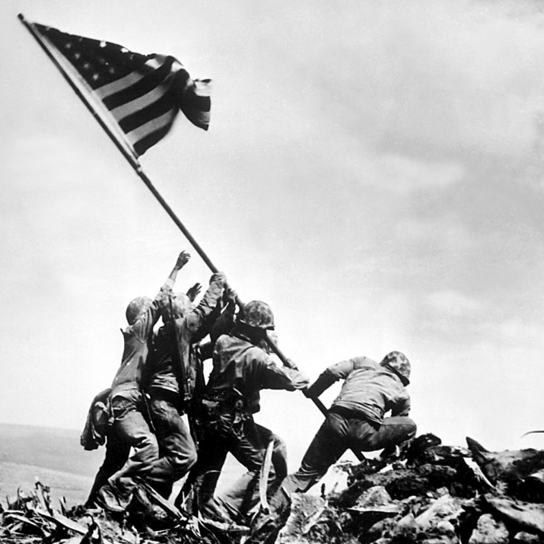
Unit 7: World War II and Postwar America (1931 – 1960)
World War II would prove to be a major victory for the US and it’s allies, however, tensions between democracy and communism would present new challenges in the years to come.

Slide 2

Quick Review of Ch. 19 - 21
Why did the United States get involved in World War 2?
How were allied forces able to defeat Germany? Japan?
What were the effects of WW 2 on the world? On the US?
What were the causes and effects of the Cold War between the US and Soviet Union?

Slide 3
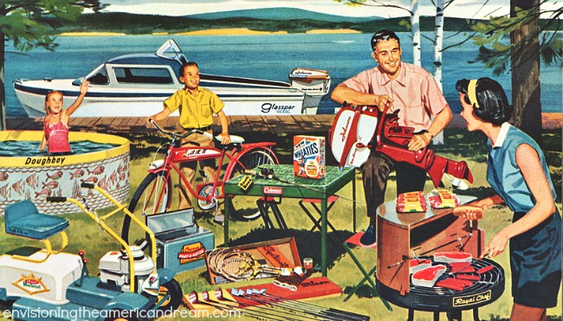
Chapter 22: Postwar Confidence and Anxiety (1945 – 1960)
In the years following WW2, the United States experienced tremendous economic growth. However, some still questioned life in America, planting the seeds that would led to the social protests of the 1960s.

Slide 4
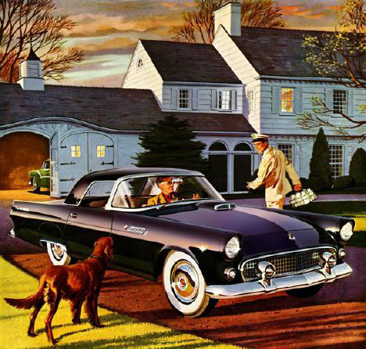
Section 1: An Economic Boom
Many Americans feared the US economy would sink back into depression after WW2.
Instead, the US economy experienced tremendous and lasting growth, allowing many Americans to enter the middle class and creating a widespread sense of optimism about the nation’s future.

Slide 5
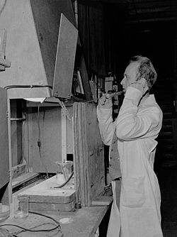
Section 1: An Economic Boom
Factors that Promoted Economic Growth
  The end of WW2 led to an increase in demand for consumer goods -> businesses produce more and hire more workers.
  The US was the only developed nation untouched by the devastation of WW2, resulting in the US producing about 50% of the world’s output.
  New technology (such as atomic energy) led to an increase in worker productivity (the rate at which goods are produced or services are performed).
  Increased government spending during the Korean War (1950 -1953) also supported new technology and economic growth.

Slide 6
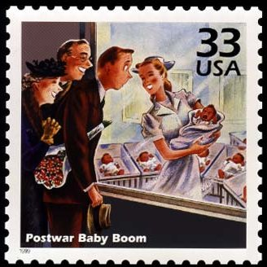

Section 1: An Economic Boom
Benefits of Economic Growth
  The Federal Government enacted the GI Bill of Rights to assist war veterans.
    Provided unemployment pay if needed, financial aid for college, and loans for building homes and starting businesses.
  Soldiers returned home ready to marry and have children, leading to a major population increase known as the ‘baby boom.’
  President Eisenhower enjoyed popularity during the 1950s thanks to economic prosperity.

Slide 7
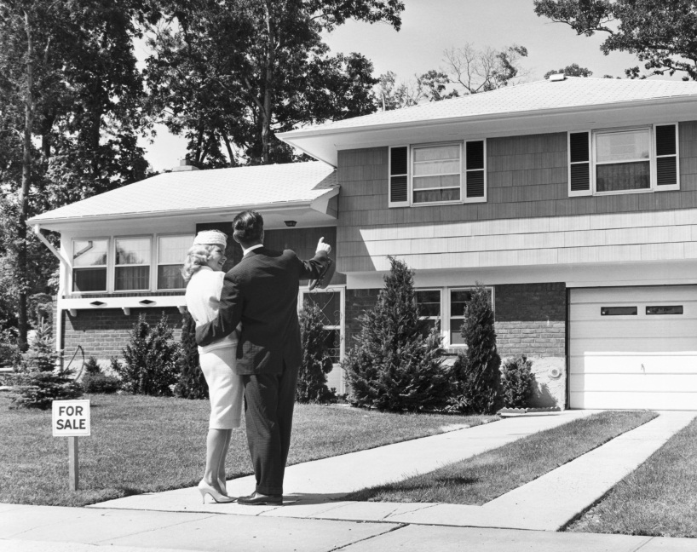

Section 2: A Society on the Move
In response to the economic growth of the years following WW2, many Americans moved around the country.
  Millions moved to newly built affordable houses in the suburbs (Communities nearby but outside of the big cities).
  Many also migrated to the ‘sunbelt’, or southern and western states, due to their warm weather and growing economies.

Slide 8
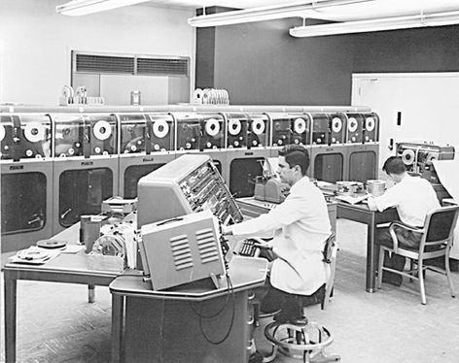
Section 2: A Society on the Move
The US economy experienced some major changes as well during this time.
  For the first time in US history, more people worked in the service sector (such as healthcare, banking, etc.) rather than the manufacturing sector.
  The development of the Information Industry, leading to the early development of the first computers.
  The rise of franchise businesses (such as the Holiday Inn), which allowed a company to distribute its goods or services through outlets owned by independent operators.
  The expansion of Multinational
  Corporations that sold their goods
  and services all over the world.

Slide 9

Quick Discussion
What do you think it usually says about a country if more of its people work in the service sector instead of the manufacturing sector?

Slide 10
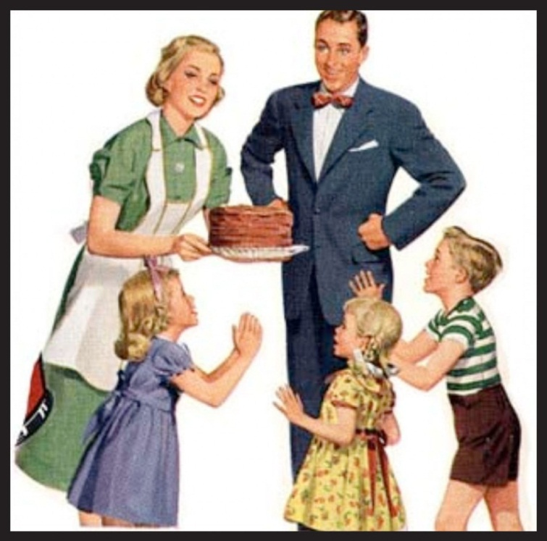
Section 3: Mass Culture and Family Life
During the 1950s, television and other forms of mass culture promoted the concept that the ‘ideal family’ was one in which men worked to support the family while women stayed home and reared their children.
  Despite this view, by 1960 about 1/3 of the nation’s jobs were held by women (1/2 of whom were married).
“A woman isn’t a woman unless she’s been married and had children.”
– Actress Debbie Reynolds in the 1955 Hollywood Film The Tender Trap.

Slide 11
Quick Discussion
How would you describe the ‘ideal family’ in modern American life?

Slide 12
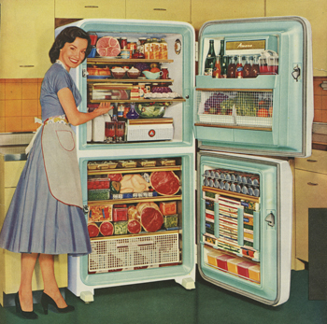
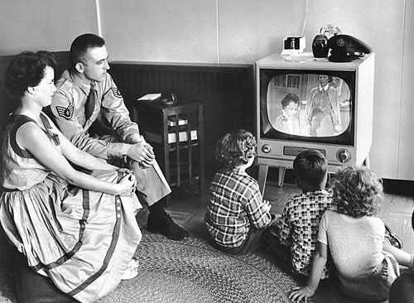
Section 3: Mass Culture and Family Life
As the US economy boomed in the postwar era, many Americans were caught up in consumerism, buying as much as they could, often on credit.
Factors contributing to American spending
  Increases in income = more money to spend
  Companies found new ways to encourage people to spend on credit. (Ex: General Motors Slogan = “Buy Now, Pay Later.”
  Plenty of goods to buy: refrigerators, washing machines, and the new television set!

Slide 13

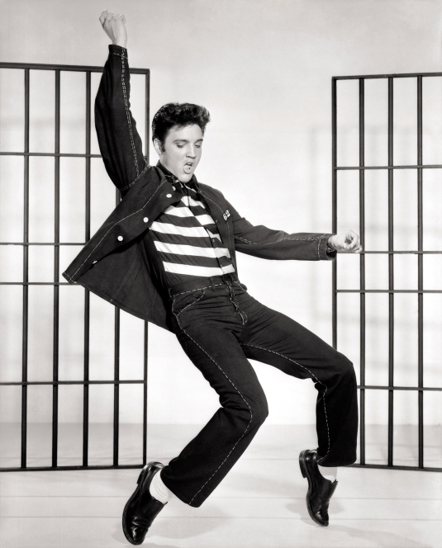
Section 3: Mass Culture and Family Life
Television Changes American Culture
  Sitcoms such as I Love Lucy and Leave it to Beaver portrayed the ideal family.
  Americans all across the country watched the same shows and the same advertisements.
  Americans could see presidential candidates in action, and candidates could buy advertising time.
Rock-and-Roll Music Shakes the Nation
  Originating in the rhythm and blues traditions of African-Americans, rock-and-roll music and performers such as Elvis Presley became very popular with young people.
  Church ministers and government officials expressed concern about the potentially dangerous effects rock music could have on young people.

Slide 14
Quick Discussion
During the 1950s, many adults were concerned about the effect rock and roll music would have on young people. Are adults today concerned about the music young people listen to? Should they be?

Slide 15
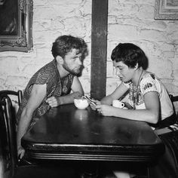
Section 4: Dissent and Discontent
Despite the prosperity of the 1950s, not all people benefited, as many in both rural and urban areas struggled with poverty.
Some, who did actually benefit from economic growth, questioned if all the material things they had gained had actually led to a better life.
Young people who rejected conformity to the culture of the times became known as Beats (or Beatniks).

Slide 16
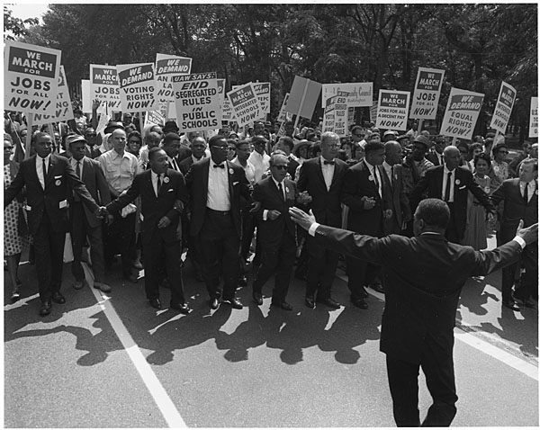
Section 4: Dissent and Discontent
The 1950s also witnessed a growing battle for civil rights.
African-Americans and other minorities (such as Latin Americans) fought for greater equality, focusing on housing and employment discrimination.
Key Idea: The discontents (poverty, racial discrimination) of the 1950s would lay the foundation for the dissent (protests) of the 1960s.

Slide 17
Quick Review of Ch. 22
What were the causes and effects of economic growth in the years following WW2?
Can you describe the culture of the 1950s?

