Slide 1

Review Game
What’s on the ppt?
Chapters 19 - 21

Slide 2
‘What’s on the ppt?’ Rules
2 Teams are Competing
1 Teammate will have his / her back turned to the ppt
Teammates will have 30 seconds to try to describe what is on the ppt, but YOU CAN’T SAY ANY OF THE WORDS ON THE PPT
If the Teammate can guess what’s on the ppt, your team get’s a point!
Whoever ends with the most points wins!

Slide 3
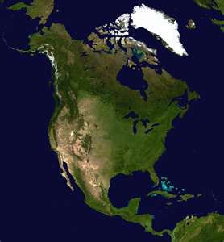
Example
The word is ‘North America’
Teammates can not say ‘North’ or ‘America’
Also, no rhyming or starts with ‘N’

Slide 4
Laws

Slide 5
Judge

Slide 6
Shared Values

Slide 7

Legislature

Slide 8
Burglary

Slide 9


Treason

Slide 10
Civil Disobedience

Slide 11
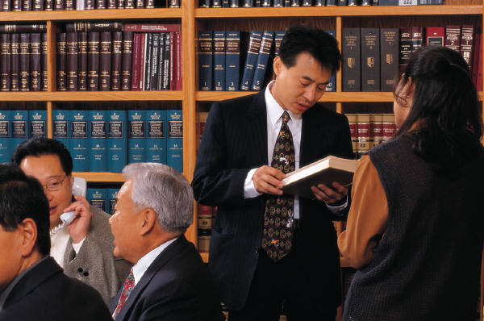
Statute

Slide 12
Felony

Slide 13

Regulation

Slide 14
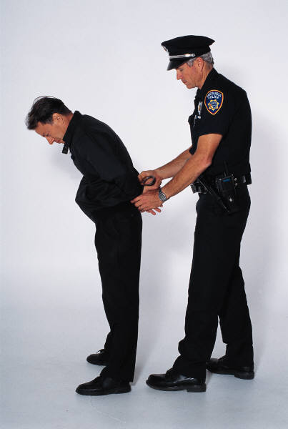
Criminal Law

Slide 15
Legal System

Slide 16
Misdemeanor

Slide 17

Assault

Slide 18
Civil Law

Slide 19

Crime

Slide 20

Embezzlement

Slide 21
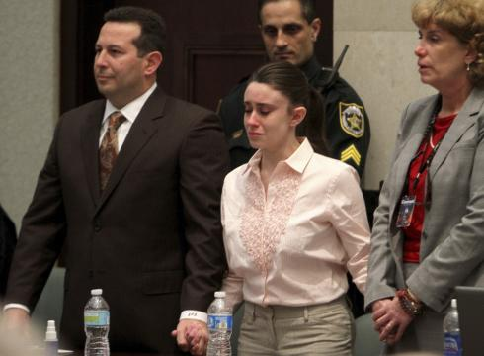
Acquit

Slide 22


Poor Parenting

Slide 23
Drug Abuse

Slide 24
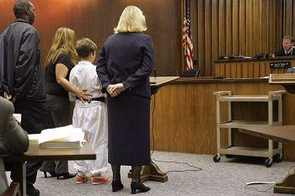
Juvenile Court

Slide 25
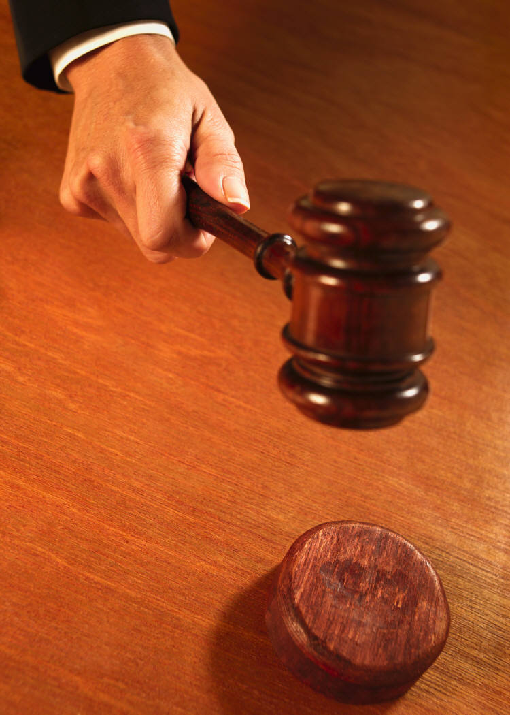
Lawsuit

Slide 26

Property Cases

Slide 27
Mediation

