Slide 1
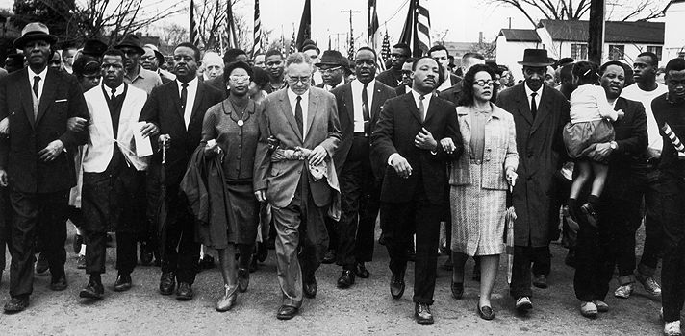
Unit 7: The Black Revolution
(1954 – Present)
The movement for equality and civil rights during the 1950s and 1960s drastically impacts the lives of African Americans and the development of American Society in the years to come.

Slide 2
Quick Review of Ch. 21
What key events / legislative acts / people characterize the Civil Rights Movement of the 1950s and 60s?

Slide 3
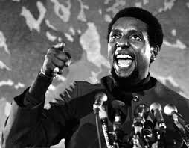
Chapter 22: The Struggle Continues
(1965 – 1980)
In the face of white backlash against the gains of the civil rights movement, many black leaders and scholars argued for black power and black separatism.

Slide 4
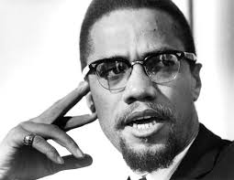
Section 1: Racial Integration
In the mid-1960s, with many white Americans increasingly hesitant to support the civil rights movement, many black Americans began to look for new approaches to solving their problems.
Some were attracted to a more militant (forceful) approach to gaining political and economic power as supported by activists like Malcolm X and Stokely Carmichael.
“The day of nonviolent resistance is over.” – Malcolm X
“The only way we gonna stop them white men from whippin’ us is to take over.” – Stokely Carmichael

Slide 5
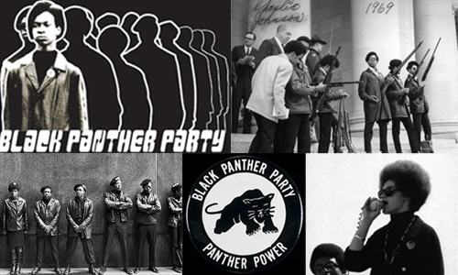
Section 1: Racial Integration
The Black Panther Party was the most organized expression of the new black militancy.
  Founded in 1966, some of the Black Panthers goals were to…
    Fight against a capitalist society they argued was against the black community
    End police brutality against blacks
    Support Black Nationalism Ideology
    Essentially fight with force if necessary to ensure blacks could determine their own destiny.
When the Panthers took up guns for self-defense and patrolled neighborhoods to monitor police, white Americans were alarmed, leading to confrontations and shootouts. Eventually the FBI and local law enforcement got involved in their attempt to take the party down.

Slide 6
Quick Discussion
What’s your take on the Black Panther Party?

Slide 7
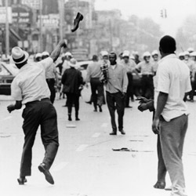
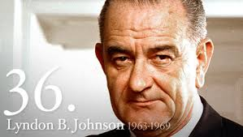
Section 2: The Great Society
President Lyndon Johnson promoted the idea of building a ‘Great Society’ in the 1960s, declaring “an unconditional war on poverty”.
  However, in the late 1960s, frustration with the lack of change in poor black communities exploded into violent and destructive riots.
  Also, increasing involvement in the war in Vietnam brought an end to many ‘Great Society’ programs.

Slide 8
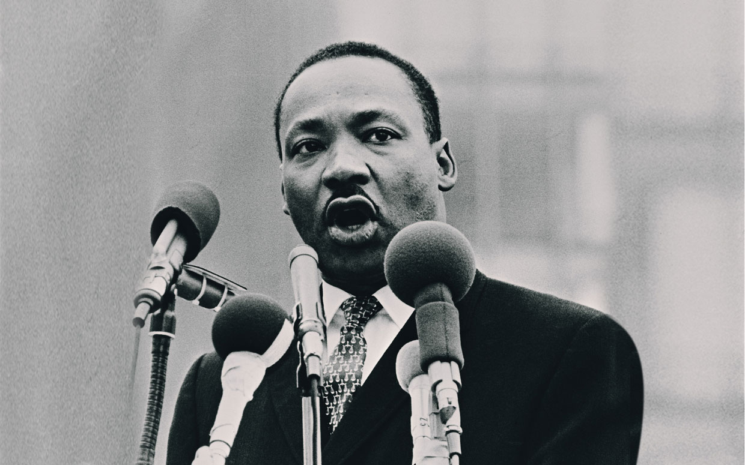
Section 3: Martin Luther King
In response to urban rebellions, in 1966 Martin Luther King moved his campaign to the North and set up SCLC operations in Chicago.
His operations ended in failure, but his experience inspired King to give more attention to efforts to eliminate poverty and end systemic economic inequality.
“What good is it to be allowed to eat in a restaurant if you can’t afford a hamburger?” - King

Slide 9
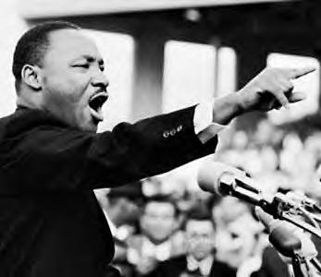
Section 3: Martin Luther King
King became one of the most vocal critics of the Vietnam War.
  He accused the federal government of sending black and white men to ‘slaughter men, women, and children’ in Vietnam while failing to protect black American civil rights protesters.
  He accused President Johnson of being more concerned with winning the war in Vietnam than winning the ‘war against poverty’ in America.
Sadly, King was assassinated on April 3, 1968 while standing on the balcony of a hotel in Memphis, Tennessee. His murder unleashed civic rage in black communities.

Slide 10
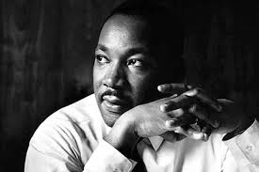
Quick Discussion
Alternate History
Can you imagine how history might have been different had MLK not been murdered in 1968?

Slide 11
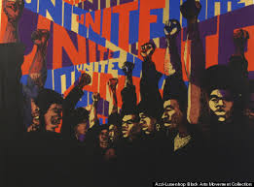
Section 4: The Arts and Education
The idea of Black Power stimulated debate about the future of black politics and the role of black art and black artists in the quest for black liberation. This period became known as the Black Arts Movement.
  Black artists (painters, actors, musicians, writers, and poets) determined to produce black art for black people and thereby accomplish black liberation.

Slide 12
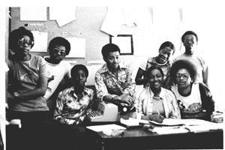
Section 4: The Arts and Education
The Black Power and Black Arts Movement also inspired many black students who were enrolled in predominantly white colleges.
  Black Students began to demand courses in black history, culture, literature, and art.
What’s the value of learning African-American history, culture, literature, art, etc.?

Slide 13
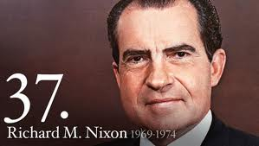
Section 5: Politics
Richard Nixon won the presidential election in 1968. His policies toward African-Americans and civil rights were, in some ways, contradictory.
  He supported an equal rights amendment that would prohibit gender discrimination, but he also pursued a Southern Strategy that realigned the Republican Party with the white southern backlash to civil rights.
Nixon stepped up the Vietnam War effort between 1969 – 1971, but by 1973 the US began the process of withdrawing. In 1974 political scandal forced Nixon to resign.

Slide 14
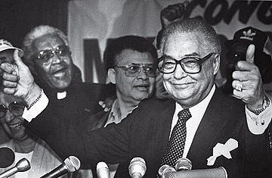
Section 6: Black Elected Officials
Blacks made impressive gains in electoral politics in the 1970s as African-Americans were elected to public office in growing numbers at almost every level of government.
Coleman A. Young served as mayor of Detroit for five terms.

Slide 15
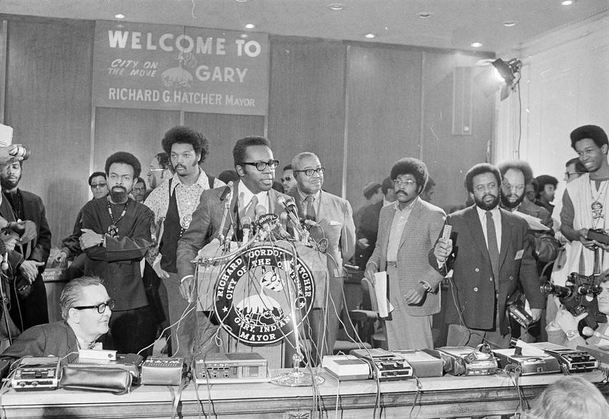

Section 6: Black Elected Officials
In 1972 African-Americans gathered in Indiana for the Gary Convention with the goal of achieving black political unity. While it failed to achieve total unity, the convention was important because it marked a change in the political focus of the black community away from mass demonstrations and protests and towards electoral politics.

Slide 16

Quick Review of Ch. 22
In what ways did African-Americans respond to frustrations and set-backs they faced in the 1960s and 70s?

