Slide 1
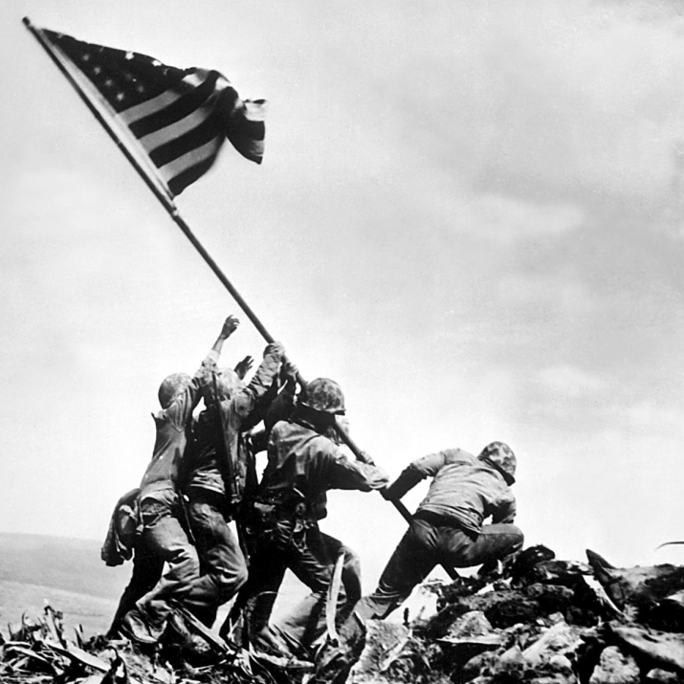
Unit 7: World War II and Postwar America (1931 – 1960)
World War II would prove to be a major victory for the US and it’s allies, however, tensions between democracy and communism would present new challenges in the years to come.

Slide 2

Quick Review of Ch. 19 - 20
Prior to the bombing at Pearl Harbor, what was the level of American involvement in the war?
After the US enters the conflict, in what ways do the US government and American citizens support the war effort?
How were allied forces able to defeat Germany? Japan?
What were the effects of WW 2 on the world? On the US?

Slide 3
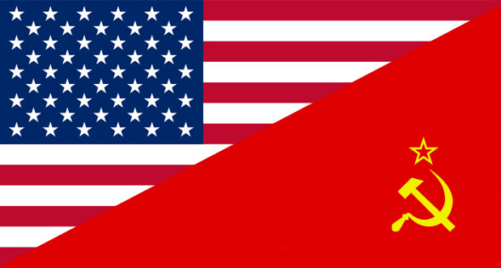
Chapter 21: The Cold War (1945 – 1960)
In the years following World War 2, political differences will cause serious tension between the United States and the Soviet Union, leading to the fear of both global conflict and the spread of Communism to the US.

Slide 4
Quick Question
Why is it called the ‘Cold’ War?

Slide 5
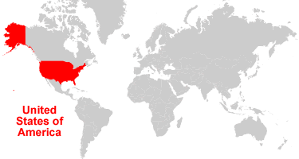
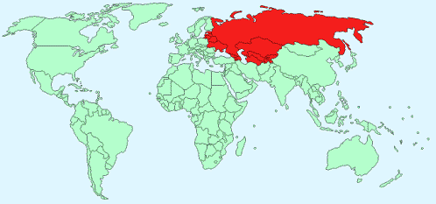
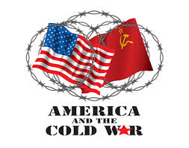
Section 1: The Cold War Begins
The US and Soviet Union worked together to defeat Nazi Germany, however after WW 2 was over, relations quickly began to fall apart as they had opposing goals for global development.
The Cold War Begins
  Cold War: worldwide rivalry between the US and Soviet Union
Soviet Union

Slide 6
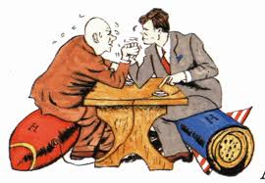
Differences Between the US and Soviet Union
United States
  Capitalist Democracy
  Supported Freed elections, economic and religious freedom, private property, individual differences
  Sought a united Germany and independent nations in Eastern Europe (Following WW2)
Soviet Union
  Communism under Joseph Stalin’s Dictatorship
  Communist Party made all key economic, political, and military decisions
  Did not support freedom of religion, speech, or private property
  Sought a weak and divided Germany and wanted Eastern Europe to remain under Soviet Control (Following WW2)

Slide 7

US Policy for Soviet Expansion
Basic Conflict: The US wants to see democracy spread in the world while the Soviet Union wants to see communism spread.
US Policy
  Truman Doctrine: The policy of helping countries who were struggling against communism
  Containment: The goal of keeping communism within its existing borders and preventing it from expanding
In 1948 Congress passed the Marshall Plan. It gave about $13 billion in grants and loans to nations in Western Europe. This helped build good relationships and prevent the spread of communism.

Slide 8
Quick Discussion
Why do you think the United States is so concerned with democracy (not communism) spreading to other nations of the world?

Slide 9
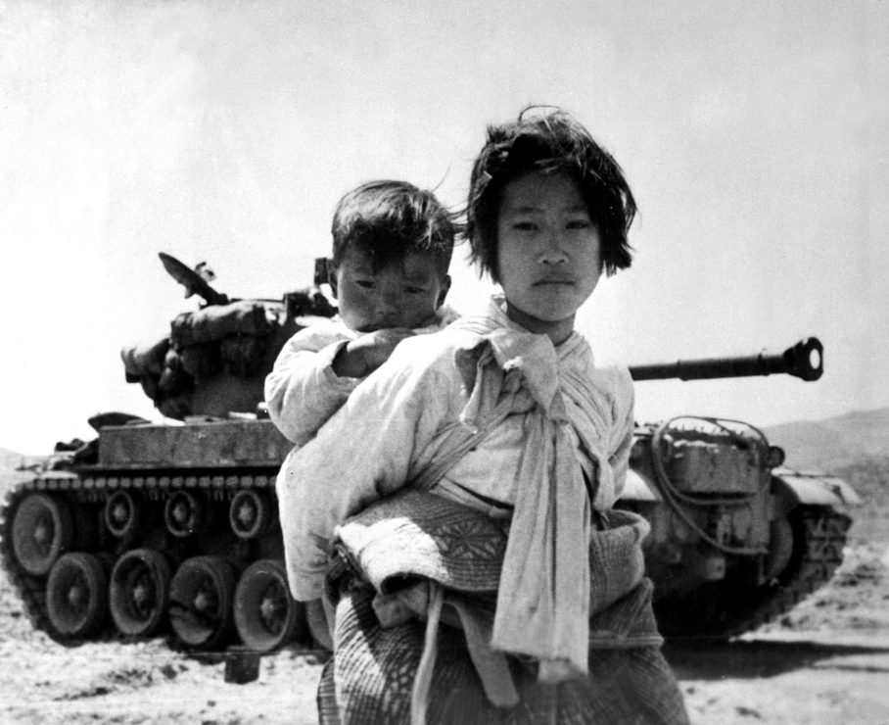
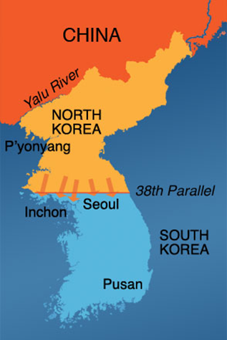
Section 2: The Korean War
In the early 1950s, the conflict between North and South Korea becomes the focus of the ‘cold war’ struggle between communism and democracy.

Slide 10

Why a North and South Korea?
Following WW2, Korea is divided into North Korea and South Korea.
The Soviets develop a communist government in the North, while the United States establish a democratic system in the South.
Communism!!!
Democracy!!!

Slide 11
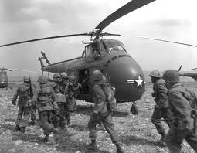

The Korean War
In 1950, North Korea Invades South Korea.
US forces step in and push North Korean forces out of South Korea.
Communist Chinese (China embraced communism after WW2) forces enter and help North Korea, forcing a stalemate (tie).
In 1953, both sides agree to a cease-fire, however tension remains until this day.
US Forces

Slide 12

Quick Discussion
What do you know about the conflict between North and South Korea in modern times?

Slide 13
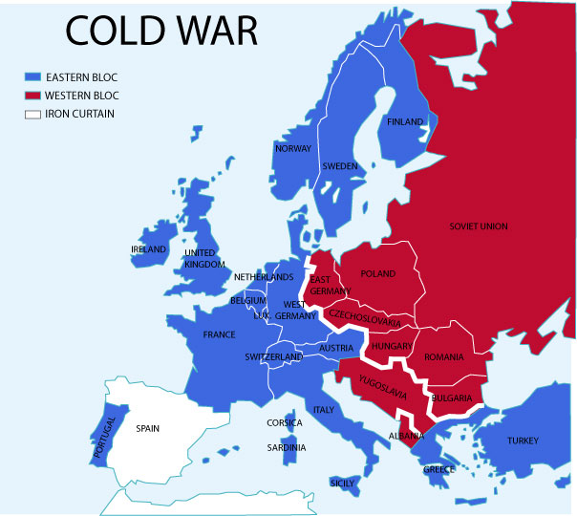
Section 3: The Cold War Expands
The conflicting ideologies and goals of the US and the Soviet Union led to a worldwide struggle for influence.
The ‘Iron Curtain’ separated Western and Eastern Europe. The US worked to support democracy in the West while the Soviet Union fought to support communism in the east. This conflict helped to shape modern history in much of the world, even spreading to Latin America and the Middle East.

Slide 14
The Cold War Increases Tensions
Weapons Race between the US and Soviet Union
  Both countries begin stockpiling nuclear weapons, hoping to discourage each other from military action.
Uprisings in Eastern Europe against Communism are put down by Soviet forces
The Soviet Union and US begin the ‘Space Race’ by launching satellites into space

Slide 15
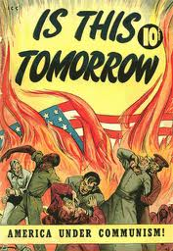
Section 4: The Cold War at Home
Following WW2, a ‘Red Scare’ takes hold in the US.
  Red Scare: Fear that communists both outside and inside America were working to destroy American life.
What does this 1950’s poster tell us about the ‘Red Scare’?

Slide 16
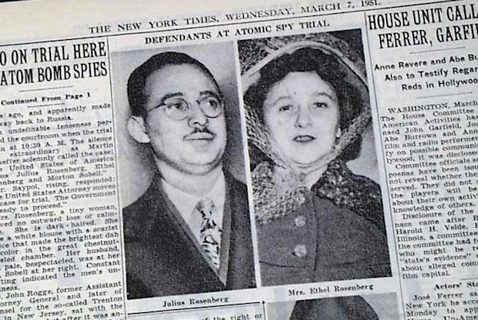
Americans Worry About Communism in America
President Truman and Congress attempt to expose and root out Communists in the US.
Communists spies are accused and convicted.
  Julius and Ethel Rosenberg are found guilty of passing nuclear secrets with the Soviet Union. They are put to death.
The Rosenbergs

Slide 17
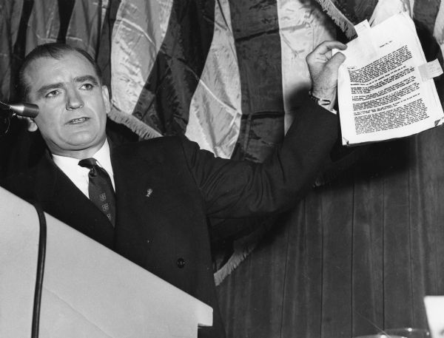
Americans Worry About Communism in America
Senator Joseph McCarthy ruthlessly and recklessly goes after members of the government and the US army, claiming they were secretly communist.
  He eventually becomes seen as a bully and loses his influence.
The end of the Korean War in 1953 and McCarthy’s downfall in 1954 signaled the decline of the Red Scare. American’s would continue to be concerned about communism in the world, but would not allow the fear of communism to prevent free speech and democracy in the US.

Slide 18
Quick Review of Ch. 21
What were the immediate causes and effects of the Cold War between the US and Soviet Union?
How did Americans respond to the Cold War?

