Slide 1
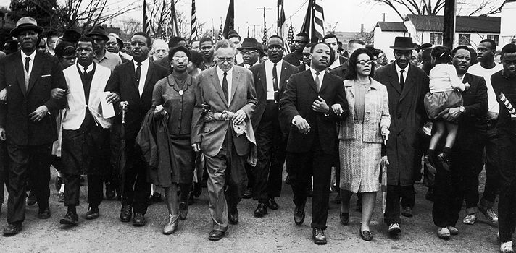
Unit 7: The Black Revolution
(1954 – Present)
The movement for equality and civil rights during the 1950s and 1960s drastically impacts the lives of African Americans and the development of American Society in the years to come.

Slide 2
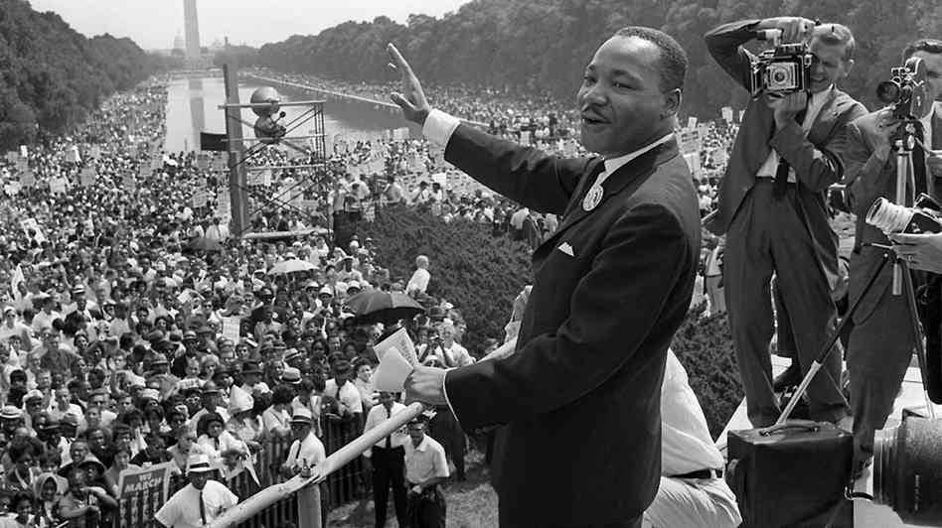
Chapter 21: The Freedom Movement
(1954 – 1965)
The struggle for greater equality gained momentum during the 1950s and 60s, resulting in the Civil Rights Movement and major legal victories for African-Americans.

Slide 3
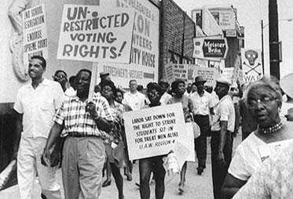
Section 1: The 1950s
Struggles During the 50s
Many whites experienced great prosperity during the 1950s, however, most African-Americans did not benefit from the country’s economic boom.
Jim Crow restrictions and the fear of violence from whites kept many blacks living in the deep South from voting.

Slide 4
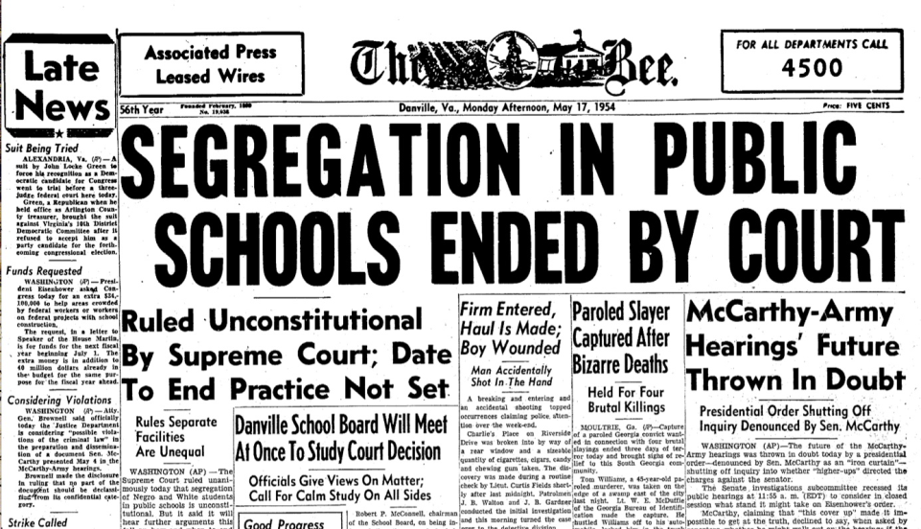
Section 1: The 1950s
A Key Victory for Blacks
In the 1954 case of Brown vs. Board of Education of Topeka, a team of NAACP lawyers successfully led the effort to overturn the practice of ‘separate but equal.’
In 1950, the all-white Sumner School of Topeka, Kansas refused to admit Linda Brown on the grounds she was black. Her father filed a lawsuit and testified in court that she had to travel over an hour to attend a black school. The case reached the Supreme Court, which in 1954 decided in favor of the Browns and declared laws requiring segregation in public schools to be unconstitutional. This decision marked a crucial victory in the battle against segregation.

Slide 5
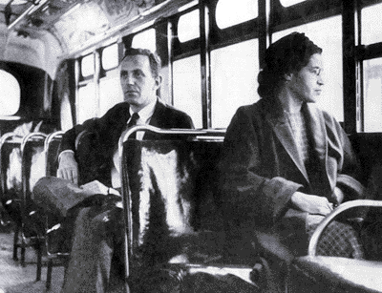
Section 2: The Montgomery Bus Boycott
In 1955, Rosa Parks was arrested in Montgomery, Alabama for refusing to give up her bus seat to a white man. In response community leaders, including MLK Jr., organized a successful boycott of the Montgomery bus system. Victory came about a year later when the Supreme Court officially ruled that segregation of public transportation was unconstitutional.
The Montgomery Bus Boycott highlighted the importance of strong local action on the community level in the fight for civil rights.

Slide 6
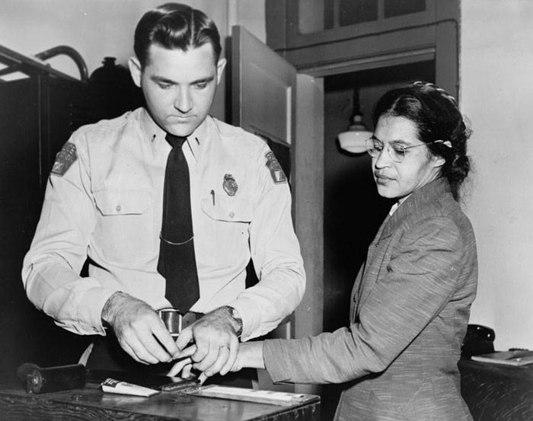
Quick Discussion
Rosa Parks is easily one of the most famous names associated with the Civil Rights Movement. Why do you think that is? What does she symbolize to you?

Slide 7
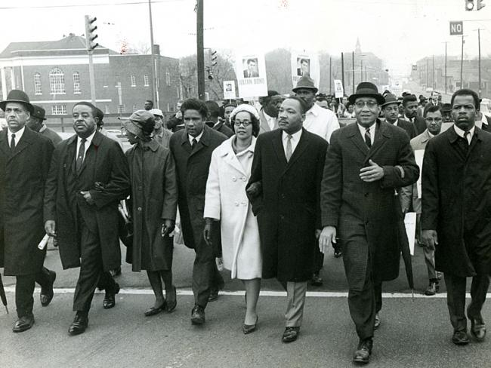
Section 3: No Easy Road to Freedom: 1957 - 1960
Following the success of the Montgomery Bus Boycott, Martin Luther King Jr. helped form the Southern Christian Leadership Council (SCLC) to serve as a base for the civil rights movement.
Despite tensions, the SCLC and NAACP worked together to advance their mutual goal of equality and civil rights for blacks.

Slide 8
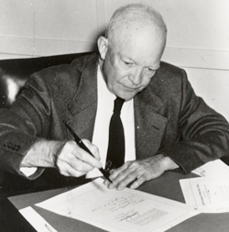
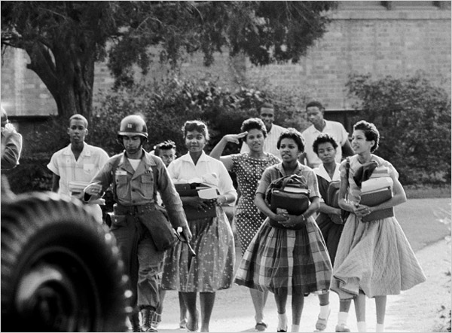
Section 3: No Easy Road to Freedom: 1957 - 1960
Another step towards desegregation was taken by President Eisenhower’s signing of the Civil Rights Act of 1957. It created a commission to monitor violations of black civil rights and help support black’s right to vote. However, black activists were not happy with the act as they felt it was not strong enough to counter white resistance.
While Eisenhower may not have been particularly eager to support the fight for black rights, he was forced to take action and support the Civil Rights Act of 1957 when Arkansas’ governor defiantly refused to allow nine black students to enter Little Rock Central High School. Eisenhower sent troops to ensure the students were safely allowed into the school. As the students withstood harrassment by segregationists, other young African-Americans in the South took notice and were inspired by their courage.

Slide 9
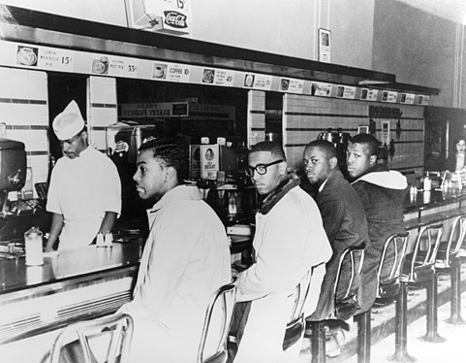
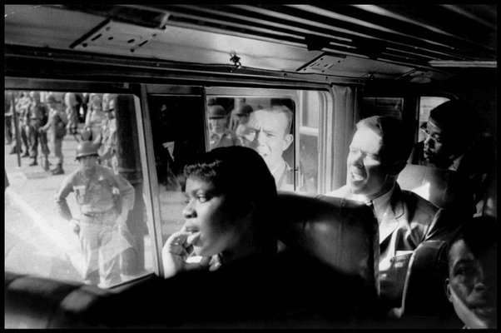
Section 3: No Easy Road to Freedom: 1957 - 1960
Activists for civil rights used sit-ins and Freedom Rides to draw attention to their cause, sometimes resulting in violence by segregationists.
At sit-ins, activists sat at segregated establishments to protest racial discrimination.
Freedom Riders rode buses and trains in the South in protest of segregation.

Slide 10
Quick Discussion
Why do you think civil rights activists choose sit-ins and freedom rides as a form of protest?
Possible risks / rewards of these demonstrations?

