Slide 1
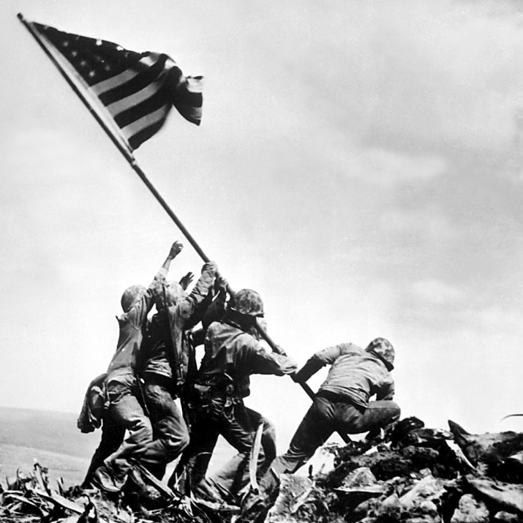
Unit 7: World War II and Postwar America (1931 – 1960)
World War II would prove to be a major victory for the US and it’s allies, however, tensions between democracy and communism would present new challenges in the years to come.

Slide 2

Quick Review of Ch. 19
What were the causes of World War 2?
Why did the US get involved in WW2?

Slide 3
Chapter 20: World War II
(1941 – 1945)
With the US and the Soviet Union joining the conflict, the momentum in World War II changes in favor of the Allied Powers. The results of WW2 will help shape the powers of the world for years to come.

Slide 4
Allies vs. Axis Powers
Key
Players
Allies
  England
  France
  United States
  Russia (Soviet Union)
Axis Powers
  Germany
  Japan
  Italy
US Soldier
German Soldier

Slide 5
Section 1: The Allies Turn the Tide
Following Japan’s attack on Pearl Harbor, the United States declares war on Japan, officially entering the global conflict on the side of the Allies.
With American support, the Allies begin to stop the seemingly unstoppable Axis powers.

Slide 6
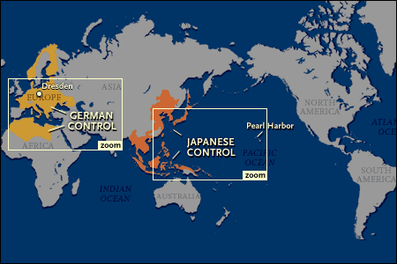
Turning the Tide in Europe
Thanks to the invention of the radar, Allied ships begin sinking German submarines in the Atlantic Ocean.
Russia is able to turn back German invasion.
The Allies drive Germany out of N. Africa and then invade Italy.
Allied planes begin bombing Germany.

Slide 7
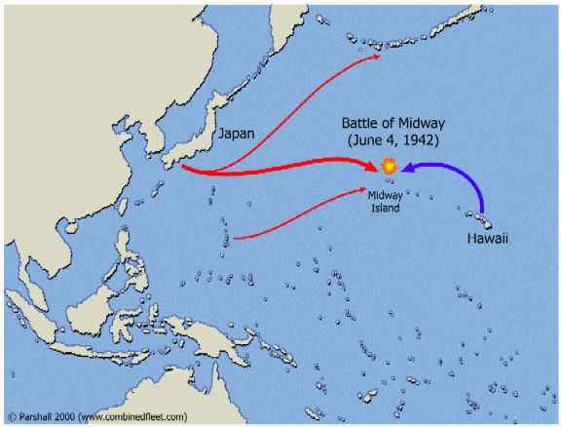
Turning the Tide in the Pacific
American forces win a critical victory at the Battle of the Midway in the Pacific Ocean.
  A turning point in the pacific, as the seemingly unstoppable Japanese forces are put on the defensive.
American forces begin seeking to capture bases in the Pacific so they can use them to bomb Japan.

Slide 8
Section 2: The Home Front
With the US entered in the war, the US government and industry quickly took measures to help support the war effort.

Slide 9
New Economic Opportunities
American industry quickly converted to war production to meet the nation’s military needs.
With the absence of many men, many women joined the work force to help meet wartime production quotas.
  Women would actually come to make up 1/3 of the wartime workforce.

Slide 10
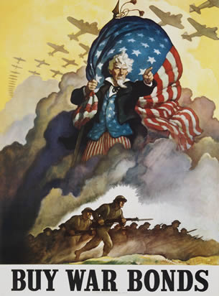
Supporting the War Effort
The war was very expensive, so the US government sought ways to collect money and manage the consumption of goods.
  Congress levied a 5% tax on all working
  Americans
  Millions of Americans bought war bonds
    Money loaned to the government to support the
    war effort
  Government controlled wages and prices
  to prevent inflation
  Government rationed (limited) the amount
  of certain goods Americans could buy (such as
  tires that were needed for the war effort)

Slide 11
Discussion Question
The US government and the majority of the American people supported America’s war effort during WW2.
Under what circumstances (if any) do you think it is good and right to support war?

Slide 12
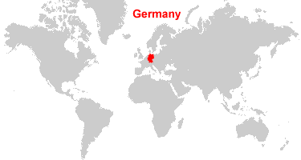
Section 3: Victory in Europe and the Pacific
In 1942-1943 the Allies turned back the Axis advances.
In 1944-1945 the Allies successfully attacked and forced the surrender of the Axis powers.
Allies attacked Germany from both the west and the east, and the US advanced across the Pacific Ocean to take down Japan.

Slide 13
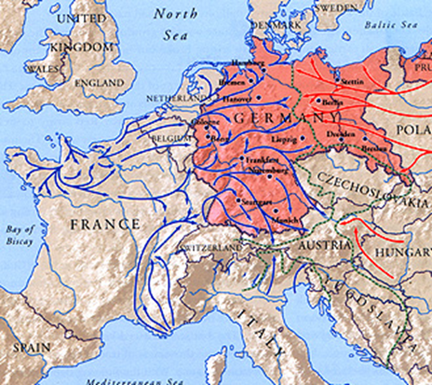
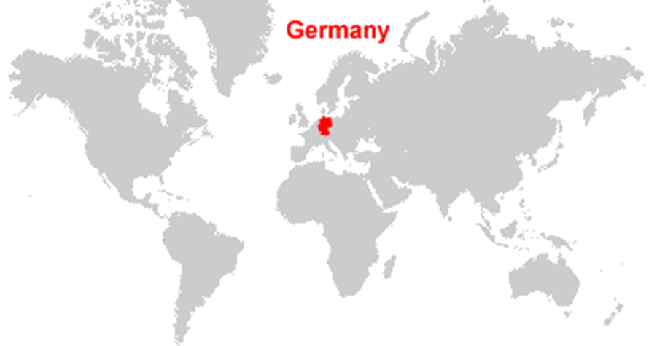
Victory in Europe
Following the D-Day invasion of Normandy, France, Allied forces advanced eastward, battling fierce German resistance.
After Germany’s failed attempt to occupy Russia, the Soviet forces advanced westward, forcing Germany to fight allied forces on both the eastern and western front.
Germany was overpowered, and on May 7, 1945 Germany officially surrendered.

Slide 14
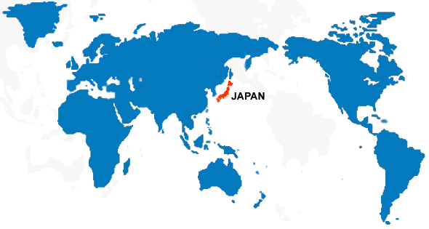
Victory in the Pacific
Facing intense Japanese resistance, American forces advanced across the Pacific Ocean, capturing islands and moving closer to Japan with the goal of using captured islands to launch bombing raids on Japan.

Slide 15

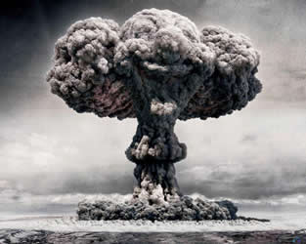
Victory in the Pacific
‘The Atomic Bomb Ends the War’
While US forces advanced close enough to Japan to bomb and invade it, military advisers feared an invasion of Japan to force its surrender could cost up to 1,000,000 American lives.
President Truman (FDR died) made the decision to use the US’s secret weapon, the Atomic Bomb, to force Japan’s surrender.
  The a-bomb was dropped twice, devastating
  Japanese cities and killing close to 100,000 residents.
  Japan finally made the decision to surrender.
  WW 2 was officially over. It was the most deadly
  war in history, with around 60,000,000 (mostly civilians)
  dead.

Slide 16
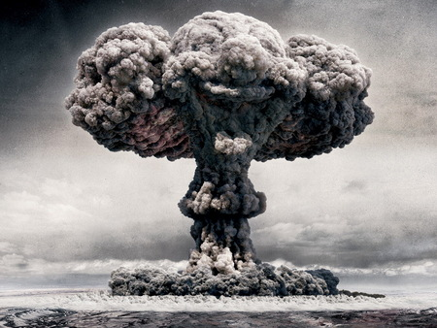
Quick Discussion
Do you think the US made the right decision to use the atomic bomb on Japan? Why?

Slide 17
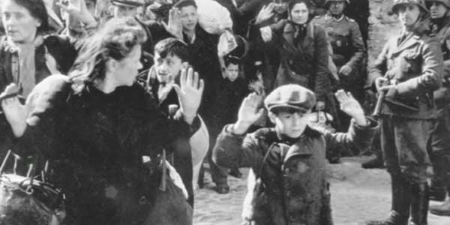
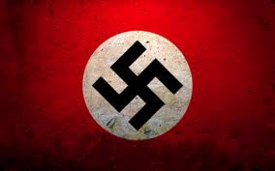
Section 4: The Holocaust
Hitler and the Nazi movement hated Jews and claimed the Jewish people were dragging down German society.
Once Hitler gained power, the Nazis began persecuting the Jewish people, denying them rights of citizenship, banning marriage between Jews and non-Jews, and segregating Jews in society.

Slide 18
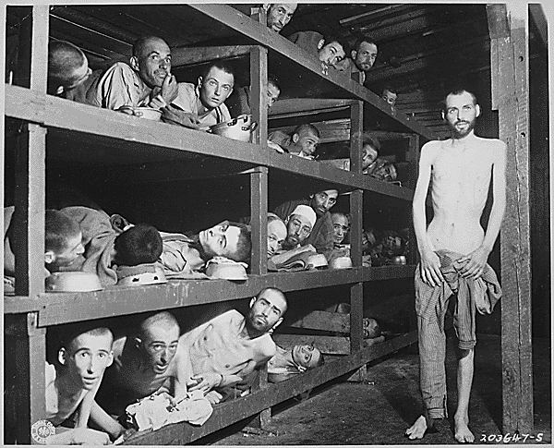
Nazis Adopt the ‘Final Solution’
Nazis begin opening concentration camps, where they sent ‘undesirables’ of society to be ‘useful members’ of society. In reality, they were sending them to perform hard labor, and eventually die.
“Undesirables” to the Nazis
Jews
Roma (Gypsies)
Poles and Slavs (E. European)
Politicians & Religious Leaders Who Resisted
Physically / Mentally Handicapped
Jehovah’s Witnesses
Homosexuals
African- Germans

Slide 19
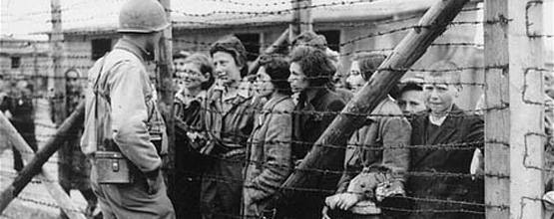
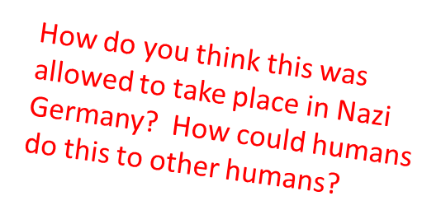
Allied Soldiers Liberate the Camps
As Allied forces advanced in Germany, they began discovering the reality of the concentration camps and the horrors that had taken place.
By the end of the war, the Nazis had murdered around 6 million Jews and 5 million others considered to be inferior. (mentally ill, homosexuals, beggars, etc.)

Slide 20


Section 5: Effects of the War
Following WW 2, the Allied Powers attempted to set the nations of the world on a course for peace and co-operation.

Slide 21

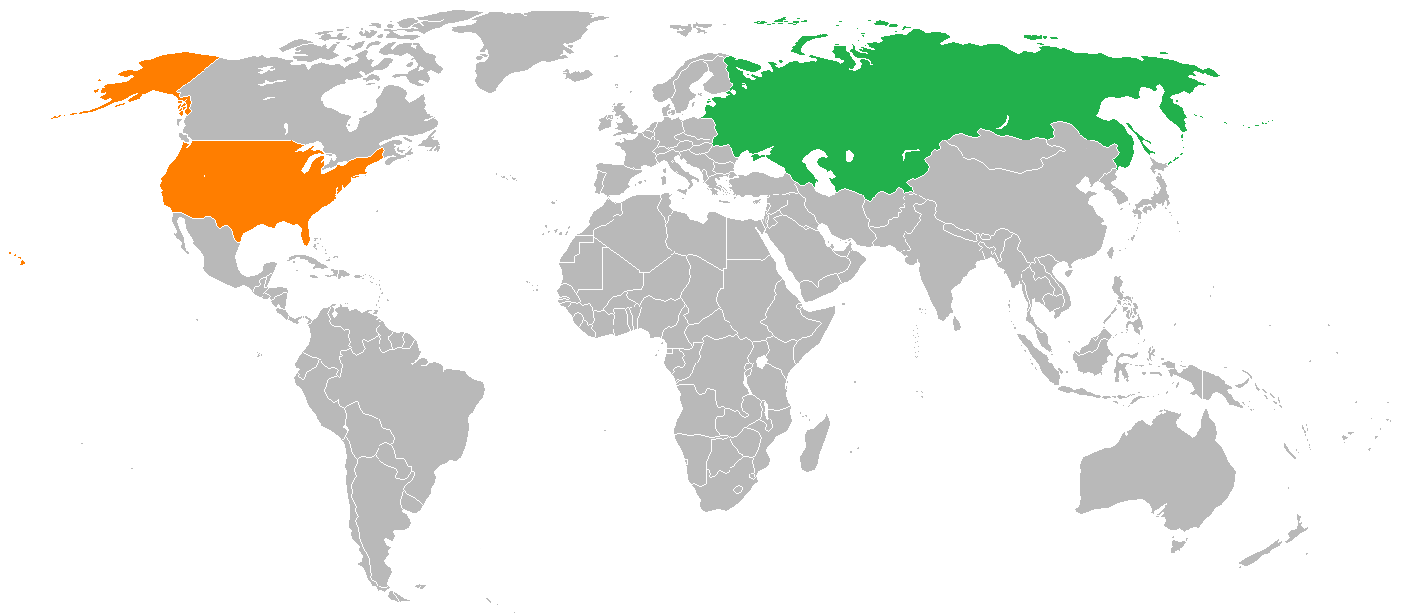
Effects of WW2 on the World
Germany is divided into East (communist) and
West Germany (democratic)
The practice of imperialism goes into decline
The US and the Soviet Union (Russia) emerged as the superpowers of the world
New efforts made to create a greater global economy
The United Nations (UN) is formed with the goal of promoting global co-operation

Slide 22
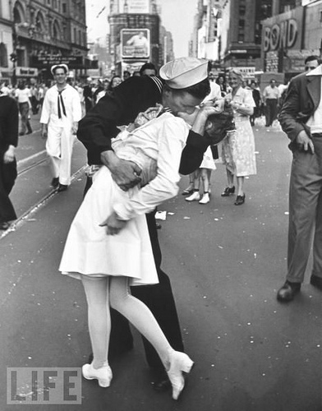
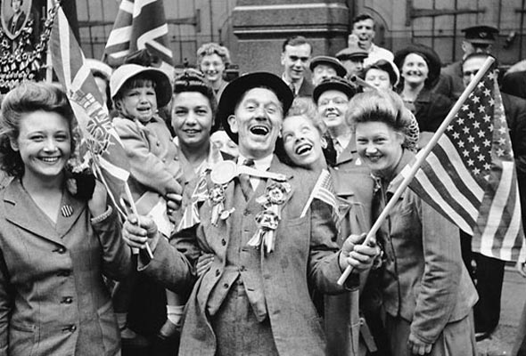
Effects of WW2 on the US
Many Americans proudly view the US as the defender of ‘tolerance, freedom, democracy, and peace’.
The US welcomes the position of global leadership.
Renewed commitment in the fight for civil rights in the US.
The US breaks out of the economic depression and emerges as a booming economic powerhouse.

Slide 23
Quick Discussion
Do you think it’s possible that there could be a World War 3 in the future? If so, what do you think would be the causes of it?

Slide 24

Quick Review Ch. 20
How were Allied Forces able to defeat Germany? Japan?
What were the effects of WW 2 on the world? On the US?

