Slide 1
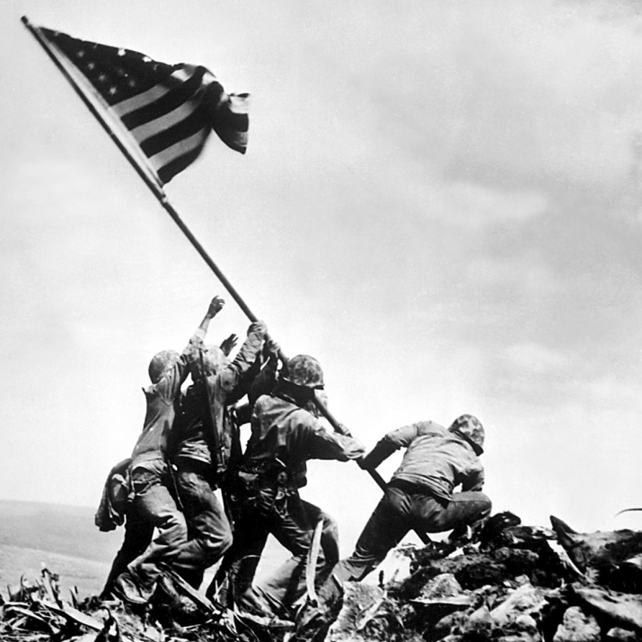
Unit 7: World War II and Postwar America (1931 – 1960)
World War II would prove to be a major victory for the US and it’s allies, however, tensions between democracy and communism would present new challenges in the years to come.

Slide 2
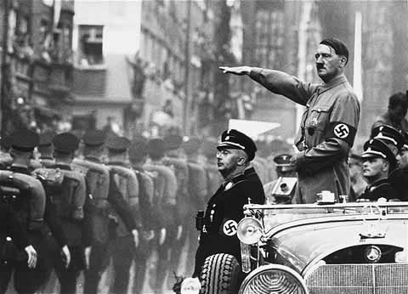
Chapter 19: The Coming of War
(1931 – 1942)
As leaders in Europe and Asia become more aggressive in their attempts to increase their nation’s power, the US is once again drawn into a global war.

Slide 3
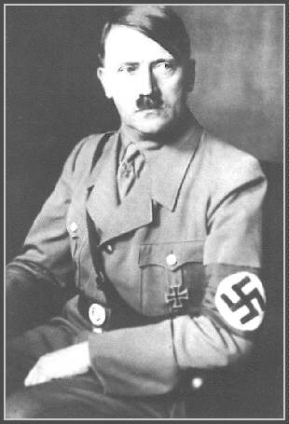
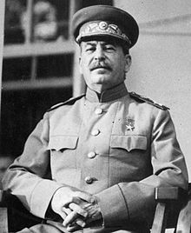
Section 1: Dictators and War
The Failure to achieve a lasting peace in Europe after World War I and the effects of a global economic depression paved the way for dictators, such as Hitler in Germany and Stalin in Russia, to rise to power.

Slide 4
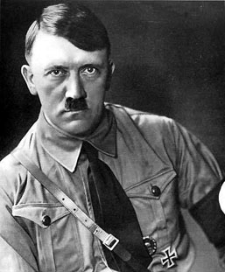
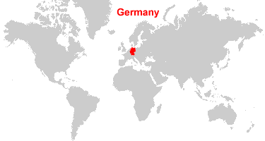
Aggressive Leaders in Germany and Japan
Germany
  As leader of the Nazi Party, Adolf Hitler rises to power, promising to restore Germany to greatness following years of economic depression.
  He begins enlarging the German military and expanding German territory.

Slide 5
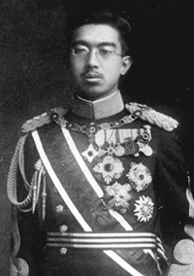
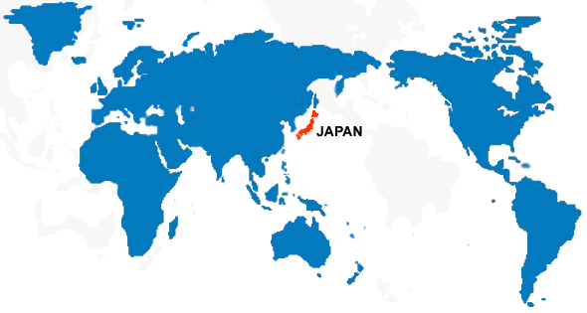
Aggressive Leaders in Germany and Japan
Japan
  Due to economic troubles in the 1930s, military leaders of Japan argued that expanded control into other parts of Asia would solve Japan’s economic problems and provide future security.
  Japan begins attacking and controlling sections of China.
Japan’s Emperor Hirohito

Slide 6
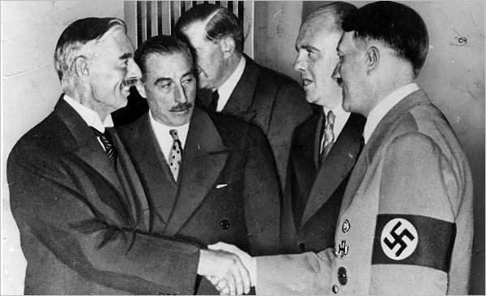
Aggression Goes Unchecked
Unwilling to risk another World War, England, France, and the US pursue appeasement tactics with Germany and Japan.
  They hope that by allowing them to make some gains, they will be satisfied and they can maintain peace.
Will appeasement work?

Slide 7
Quick Discussion
Can you think of any military / political leaders in more recent times that have been more aggressive in trying to increase their power?

Slide 8
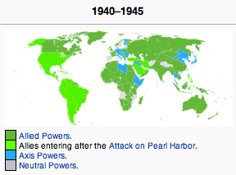
Section 2: From Isolationism to Involvement
Appeasement tactics fail, as Germany continues its policy of aggression and expansion in Europe. War erupts in Europe!
The Axis Powers form = an alliance between Germany, Italy, and Japan
The Allies form = starting with Britain and France, and later including the United States and the Soviet Union

Slide 9
Americans Debate Involvement
While Hitler occupies France and then begins bombing England, the US is forced to decide whether or not this is a fight for the USA.
While at first the US decided not to enter the war, President Roosevelt begins taking steps toward helping England that would eventually lead the US towards war.
Should the US get involved in ANOTHER global war?

Slide 10
Steps Towards US Involvement
The Lend-Lease Act (March 1941)
  The US sent more than $40 billion of aid to the Allies (Britain and France)
Atlantic Charter (August 1941)
  Roosevelt met with England’s Prime Minister, Winston Churchill, to sign this document, strengthening the alliance between the US and England
Conflict with German U-Boats (Fall of 1941)
  German submarines attack American ships. FDR gives the order for American ships to attack German submarines if spotted.

Slide 11
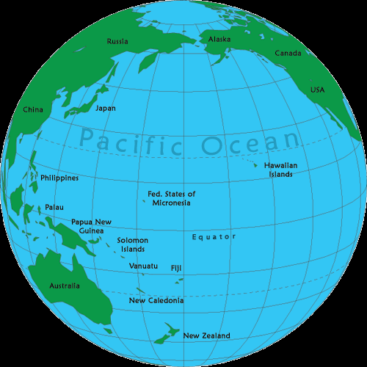
Section 3: America Enters the War
Germany’s ally, Japan,
feels threatened by
America’s presence
in the Pacific Ocean.
  The US has bases in Hawaii, Guam and the Philippines. Also, the US supports China, the country Japan is invading.
Guam

Slide 12
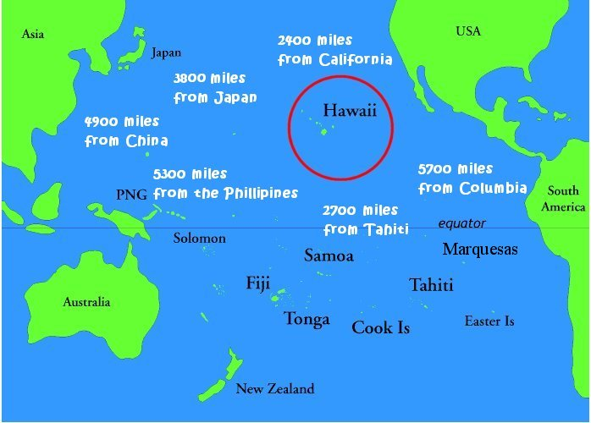
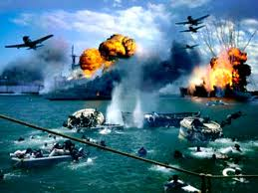
Japan Attacks the US
Hoping to decrease American power and presence in the Pacific, Japan makes the decision to attack America’s main navy base in the Pacific… Pearl Harbor, Hawaii.
On December 7, 1941 Japan bombs Pearl Harbor.
  Nearly 2,500 Americans killed and 8 Battleships damaged.
  The United States immediately declares
  war on Japan and enters World War 2.

Slide 13
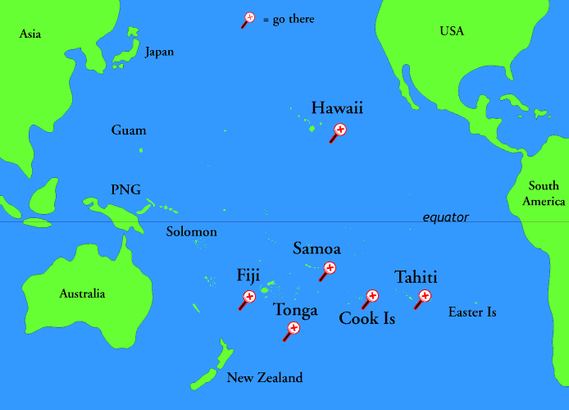
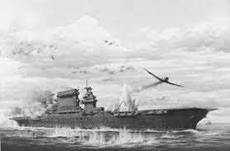
Fierce Fighting in the Pacific
With advanced weaponry and a highly-motivated military, Japan seemed to have the advantage at first.
Japan takes the Philippines and appeared ready to continue its dominance in the Pacific.
However, the Battle of Coral Sea marked a shift in momentum in the favor of the US.
  As battles would be fought based on the strength of aircraft carriers and planes, the US had an advantage thanks to its productive capacity.
Battle of Coral Sea

Slide 14

Quick Review of Ch. 19
How did a man like Hitler rise to power in Germany?
What was the motivation behind aggressive expansion policies for Germany and Japan?
Prior to the bombing at Pearl Harbor, what was the level of American involvement in the war?
Why would Japan, a former ally of the US and trade partner, suddenly launch a surprise attack on the US?

