Slide 1
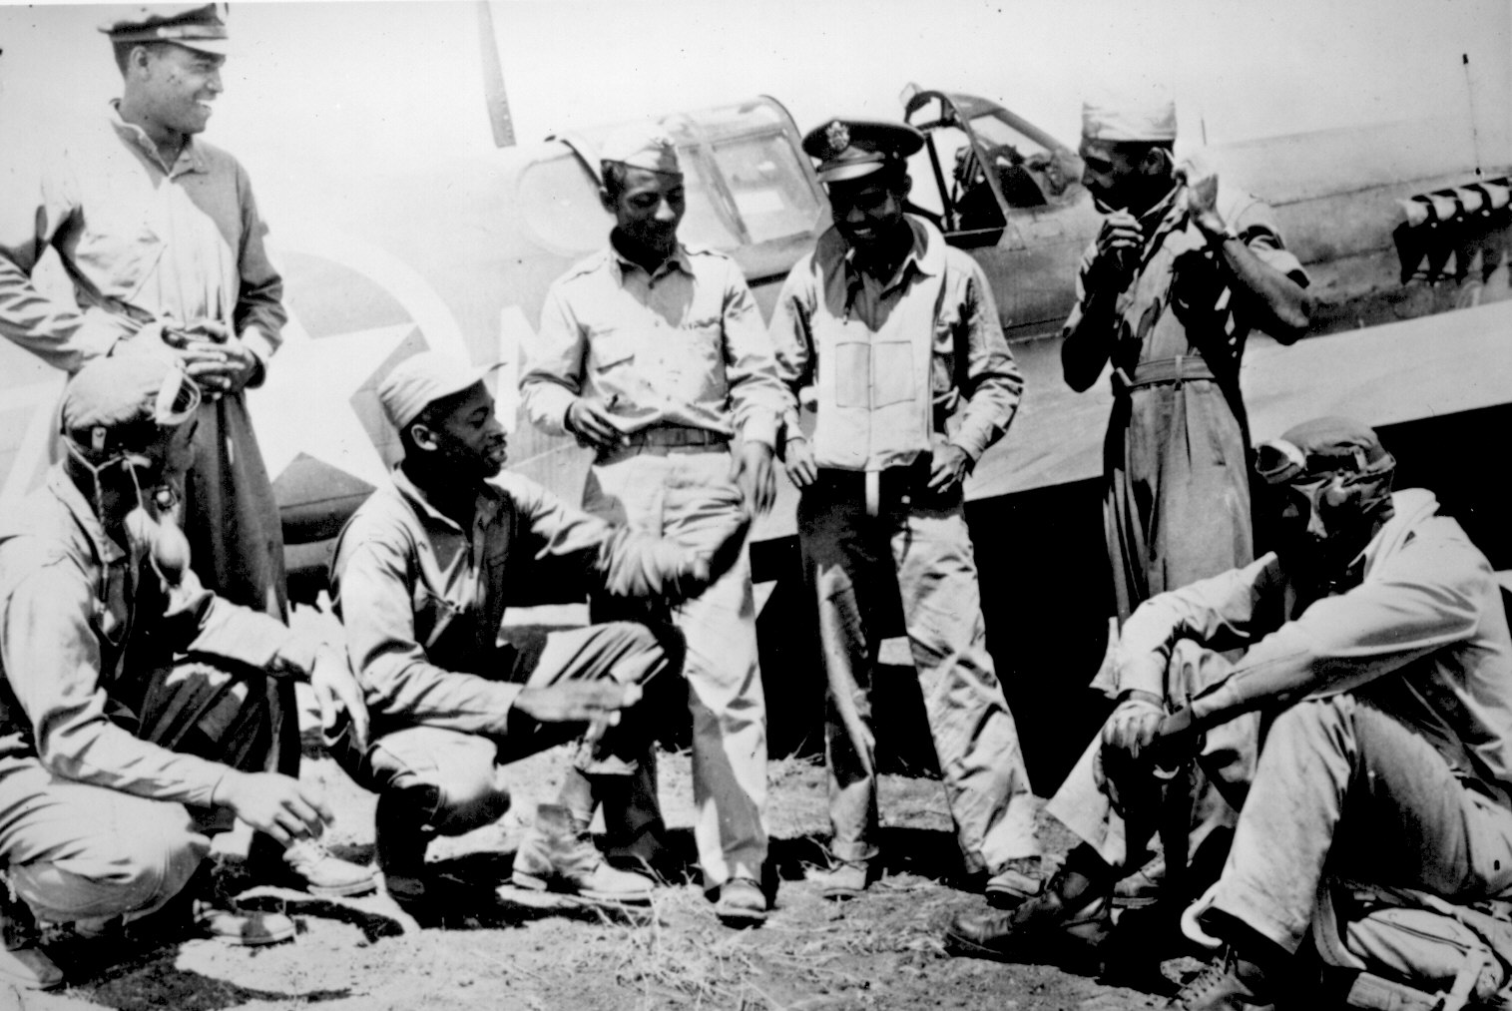
Unit 6: The Great Depression and World War II (1929 – 1949)
African-Americans continue to develop their culture and establish their place in American society during the Great Depression and World War 2.

Slide 2

Quick Review of Ch. 18 - 19
Can you discuss the struggles / advancements of African-Americans during the 1930s and 1940s?
What are some examples of how African-Americans during the 1930s and 1940s attempted to express black culture in meaningful ways?

Slide 3
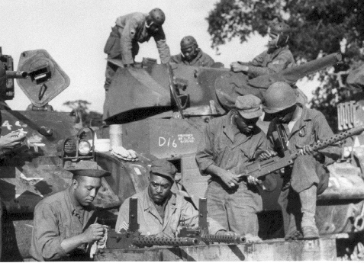
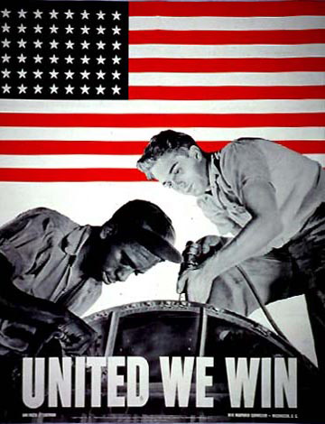
Chapter 20: The World War II Era and the Seeds of a Revolution (1936 – 1948)
The outbreak of World War II impacted the lives of African-Americans, as many served in the military overseas or as wartime workers on the home front.

Slide 4
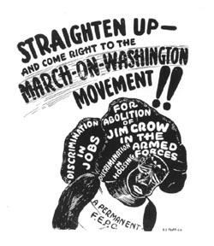
Section 1: World War II
As the 1930s came to an end, the world moved ever closer to another global war.
Many African-Americans responded to the growing crisis of WW2 with greater activism.
  For example, A. Philip Randolph organized a march on Washington to demand that blacks have the right to work and fight for their country.
The march was eventually called off after President Roosevelt created the Fair Employment Practices Committee (FEPC).

Slide 5
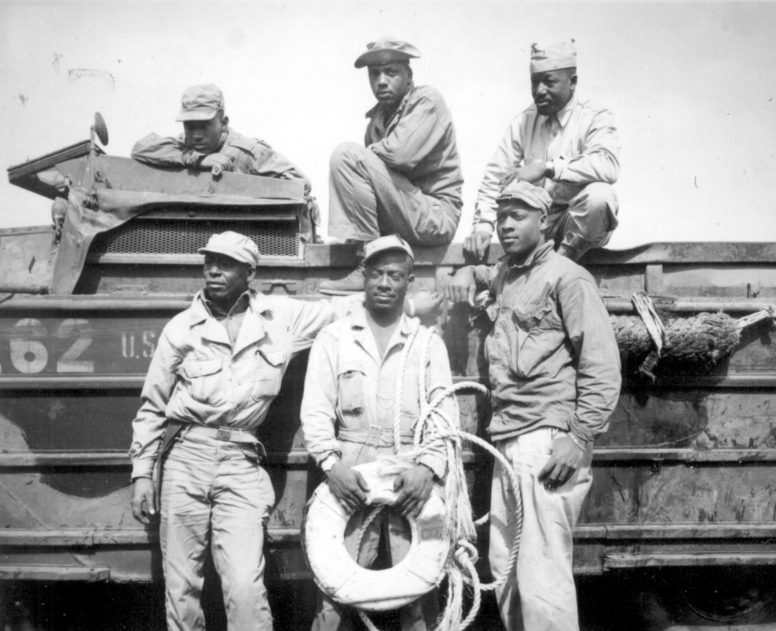
Section 2: Race and the U.S. Armed Forces
Calls for the end of discrimination in the military met strong resistance, as African Americans continued to face racism and discrimination.
Examples of Racism: A study by the American War College concluded that blacks could not control themselves in the face of danger and that they did not have the resourcefulness of whites.
Example of Discrimination: African-American soldiers were segregated and served mostly in noncombat units (kitchens, boiler rooms, transportation, etc.).

Slide 6
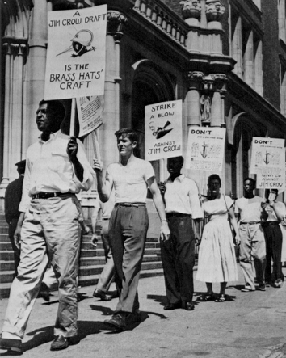
Section 2: Race and the U.S. Armed Forces
The black community responded to discrimination in the military with attempts to create awareness of it and through protest.
Black American leaders mobilized black workers, black women’s groups, college students, and an interracial coalition to protest against inequality in the military.
The NAACP published numerous editorials which spoke against the army’s segregation policy.

Slide 7
Quick Discussion
Segregation and discrimination seem to be a consistent theme in the military up until this point. What do you think black soldiers said to themselves and to each other to encourage one another to continue serving?

Slide 8
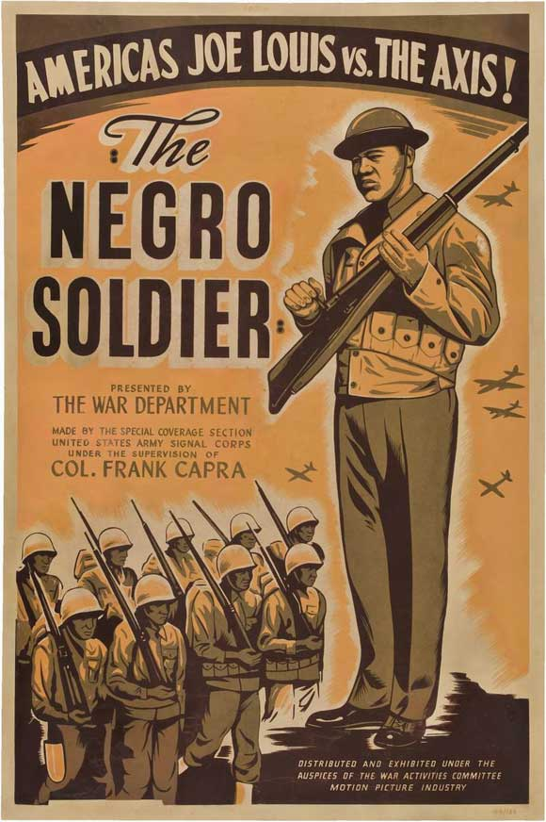
Section 3: The Beginning of Military Desegregation
In response to pressure from black officers, civil rights leaders, and the press, the War Department made some changes.
In 1943 the War Department produced the film, The Negro Soldier. The film, designed to appeal to both black and white audiences, emphasized the contributions of blacks soldiers since the American Revolution.
Many African Americans saw combat, although under white officers. Black artillery, tank destroyer, antiaircraft and combat engineer battalions fought well in Europe and Asia.

Slide 9
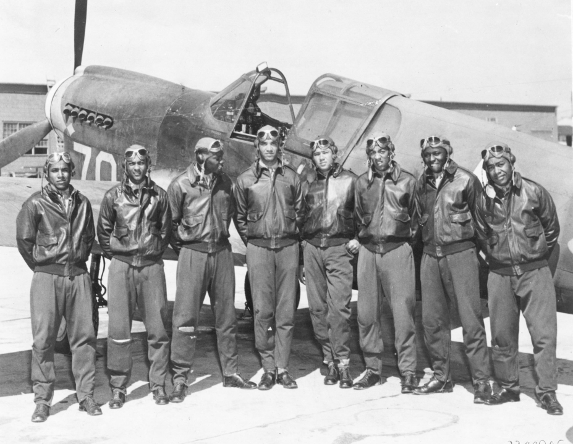
Section 3: The Beginning of Military Desegregation
The most visible group of black soldiers served in the Army Air Force.
The Tuskegee Airmen, an all black unit trained in Tuskegee, Alabama, showed the effectiveness of black pilots in combat.
The Tuskegee Airmen completed over 1, 578 missions, destroyed 409 enemy aircraft, and sank an enemy destroyer.
Tuskegee Pilot Coleman Young stated, “Once our reputation got out as to our fighting ability, we started getting special requests for our group to escort their group, the bombers.”

Slide 10
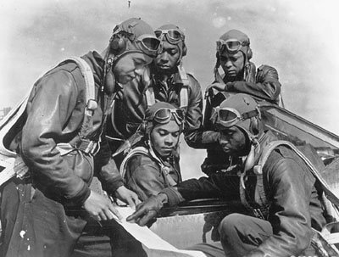
Section 3: The Beginning of Military Desegregation
*Key Idea*
  African-American soldiers returned home from their service experience with a greater sense of themselves and a greater commitment to the fight for black equality.

Slide 11

Quick Discussion
Many African-Americans who served in World War 2 returned home to the United States, which at the time still had segregation laws and no shortage of racism. How do you imagine black soldiers responded to this? How would you respond?

Slide 12
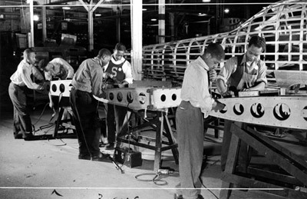
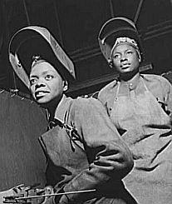
Section 4: Black People on the Home Front
WW2 helped accelerate the migration of blacks from rural areas to the cities in search of work.
The need for wartime workers helped break down barriers to employing African Americans in industry.
  The government took further steps to ban job discrimination in defense industries.

Slide 13
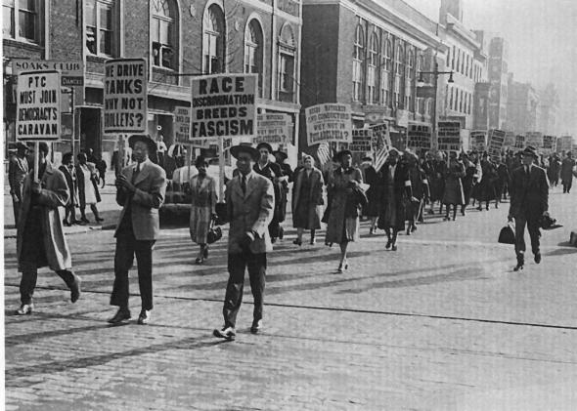
Section 4: Black People on the Home Front
Despite advancements for black workers at this time, racial tensions remained high, sometimes resulting in violence.
Throughout the war, African-American protest groups continued to fight racial inequality.

Slide 14
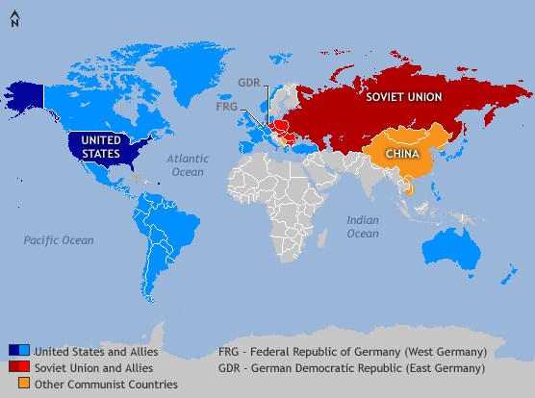
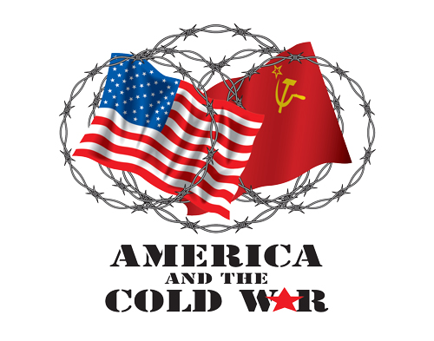
Section 5: The Transition to Peace
As WW II came to an end, a new conflict known as ‘The Cold War’ began. The two superpowers, the US and the Soviet Union, were in conflict over their competing political views, ‘Democracy vs. Communism’.
In the US, conservatives used fear of communism to attack all advocates of change, including people who fought for civil rights.

Slide 15
Section 5: The Transition to Peace
In 1948, President Harry Truman issued Executive Order #9981, officially desegregating the armed forces.
Executive Order #9981 marked a victory in the struggle to fully integrate the nation’s military.
With the outbreak of the Korean War in 1950, the US military would become one of the first sectors of American society to abandon segregation.

Slide 16

Quick Review of Ch. 20
What struggles did African-Americans face during the time period surrounding WW2?
What advancements did African-Americans make during the time period surrounding WW2?

