Slide 1

Review Game
What’s on the ppt?
Chapters 16 – NC 18

Slide 2
‘What’s on the ppt?’ Rules
2 Teams are Competing
1 Teammate will have his / her back turned to the ppt
Teammates will have 30 seconds to try to describe what is on the ppt, but YOU CAN’T SAY ANY OF THE WORDS ON THE PPT
If the Teammate can guess what’s on the ppt, your team get’s a point!
Whoever ends with the most points wins!

Slide 3
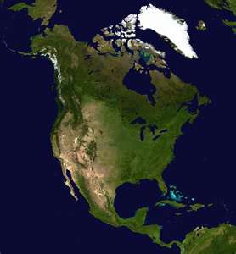
Example
The word is ‘North America’
Teammates can not say ‘North’ or ‘America’
Also, no rhyming or starts with ‘N’

Slide 4
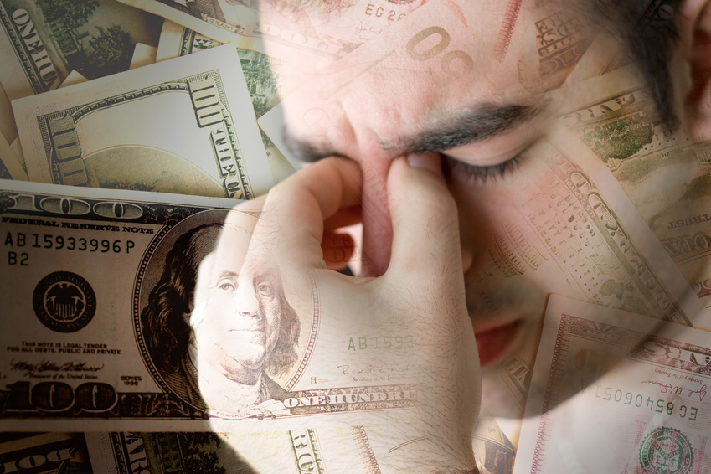
Economic Problems

Slide 5
Government Spending

Slide 6

Social Security

Slide 7
Tax Collection

Slide 8
Fiscal Policy

Slide 9

Federal Reserve System

Slide 10
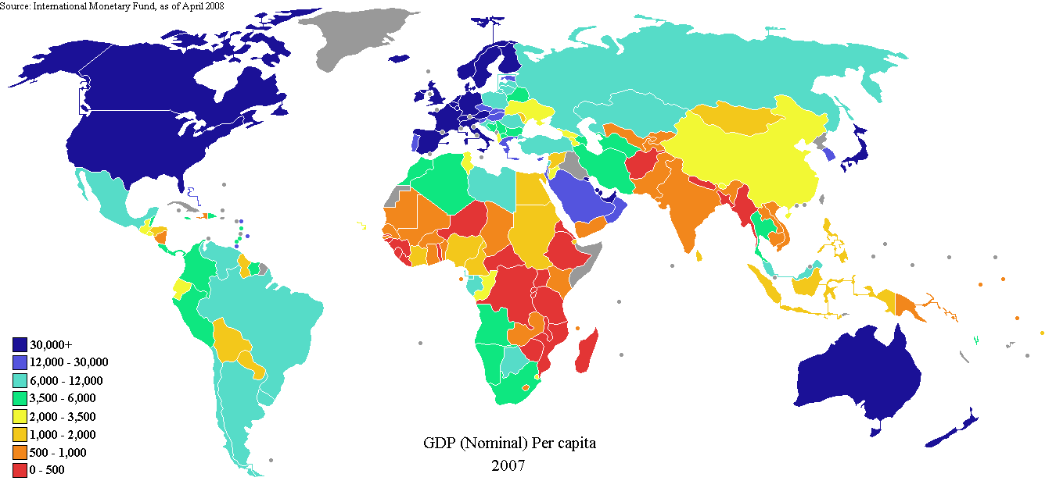
GDP

Slide 11

Monetary Policy

Slide 12

Standard of Value

Slide 13
Loan Interest

Slide 14

Banking System

Slide 15
Income Tax

Slide 16
Savings Account

Slide 17
Bank Loan

Slide 18

Progressive Tax

Slide 19
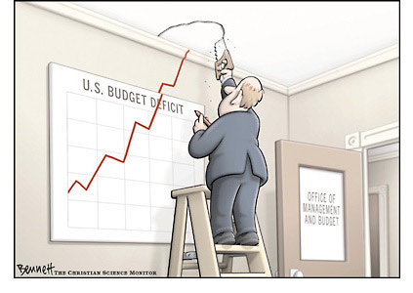
Budget Deficit

Slide 20

National Debt

Slide 21

Biotechnology

Slide 22

Globalization

Slide 23

Department of Commerce

Slide 24
North Carolina’s Economy

