Slide 1
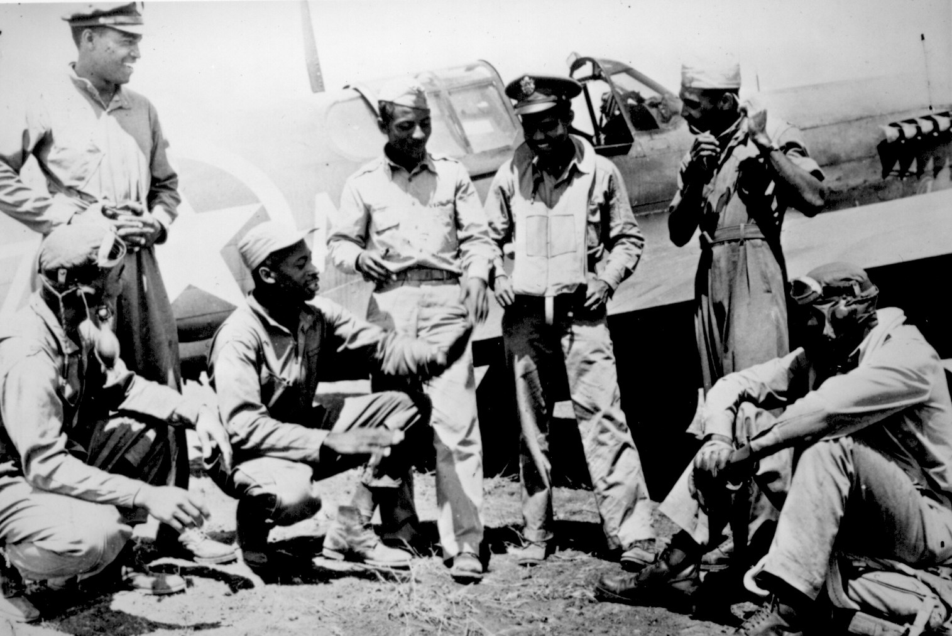
Unit 6: The Great Depression and World War II (1929 – 1949)
African-Americans continue to develop their culture and establish their place in American society during the Great Depression and World War 2.

Slide 2

Quick Review of Ch. 18
Can you discuss the struggles African-Americans had during the 1930s?
Can you discuss the advancements African-Americans made during the 1930s?

Slide 3
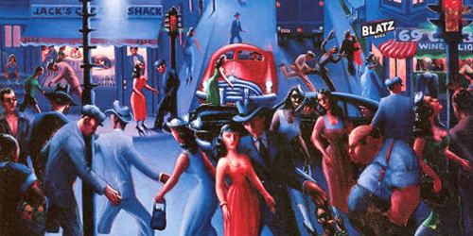
Chapter 19: Culture and Society in the 1930s and 1940s (1930 – 1949)
Music, art, sports and the church all played significant roles in the continued development of black culture during the 1930s and 1940s.

Slide 4
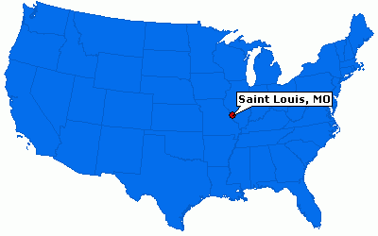
Section 1: Black Culture
Black institutions (such as schools, universities, churches, and newspapers) played an important part in helping African-American culture develop during this time.
Due to black migrants, the city of St. Louis, Missouri became a cultural center during the 30s and 40s.
Examples
Black Newspapers publicized concerts
All-Black Universities trained musicians

Slide 5
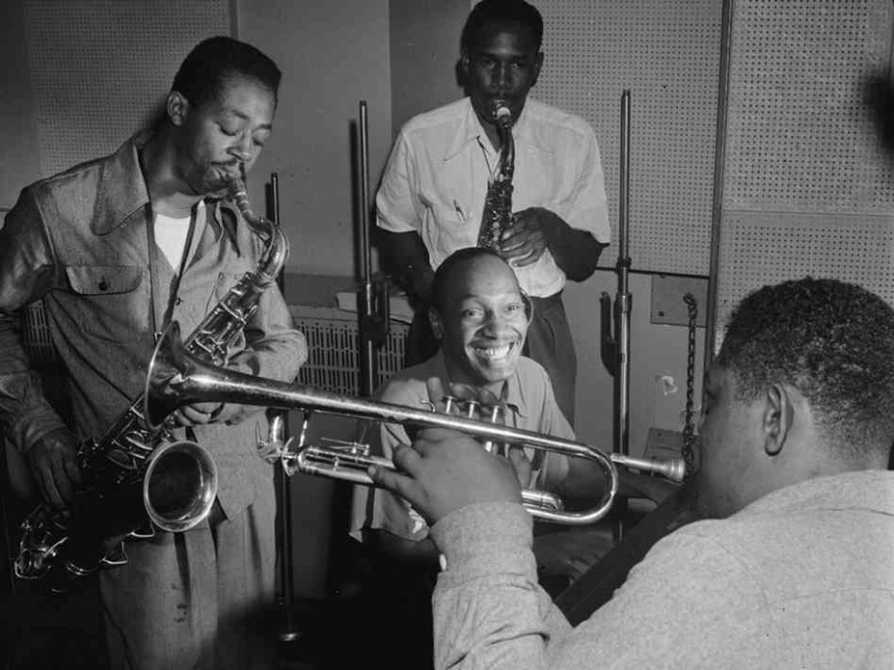
Section 1: Black Culture
The political content of black art created debate among the black community. Should art not only create beauty, but also be used to further black political freedom from oppression?
Also, if black artists wanted to make money off of their creativity, they needed to compromise and adapt their work to make it acceptable to a white audience.
Example
- Bebop (a musical style that emphasized improvisation) was the dominant black music of the 1940s. However, after 1945 when WW2 veterans returned home, they wanted slower music with simple love songs. Bebop’s popularity faded out.

Slide 6
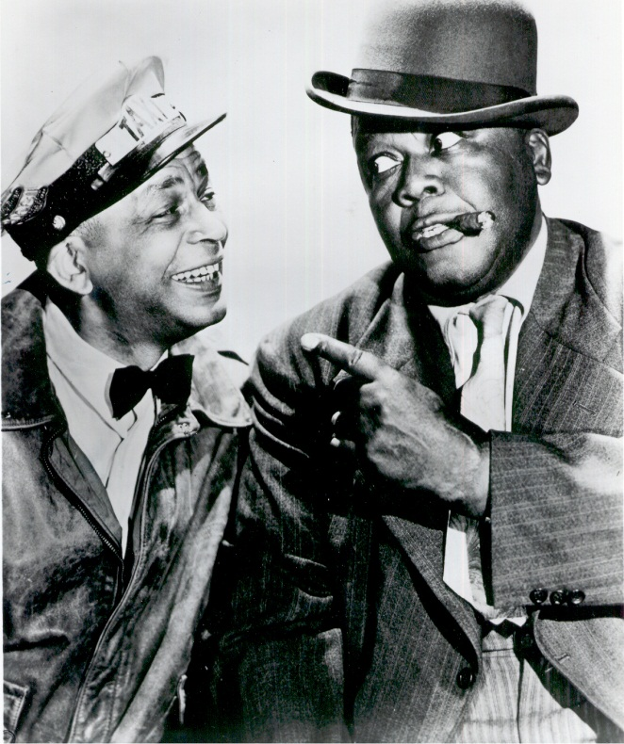
Section 2: Popular Culture for the Masses
Mainstream, commercial media often marginalized black performers and presented the audience with stereotyped black characters.
Example
The Amos and Andy Show, a popular 1930s radio program and later TV show, was a comedy that often depicted black women as bossy and black men as childish clowns.
What did you notice from The Amos and Andy Show video clip?

Slide 7
Section 2: Popular Culture for the Masses
However, African Americans produced their own popular culture intended for black audiences.
In comics and films, blacks attempted to create positive images of African Americans.
Example
The Philadelphia Independent, a black newspaper, ran a comic during the 1930s entitled ‘The Jones Family’. It emphasized black people’s desire for achievement and respectability in the face of the hardships of the Great Depression.

Slide 8
Quick Discussion
In modern popular culture, do you notice any negative stereotypes for African-Americans?
How about attempts to create a positive image of African Americans?

Slide 9
Section 3: The Black Chicago Renaissance
Chicago was the center of black culture in the 1930s and 1940s.
African Americans who migrated to Chicago looking for a better life helped to inspire a ‘Chicago Renaissance’ of black culture during this time.
The culture of the Chicago Renaissance helped influence the development of jazz, gospel and dance.

Slide 10
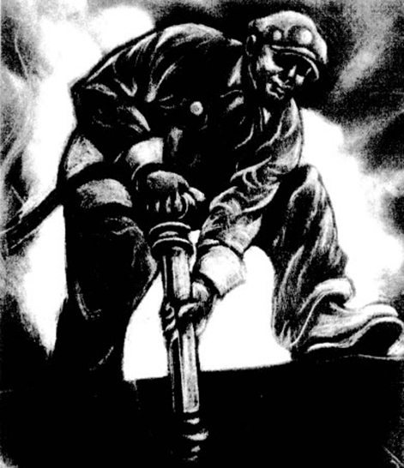
Quick Discussion
What do you think the artist is trying to communicate in this painting?

Slide 11

Section 4: Black Art and Literature
Many black artists of the 1930s considered themselves to be Social Realists, meaning that they attempted to make their art socially and politically relevant.
  For example, these artists’ work depicted the causes and consequences of the Great Depression and the realities of social and racial inequality.
Defense Worker, a painting by Dox Thrash, shows an isolated black worker, alluding to the dream of a more racially integrated labor force with equal opportunity.

Slide 12
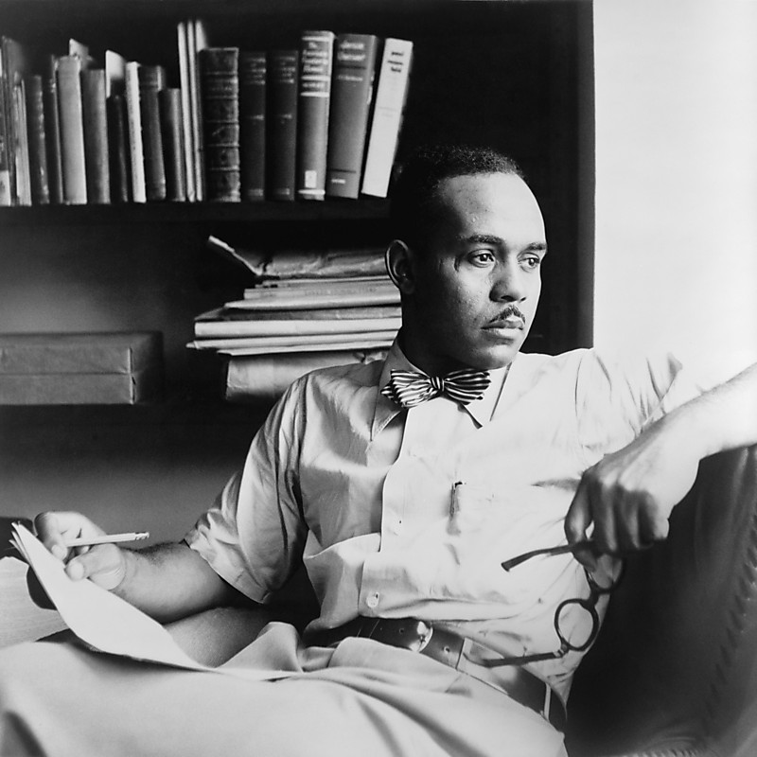
Section 4: Black Art and Literature
Black writers also explored black identity and described the reality of black urban life in America. Writers such as Richard Wright and Ralph Ellison helped present these issues to the general reading public.
Ralph Ellison’s novel Invisible Man, followed the life of a young man from the South as he migrated to New York City. The work explored class tensions within American society and within the black community, while also discussing the interaction between whites and blacks.

Slide 13

Quick Discussion Question
Can you think of any recent works of art (music, film, art, writing, etc.) that you think discusses issues that are relevant and important to the African-American community?

Slide 14
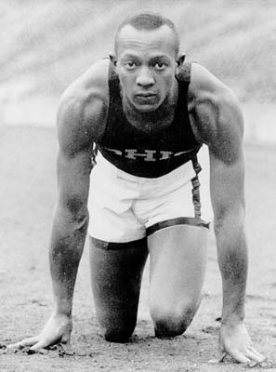
Section 5: African Americans in Sports
Athletes like Jesse Owens (Olympic Runner), Joe Louis (Boxer), and Jackie Robinson (Baseball Player) inspired blacks with pride and hope, demonstrating that blacks could compete at the highest levels of sports.
The 1936 Olympics were held in Nazi Germany during Hitler’s rule. When Jesse Owens won gold medals, Hitler left the stadium to avoid congratulating him, since Nazi’s believed blacks to be inferior. African-Americans celebrated Owen’s victory over racism.

Slide 15
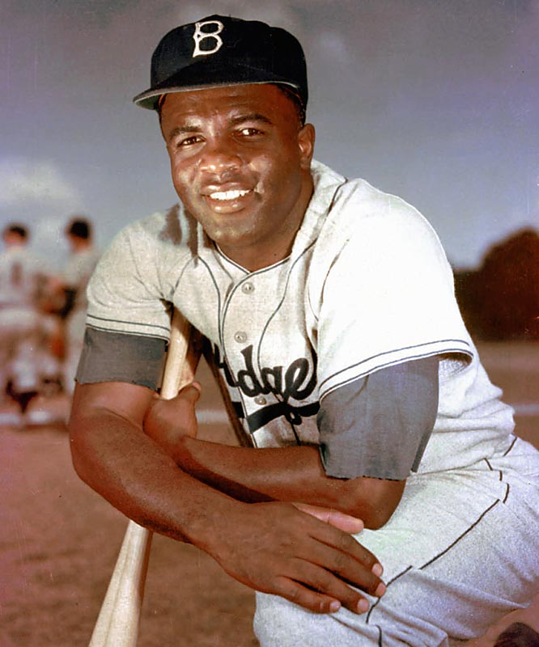
Section 5: African Americans in Sports
While sports such as track and boxing had been integrated, professional baseball remained strictly segregated… until 1947 when Jackie Robinson broke the color barrier and played 1st base for the LA Dodgers.
Robinson was a man of determination. Though taunted and threatened by some spectators and players, he responded by playing spectacular baseball and winning Rookie of the Year in 1947.

Slide 16
Quick Discussion Question
Jackie Robinson is a stand out when it comes to African-Americans professional athletes of his day. What do you think is the impact of modern-day black professional athletes?

Slide 17
Section 6: Black Religious Culture
Black churches played an important part in helping black migrants adjust to urban life.
Black Churches provided a set of core values that all blacks, rural and urban, could agree upon.
Freedom
Justice
Equality
African Heritage
The church also helped blacks through the Depression by enabling them to pool their resources together and offering them spiritual inspiration and comfort.

Slide 18
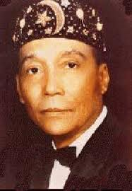
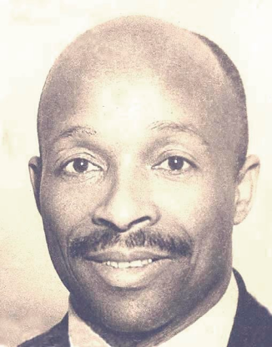
Section 6: Black Religious Culture
Alternative religious movements, such as the Nation of Islam and the Peace Mission Movement, came about during the 1930s in response to the needs of blacks during the Depression as well as the difficulties of migrating to the North.
The Nation of Islam’s leader, Wallace D. Fard, taught that black people were the true Muslims . This attracted poor blacks living in Depression-Era northern cities.
The Peace Mission Movement was led by George Baker, aka Father Divine. He preached hard work, honesty, and equality while also providing free/cheap meals and shelter for those in need.

Slide 19
Quick Review
What are some examples of how African-Americans during the 1930s and 1940s attempted to stand up for blacks and express black culture in meaningful ways?

