Slide 1
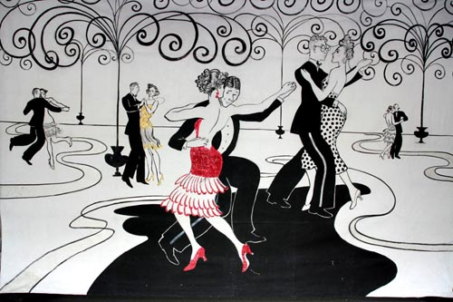
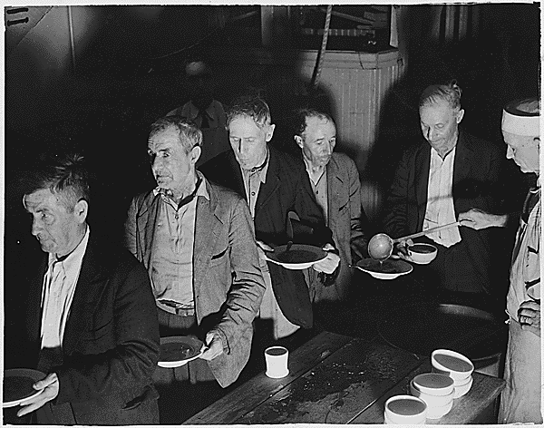
Unit 6: Prosperity and Depression
(1919 – 1941)
The United States experiences economic prosperity during the 1920s. However, the Great Depression brings about hard times, followed by government programs intended to help Americans get back on their feet.
The 1920’s
The 1930’s

Slide 2

Quick Review of The Twenties and The Great Depression (Ch. 16 – 17)
How would you describe life in America during the 1920’s?
What were some of the causes of economic decline at the end of the 1920s?
In what ways did the Great Depression impact the lives of many Americans?
How would you describe President Hoover’s response to the depression?

Slide 3
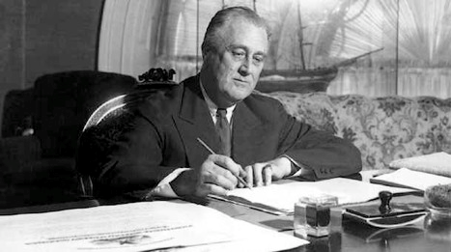
Ch. 18 The New Deal (1932 – 1941)
With Americans across the country hit hard by the Great Depression, the federal government attempted to lend folks a hand while also trying to spark economic growth.

Slide 4
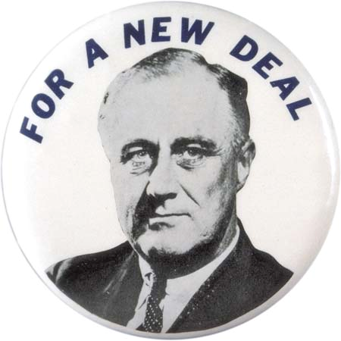
Section 1: FDR Offers Relief and Recovery
Franklin Delano Roosevelt (FDR) easily defeats Herbert Hoover to win the presidential election of 1932, promising strong action by the federal government to combat the depression. He promised them a ‘New Deal’.

Slide 5
The First New Deal
3 Primary Goals of the First New Deal
  Relief, Recovery, and Reform
*Key Idea* Roosevelt’s policies would begin a new era of increased federal government involvement to protect the economy and provide for the needs of the American people.*

Slide 6
Key Acts Under Roosevelt
Federal Deposit Insurance Corporation (FDIC)
  Insured bank deposits up to $5,000
Civilian Conservation Corps (CCC)
  Provided jobs for young men replanting forests, building trails, digging irrigation ditches, and fighting fires
National Recovery Administration (NRA)
  Developed codes of fair competition to govern industries and promote economic growth
Public Works Administration (PWA)
  Created jobs for building bridges, dams,
  power plants and government buildings

Slide 7
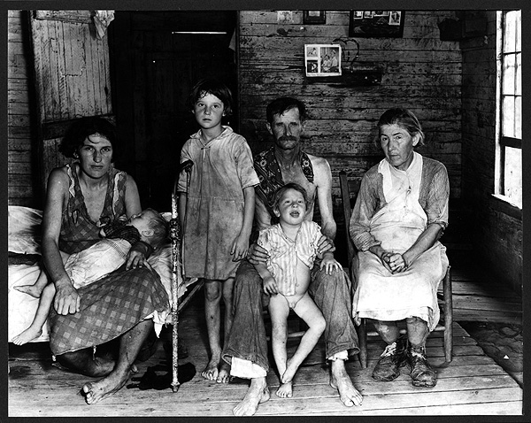
Section 2: The Second New Deal
Progress had been made under the first New Deal, however much work remained to be done. In 1935 Roosevelt announced the ‘Second New Deal’ to address the many social needs of the American people.

Slide 8
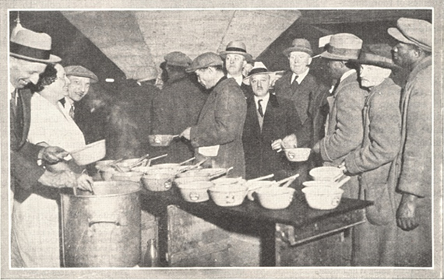
Goals of the Second New Deal
Help the elderly, poor, and unemployed
Create new public-works projects
Help farmers get back on their feet
Protect workers’ rights
Hungry Americans waited in lines at soup kitchens.

Slide 9
Key Acts of the Second New Deal
Works Progress Administration (WPA)
  Built or improved highways, dredged rivers and harbors, and promoted soil and water conservation (Creating Jobs)
Social Security Act
  Created a pension system for retirees and established unemployment insurance for workers who lost their job
Wagner Act
  Recognized the right of workers to join labor unions and use collective bargaining
Fair Labor Standards Act
  Established a minimum wage (25 cents per hour)
  and maximum workweek of 44 hours

Slide 10

Quick Discussion
During the Great Depression, President Roosevelt’s administration increased the federal government’s role in the economy and society in an attempt to help Americans who had fallen on hard times.
Can you think of any ways the US government in modern times attempts to help those in need? (unemployed, elderly, disabled, poor)
  Any ways this can be effective or ineffective?

Slide 11
Section 3: Effects of the New Deal
*Key Idea* The New Deal provided relief from the depression and guarded against further economic catastrophe, however it did not end the depression.
The impact of massive military production and spending during World War II in the 1940s actually ended the depression.

Slide 12
Section 3: Effects of the New Deal
The Federal Government became actively involved in trying to create economic growth
The government began taking responsibility for the welfare of children and the poor, elderly, sick, disabled, and unemployed
The creation of new federal agencies increased the power of the President and the Executive Branch

Slide 13
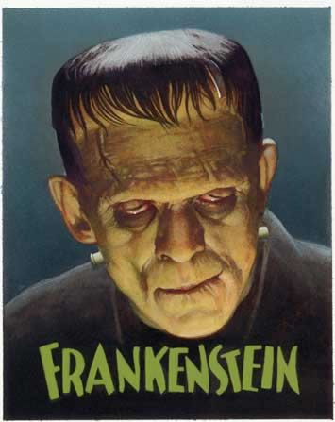


Section 4: Culture of the 1930’s
Movies became really popular during the 30’s.
Why do you think that was?

Slide 14

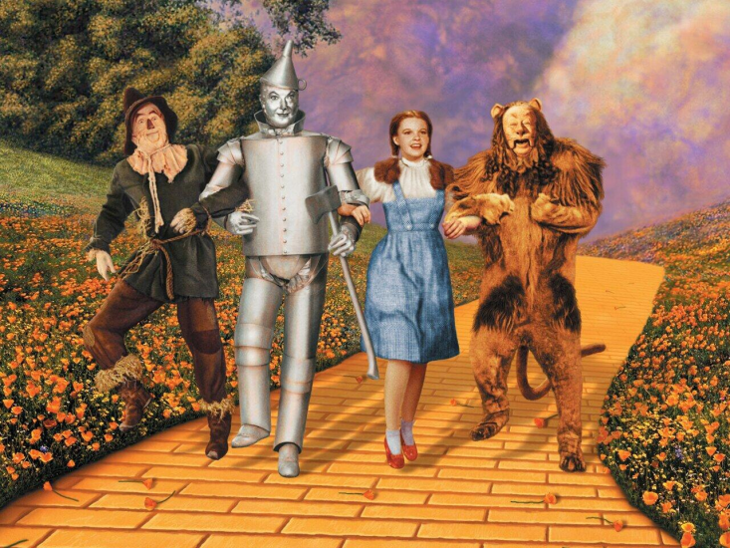
Culture of the 1930’s
Thanks to radio and movies, entertainment became big business as many Americans looked for ways to escape the difficulties of real life.
  Ex: Snow White, Frankenstein, Gone With the Wind, The Lone Ranger, The Shadow
Films such as The Wizard of Oz helped people believe that maybe their dreams really could come true.

Slide 15
Quick Discussion
What are some ways Americans nowadays try to escape the difficulties of real life?

Slide 16

The New Deal Supports the Arts
For the first time the government provided $ to help fund the arts.
Federal Art Project
  Provided work for artists to create artworks for public buildings and sponsored art-education programs and exhibitions

Slide 17
Quick Review
What was the New Deal and what did it seek to accomplish?
How did the New Deal transform the role of the US government?
What is your opinion of the New Deal?

