Slide 1

Using your textbook effectively.
Outline at Beginning of Chapter (p.5)
Pay attention to bold print words. (p. 7)
Glossary at back of book (p.931)
Timelines at the end of each chapter are helpful. (page 30)
Very Helpful! Chapter Review and Assessment at the end of each chapter. (p. 32)

Slide 2
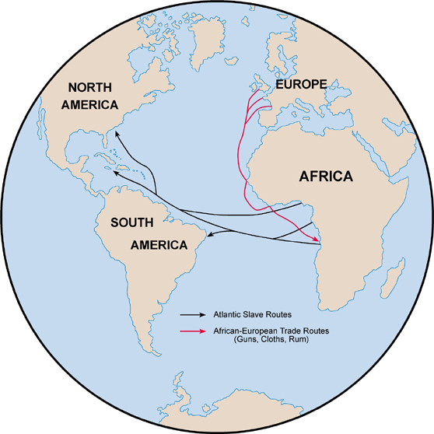
Unit 1: From West Africa to the Early Americas (Ancient Times – 1763)
The Atlantic Slave Trade brings West Africans to the Colonies of the Americas.

Slide 3
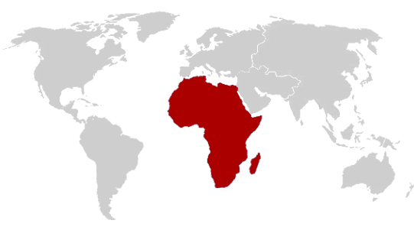
Chapter 1: Africa
6000 BC – 1600 AD
Africa is home to many ancient civilizations.

Slide 4
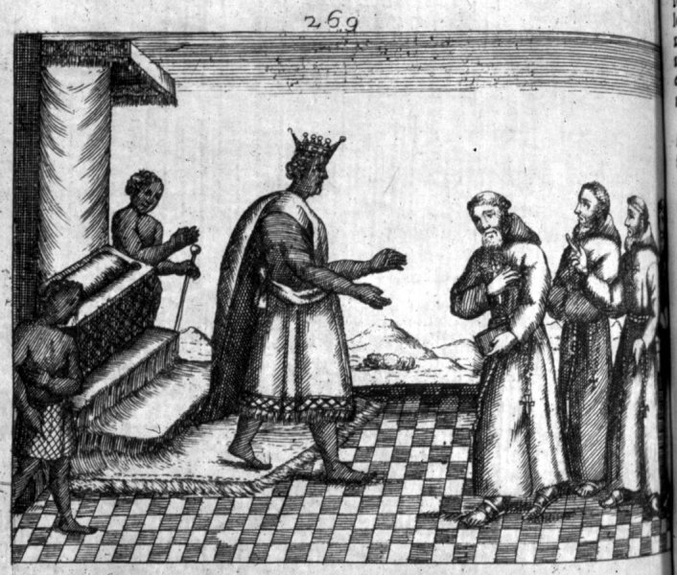
Interesting Quote
“These West African nations think themselves the foremost men in the world, and nothing will persuade them to the contrary. They imagine that Africa is not only the greatest part of the world but also the happiest and most agreeable.”
      Father Cavazzi, 1687

Slide 5
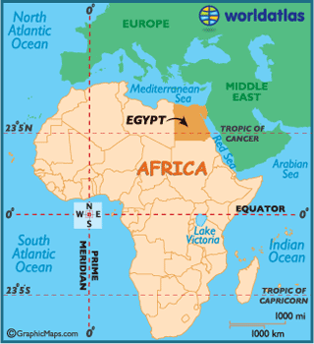
Section 1: Africa
Large and geographically diverse continent
  Desert, Coast, Rain Forest, Grasslands, etc.
Believed to be the ‘birthplace’ of humanity
Ancient Egypt – one of the earliest civilizations in world history
  Egyptian King = Pharaoh
Other Ancient African Kingdoms
  Kush, Meroe, and Axum

Slide 6
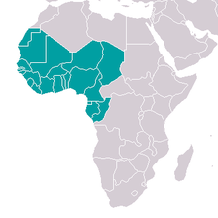

Section 2: West Africa
West African Kingdoms Rise and Fall
  Ancient Ghana (c. 350 – c. 1200 AD)
  Mali (1230 – 1468 AD)
  Songhai (1464 – 1591 AD)
    What was the source of their power?
      Wealthy Trading Networks
        Goods such as: pepper, slaves, and especially gold

Slide 7
Section 2: West Africa
West Africans served as both slave traders and slaves themselves.
Most African-Americans trace their roots to the Western region of Africa.
  Quick Discussion: Why do you think that is???

Slide 8
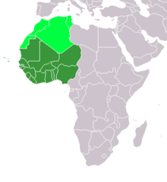
Section 3: West African Society and Culture
By the early 16th century, most West Africans were farmers.
Family Connections
  Depending on the ethnic group, extended families and lineages were either patrilineal or matrilineal.
    Patrilineal: tracing descent through the male line
    Matrilneal: tracing descent through the female line

Slide 9
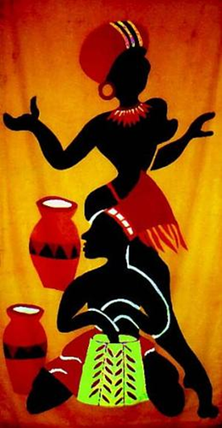
Section 3: West African Society and Culture
“Key Concepts”
In general, men dominated women in West Africa.
Slavery was a part of the social structure since ancient times.
Religion: Islam or Indigenous (Local Beliefs)
Art and Music: Connected to Local Religion
Literature: Orally passed from generation to generation.

Slide 10
Quick Review Questions
Ch. 1 Africa
How would you describe the continent of Africa?
Why are we focusing on West Africa for African-American studies?
How would you describe West African culture?

