Slide 1
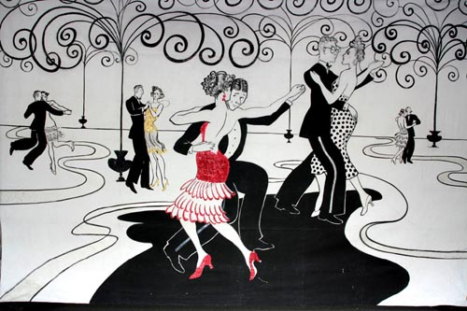
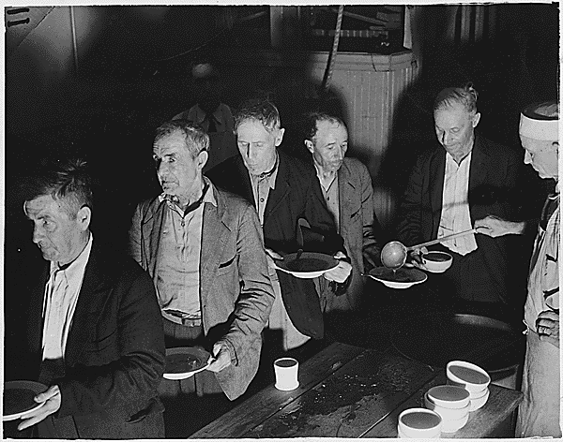
Unit 6: Prosperity and Depression
(1919 – 1941)
The United States experiences economic prosperity during the 1920s. However, the Great Depression brings about hard times, followed by government programs intended to help Americans get back on their feet.
The 1920’s
The 1930’s

Slide 2
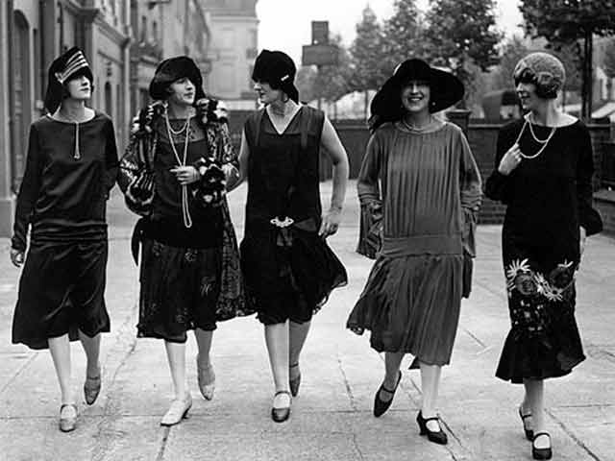
Quick Review of the Twenties
How would you describe life in America during the 1920’s?
What effect did Prohibition have on society?
What was the Harlem Renaissance?

Slide 3
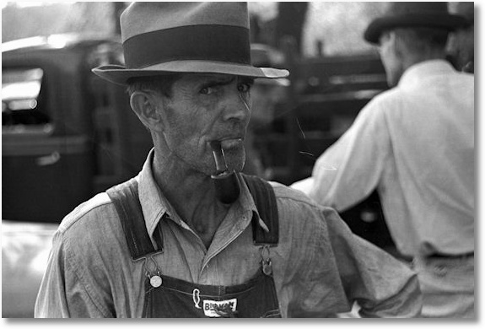
Chapter 17: The Great Depression
1928 - 1932
When the US economy collapsed at the end of the 1920s, Americans faced unemployment and the government struggled to find the answers for the crisis.

Slide 4

Section 1: Causes of the Depression
After enjoying a decade of prosperity, the US market crashed in the Fall of 1929. As production fell and unemployment rose, Americans faced a period of economic decline.

Slide 5

Causes of the Depression
Overproduction and Under-consumption of Agricultural Crops
Uneven Distribution of Income
  Not enough really wealthy people to spend money and build up a healthy economy.
Many Consumers Developed Debt
  People were living beyond their means. They were using credit to buy things they couldn’t actually afford.
Stock Market Investors Take Many Risks
  They were essentially gambling, often with money they didn’t really have, with the hopes of gaining a quick profit.
  This helped create an unstable stock market, and on
  October 29, 1929 (Black Tuesday) the market crashed.
  Billions of dollars were lost.

Slide 6
Quick Discussion
Can you think of anything that might threaten the United States economy in modern times?

Slide 7
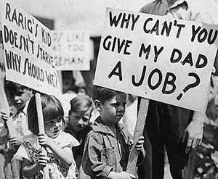
Effects of the Depression
Banks and Businesses Fail
Heavy Unemployment
Personal Income Declines
The International Economy Declines as Europeans Had Depended on US Loans

Slide 8
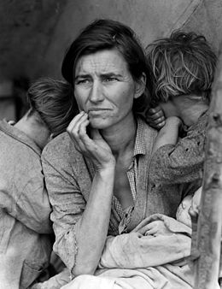
Section 2: Americans Face Hard Times
By 1933, the unemployment rate was around 25%
Families faced homelessness and hunger
Many farmers were unable to pay their mortgages, so they lost their farms

Slide 9
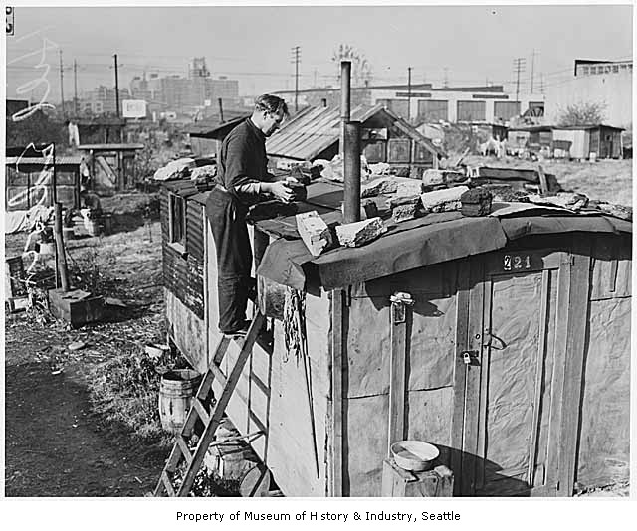
Section 2: Americans Face Hard Times
Many who were homeless grouped together into makeshift shantytowns of tents and shacks built on public land or vacant lots.
  These communities became known as Hoovervilles, named after President Hoover and the blame many placed on him for their hardships.

Slide 10
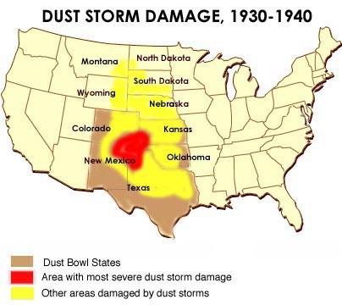
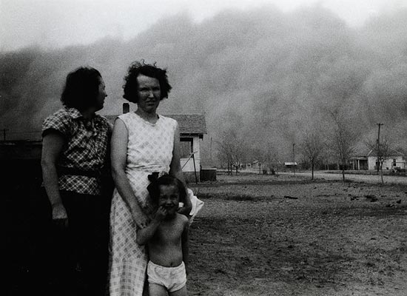
Section 2: Americans Face Hard Times
In addition to economic depression, the combination of drought and high winds in the Great Plains (Texas, Oklahoma, Kansas, New Mexico, etc.) created dust storms, adding to the misery of farmers living in the ‘Dust Bowl’.
The combination of financial hardship and dust storms caused many farm families of the Midwest to move to cities in hopes of better opportunities.

Slide 11
Quick Discussion
What do you imagine people in modern times might do in the United States if we were to face an economic crisis as severe as that of the Great Depression? How might people respond?

Slide 12
Section 3: President Hoover’s Response Fails
Initially, President Hoover tried to avoid federal government interference in the economy.
He hoped that local governments and volunteers would help those in need and that the economy would naturally recover.

Slide 13
Section 3: President Hoover’s Response Fails
Hoover eventually supported government loans to large businesses in an attempt to spark the economy, however it was too late for him in the eye of the public.
Many felt Hoover was not leading the country out of the economic depression and they blamed him for their suffering. In the election of 1932 Americans would voice their disapproval.

Slide 14

Quick Review
Why did the US enter an economic depression at the end of the 1920’s?
How did the Great Depression impact the lives of many Americans?
How would you describe President Hoover’s response to the depression?

