Slide 1
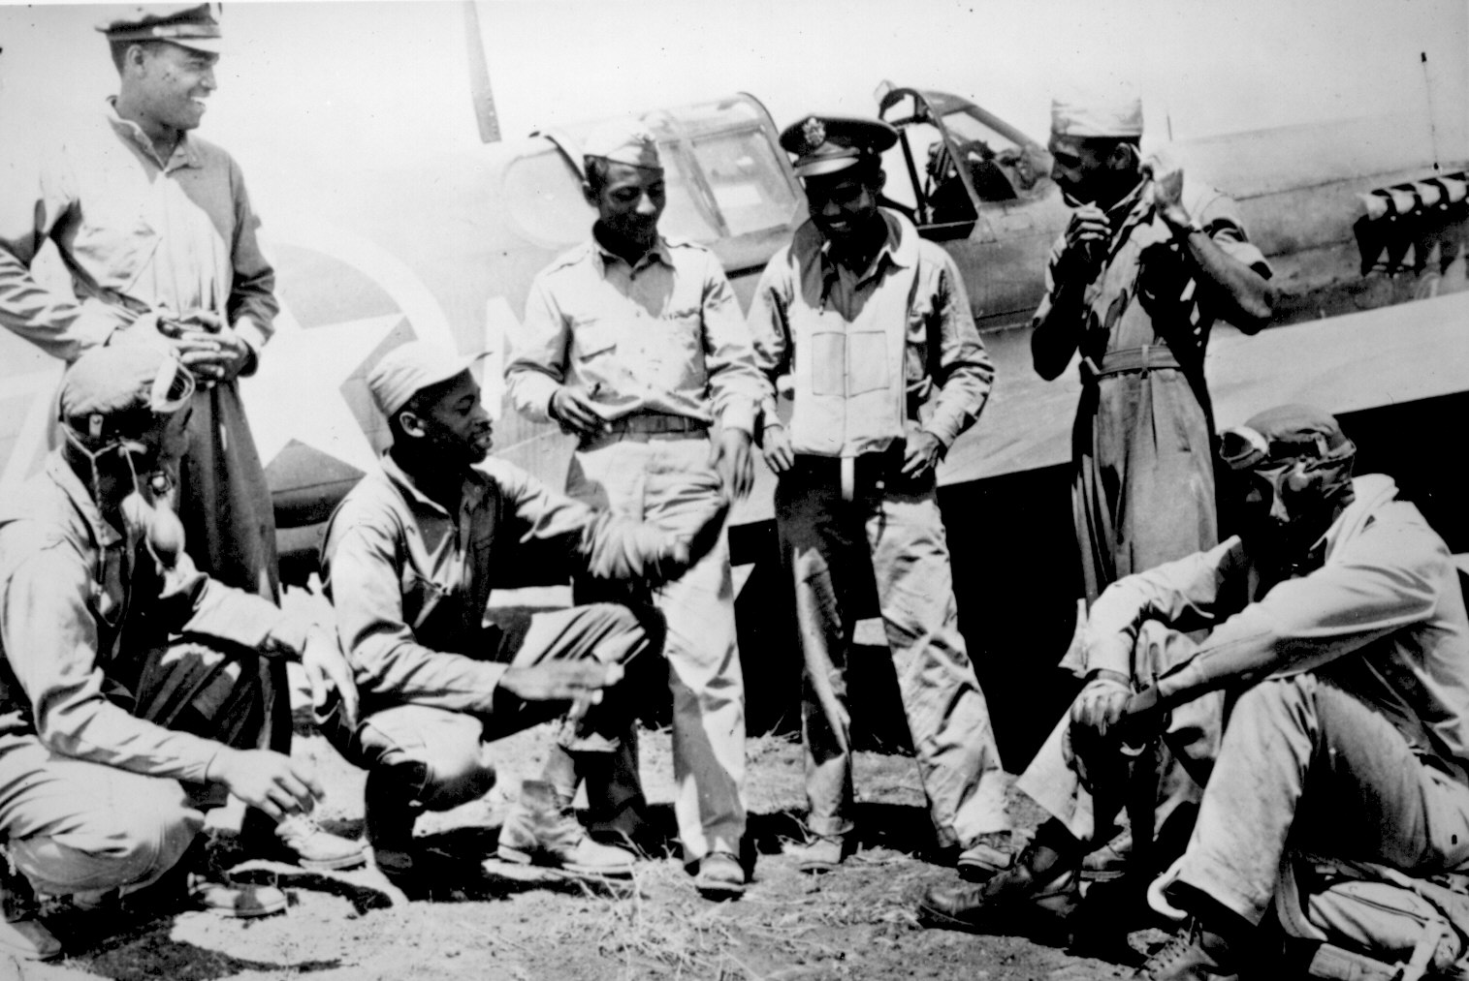
Unit 6: The Great Depression and World War II (1929 – 1949)
African-Americans continue to develop their culture and establish their place in American society during the Great Depression and World War 2.

Slide 2
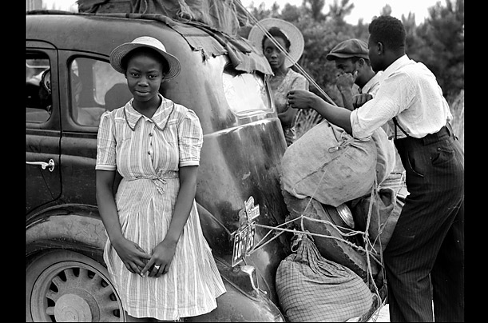
Ch. 18: Black Protest, the Great Depression, and the New Deal (1929 – 1941)
Both whites and blacks were hit hard by the Great Depression of the 1930s. During the economic depression, organizations such as the NAACP and even the Communist Party supported blacks in their continued struggle for civil rights.

Slide 3

Section 1: The Great Depression
(The early years, 1929 – 1933)
Due to a variety of factors, starting around 1929 the US experienced an economic collapse known as the Great Depression.
Effects of the Depression
  Very High Unemployment
  People Lost Their Savings
  National Income fell by
  more than 50%

Slide 4
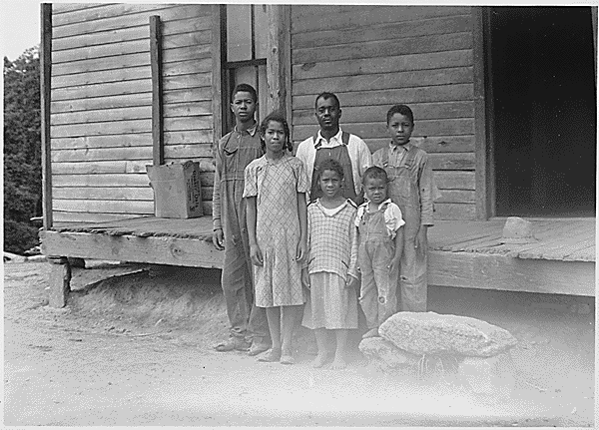
Section 1: The Great Depression
(The Early Years, 1929 – 1933)
The Depression hit African-Americans particularly hard as blacks across the country suffered unemployment rates and a decline in income that was even greater than that of whites.
Hard times effected not only poor blacks, but black business owners and the black professional class as well.
By 1934, about 17% of whites could not support themselves. About 38% of blacks could not support themselves.

Slide 5

Quick Discussion
Why do you imagine that blacks had a higher rate of unemployment than whites during the Great Depression?

Slide 6
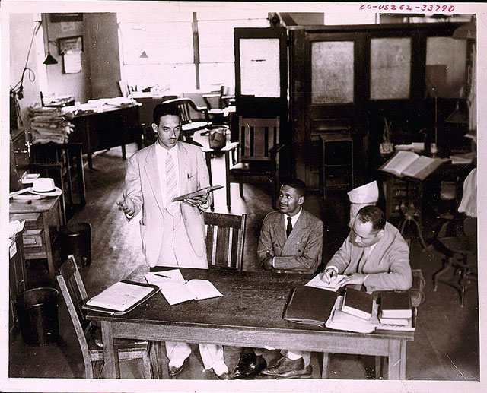
Section 2: Black Protest During the Great Depression
During the 1930s, the NAACP (National Association for the Advancement of Colored People) effectively fought for civil rights.
Through strong leadership and their continued attempts through the court system, the NAACP worked hard to protect African-American rights and end discrimination.
However, some black people (especially younger blacks) criticized the NAACP for focusing on civil rights rather than the economic struggles so many were facing.

Slide 7
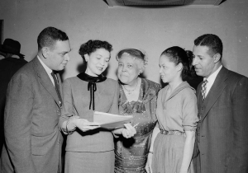
Section 2: Black Protest During the Great Depression
Black women made exceptional contributions to the NAACP during the 1930s.
  They helped to raise money, fight segregation and lynching, and gain members for the NAACP.
Can you think of some ways that black women continue to play an important role in the African-American community in modern times?

Slide 8
Section 3: The New Deal
As most Americans were unhappy with President Hoover’s limited efforts to create government solutions for the depression, Franklin D. Roosevelt (FDR) easily won the presidential election of 1932.
He immediately began to push policies and federal government programs intended to spark the economy, create jobs, and help the needy. His campaign was called ‘The New Deal’.
New Deal programs helped many African-Americans. Although at first whites tended to receive more benefits, by 1935 benefits were more equal.

Slide 9
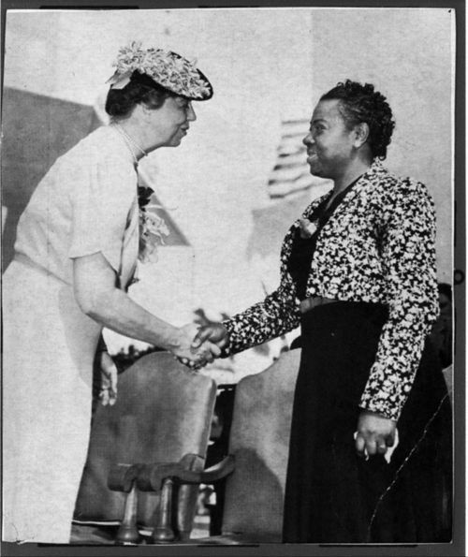
Section 3: The New Deal
African-Americans gained new influence and support under the Roosevelt Administration.
The work of black scientists and scholars was more well received during this time.
In fact, First Lady Eleanor Roosevelt was well known for her commitment to racial justice. She invited black leaders to the white house and even defied Jim Crow laws by refusing to sit in a ‘white only’ section while at a meeting in the South.

Slide 10
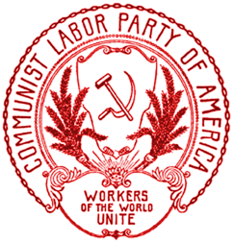
Section 4: The Communist Party and African Americans
During the 1930s, the Communist Party sought to gain the support of blacks, as the party supported African-Americans’ efforts to seek social and economic justice.
Some African-Americans were attracted to the Communist Party for several reasons.
It was against racism and sought to be interracial.
It gave black men key leadership positions.
It criticized white labor unions who refused blacks.

Slide 11
Section 4: The Communist Party and African Americans
Black public opinion of the Communist Party was split, but in the end most African-Americans were unwilling to abandon the traditional American political system of democracy for communism.

Slide 12
Quick Discussion Question
What is Communism?
Why do you think the Communist Party in America was against racism?

Slide 13
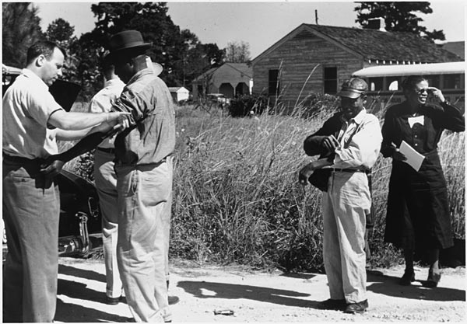
Section 5: The Tuskegee Study
The Tuskegee Study, which occurred in Alabama, during the 1930s was one of the worst cases of racism in American science.
The purpose of the study was to chart the course of untreated syphilis, an STD that can cause paralysis, insanity, and heart failure.
U.S. Public Health Service officials conducting the study recruited 622 black men, 431 of whom had the disease of syphilis.
The men were told they were receiving treatment, but in fact they all received placebos (ex: a pill that does nothing).
The program lasted for almost 40 years
and did not come to the attention of the
general public until 1972.
The government paid a $9 million
settlement to the Tuskegee survivors
and the descendants of those who
had died.

Slide 14
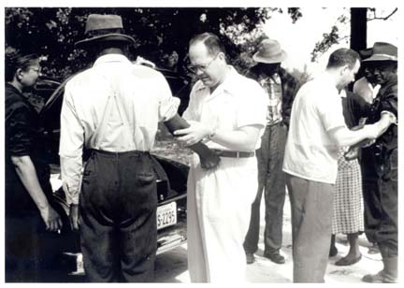
Quick Discussion Question
The Tuskegee Study. Wow, pretty messed up right? What are your thoughts on this event? How and why was this allowed to happen?

Slide 15

Quick Review
Can you discuss the struggles African-Americans had during the 1930s?
Can you discuss the advancements African-Americans made during the 1930s?

