Slide 1
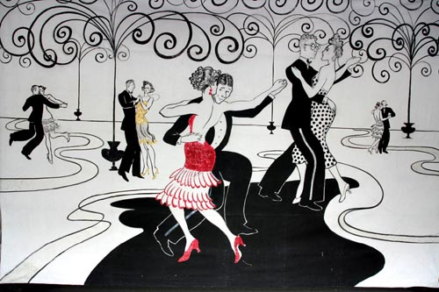
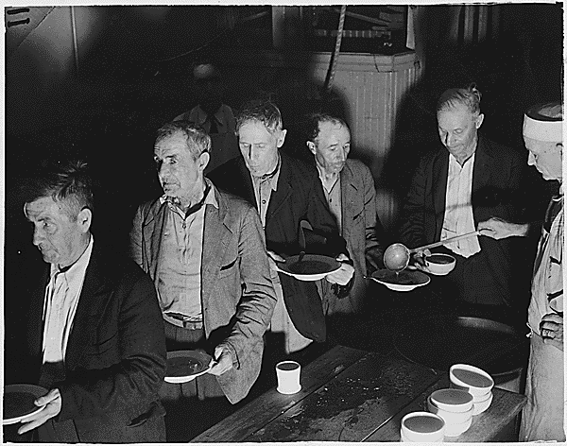
Unit 6: Prosperity and Depression
(1919 – 1941)
The United States experiences economic prosperity during the 1920s. However, the Great Depression brings about hard times, followed by government programs intended to help Americans get back on their feet.
The 1920’s
The 1930’s

Slide 2
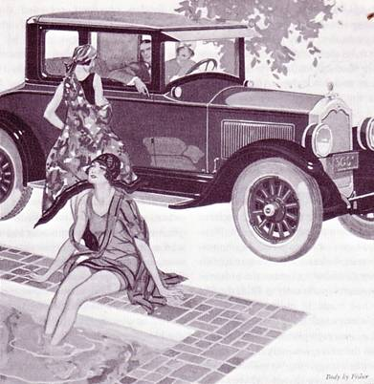
Chapter 16: The Twenties
(1919 – 1929)
During the 1920s, the decade following World War 1, the United States experienced booming economic growth and social changes.

Slide 3
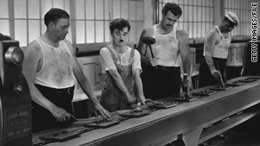
Section 1: A Booming Economy
Following WW1, the American economy experienced tremendous growth.
Using mass-production techniques, American workers produced more goods in less time.
Mass Production: the rapid manufacture of large numbers of identical products
Ex: Producing the buttons for a typewriter.

Slide 4
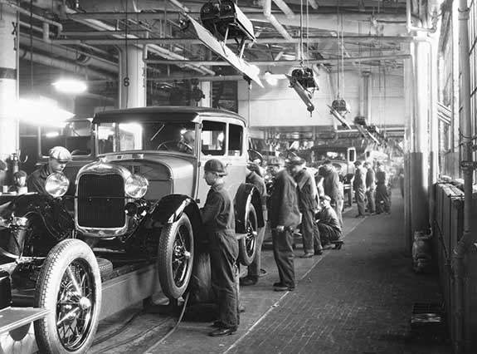
The Automobile Drives Prosperity
In 1908 carmaker Henry Ford introduced the Model T, a reliable car that the average American could afford.
Ford’s methods and ideas revolutionized production, wages, working conditions, and daily life for Americans.
- Ford used the assembly line to build his cars, allowing his workers to build a car faster and at a lower sales price.
- The growth of the automobile industry led to the growth of other industries, such as: steel, glass, rubber, gasoline, insurance, and road construction.

Slide 5
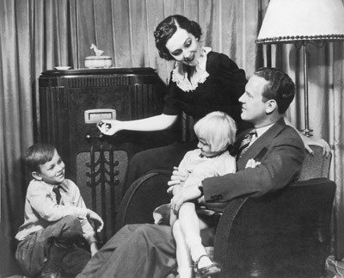
Consumer Revolution
The widespread availability of electrical power sparked a consumer revolution during the 1920s
  Many new, affordable goods became available to the public
    Washing Machines
    Vacuum Cleaners
    Radios
    Refrigerators
The Consumer Revolution was also fueled by Americans starting to buy products using credit, or making monthly payments over time rather that paying all at once.

Slide 6
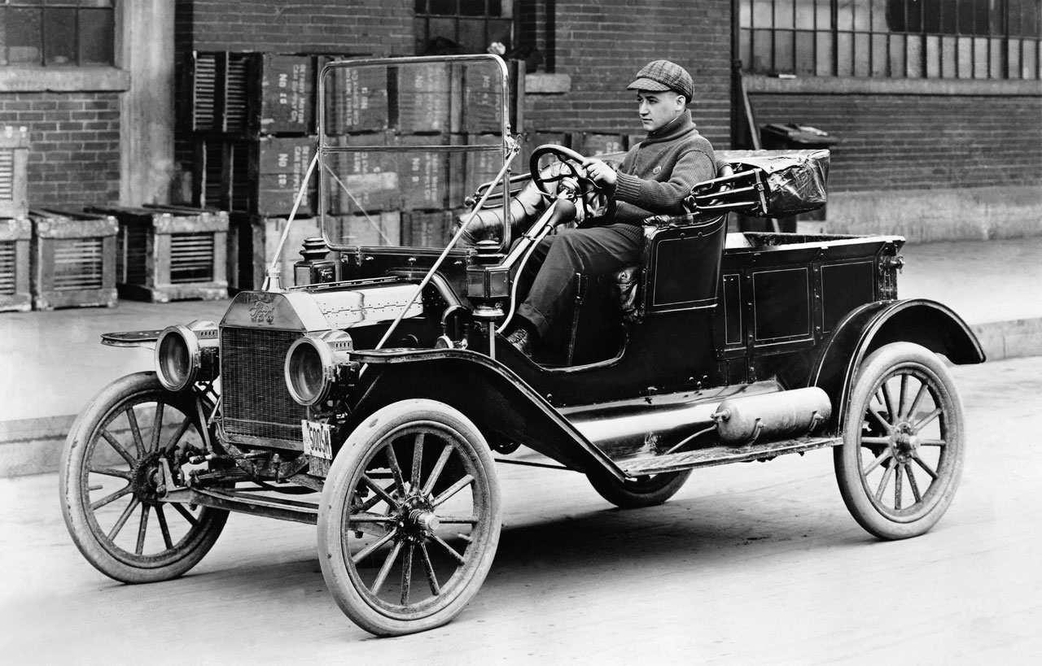
Quick Discussion
What are some ways that you think the invention of the automobile changed the daily lives of Americans during this time?

Slide 7
Section 2: The Business of Government
Presidents Warren G. Harding and Calvin Coolidge
  Instead of seeking to change government as the Progressives had done, they favored more conservative (traditional) policies that helped aid the growth of business.
  Under their leadership the US continued to play an increasingly important role in world business and trade.
  Foreign Policy = Trying to avoid another World War

Slide 8
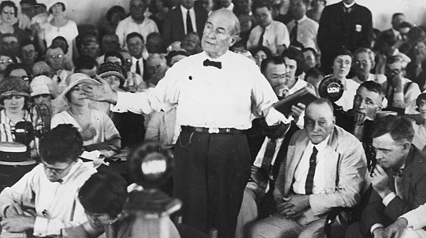
Section 3: Social and Cultural Tensions
Modernism vs. Fundamentalism
  Modernism: emphasized science and secular values over traditional ideas about religion
  Fundamentalism: emphasized traditional views on religion and the belief that the Bible is literally true
The Scopes Trial in 1925 displayed the conflict between modernism and fundamentalism. John Scopes was put on trial for teaching the theory of evolution in a Tennessee public school, which was against the law. In the end, he was found guilty of breaking the law and fined.

Slide 9
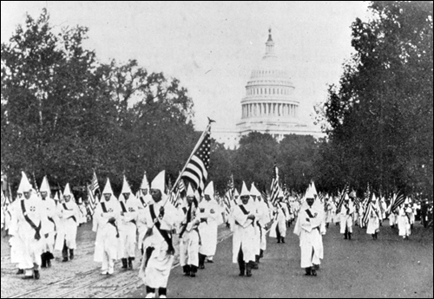
Section 3: Social and Cultural Tensions
Some Americans, known as Nativists, fought to oppose immigration. They argued that new immigrants took away jobs from native-born workers and threatened American traditions.
Also, the Ku Klux Klan (KKK) revived as its members believed America’s increasing diversity and urbanization was bad for the country.
  They promoted prejudice against blacks, Jews, Catholics and immigrants.
Why do you think KKK members were so strongly against these minority groups?
What are your opinions on the KKK?

Slide 10
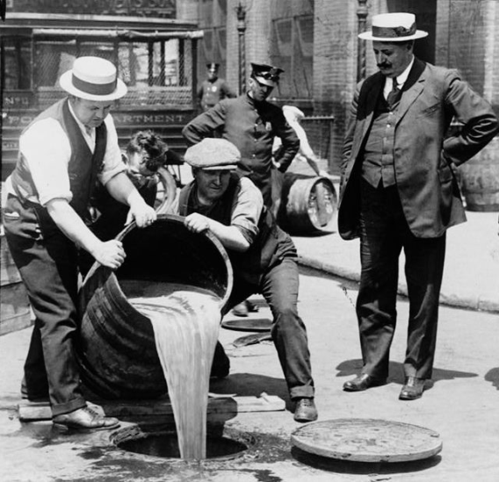
Prohibition and Crime
Since the early 1800s, reformers had fought for prohibition (the prohibiting of alcohol use).
In 1919, the 18th Amendment banned the manufacture, distribution, and sale of alcohol.
Positives of Prohibition
Supporters argued that it strengthened families and communities
Alcoholism and liver disease declined
Negatives of Prohibition
Opponents argued that it created an atmosphere of hypocrisy
Many Americans broke the law and drank anyway, leading to a rise in organized crime.

Slide 11
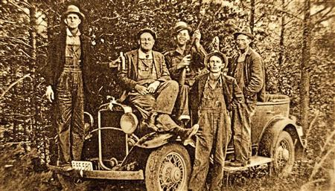
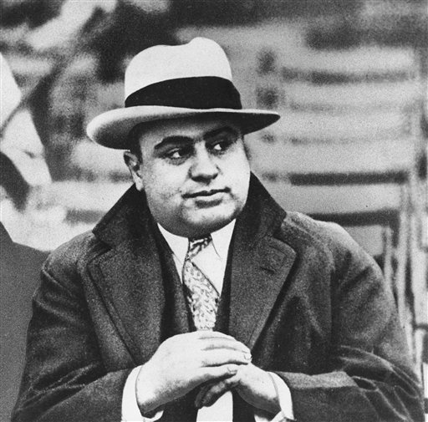
Prohibition and Crime
In rural areas, Moonshiners provided illegal alcohol for those who wanted a drink.
In urban areas, gang leaders, such as Al Capone, got rich by providing illegal alcohol, usually in secretive clubs.
  Capone argued it was merely a ‘business’. The problem is his other ‘businesses’ included prostitution, drugs, robbery and murder.
Moonshiners
Americans remained divided over the issue of prohibition until 1933, when the 21st Amendment repealed (reversed) prohibition.
Chicago Gangster Al Capone

Slide 12
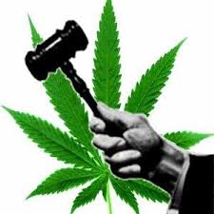
Quick Discussion
In modern times the issue of legalizing marijuana is a topic of debate. It is illegal in most states, but in some states it is legal for medical purposes, and even for recreational use in states like Colorado and Oregon.
Do you think marijuana should be legal throughout the US? Why?
What are the possible benefits and harmful effects of legalizing marijuana?

Slide 13
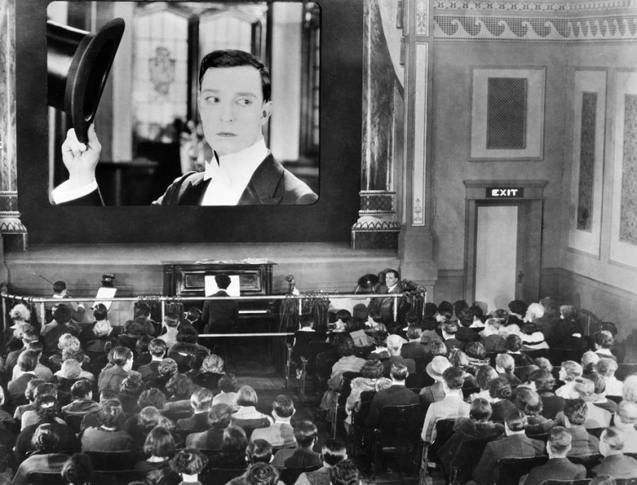
Section 4: A New Mass Culture
Several factors during the 1920s encouraged the development of a shared popular culture among Americans
  Cars made it easier for people to travel
  City dwellers were starting to work less hours, so they had more leisure time
  Radios helped Americans learn the same songs and dances
  Movie theaters allowed Americans to share the same experiences of Hollywood Movies

Slide 14
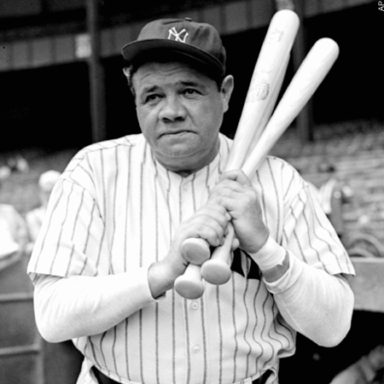
An Age of Heroes
World War I had destroyed many American’s belief in progress in the world.
During the 1920s, sports heroes helped reassure Americans that people were still capable of doing great things.
Perhaps no one stood out more during an Age of Sports Heroes than the famous Babe Ruth. He was a great pitcher for the Boston Red Sox and an even greater hitter for the New York Yankees.

Slide 15
Quick Discussion
In modern times, who do you think Americans look to as their ‘heroes’? Why?

Slide 16
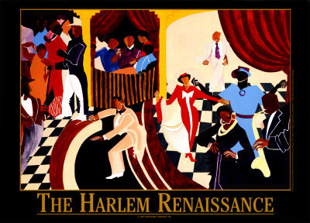
Section 5: The Harlem Renaissance
During the 1920s, many African-Americans continued to migrate to the urban north.
With more blacks living in northern cities, the expression of black culture began to grow.
  Nowhere did this take place more than in Harlem, New York.

Slide 17
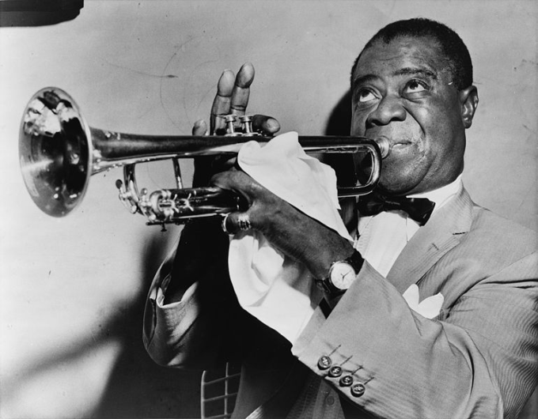
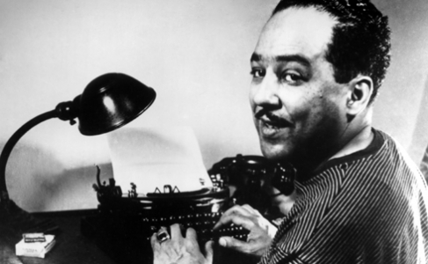
Section 5: The Harlem Renaissance
African-American authors, poets, artists and musicians used their talents to express the pains and joys of being black in America.
The movement gave a voice to black culture.
While the Harlem Renaissance ended with the economic collapse at the end of the 1920s, it still helped to create a sense of black identity that would became a foundation for the civil rights movement to come later down the road.
Poet Langston Hughes
Musician Louis Armstrong

Slide 18

Quick Review
Chapter 16: The Twenties
How did the US experience economic growth during the 1920s?
What are some examples of social tension in the US during this time?
What was the Harlem Renaissance?

