Slide 1
Test on Chapters 14 - 17 Unit 5: Life in Post-Slavery America (1875 – 1928)
Review your notes for chapters 14 - 17
Focus on Key Concepts and Terms
About 20 - 30 questions
T/F, MC
2 Essay Questions
Mr. Gay will inform you of the topics.

Slide 2
Essay Question Choose two of the following topics and then write a 1 – 2 paragraph response for each one.
Can you discuss the various hardships and challenges that African-Americans faced during the late 1800s and early 1900s?
Can you discuss the various ways that African-Americans attempted to overcome hardships and better their lives during the late 1800s and early 1900s?
What was the Harlem Renaissance and why is it so significant to African-American Studies?

Slide 3
How will essays be graded?
Essay Grading Criteria
Does your response accurately answer the question?
Did you use examples to support your answer?
Is it 1 – 2 paragraphs and well written?
Is the grammar and spelling mostly correct?
Does the sentence structure fit together to form a well-organized paragraph(s)?

Slide 4
Prepare for your Test
Review your notes
Review your chapter assessments
Review and practice writing out the essay questions and your answer
Make flashcards / a study sheet
Quiz each other
Review todaysmeet.com content

Slide 5
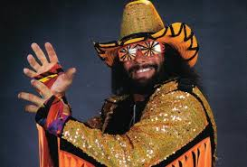
Any questions about your test?

