Slide 1
Ch. 16 Discussion Questions
What role does government play in our economy?
In what ways does the govt. try to fix economic problems?
Do you think the govt. of the U.S. is too involved, not involved enough, or just the right amount of involved in our economy? Can you explain your answer?

Slide 2


Ch. 17: Money and Banking

Slide 3
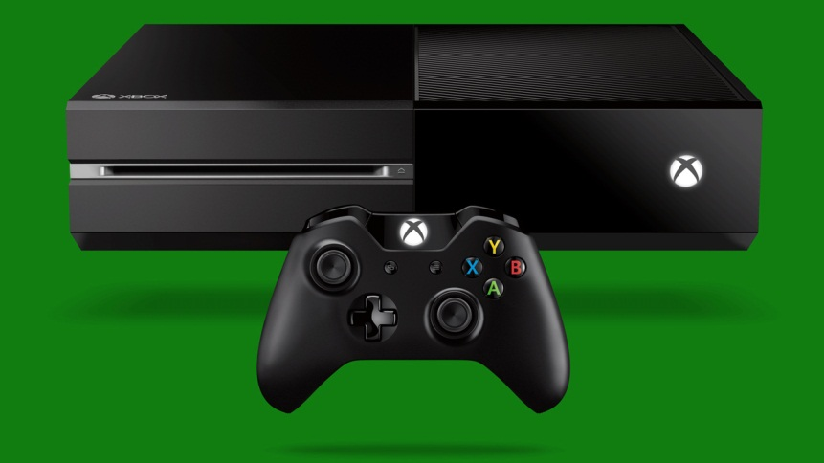
Section 1: Money
The Basic Functions of Money
  A Medium of Exchange
    Ex: Exchanging $$$ for an Xbox One
  A Standard of Value
    Ex: An Xbox One has a value of about $500, not $5
  A Store of Value
    Ex: Instead of spending your $500 to buy and Xbox One, you could save that money in case of an emergency.

Slide 4
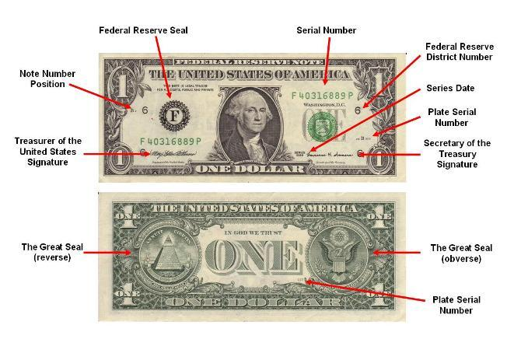
Characteristics of Our Money
1. It is generally acceptable
2. It can be counted and measured accurately
3. It is durable and not easily destroyed
4. It is convenient and easy to carry and use.
5. It is inexpensive to produce
6. It is easily controlled

Slide 5
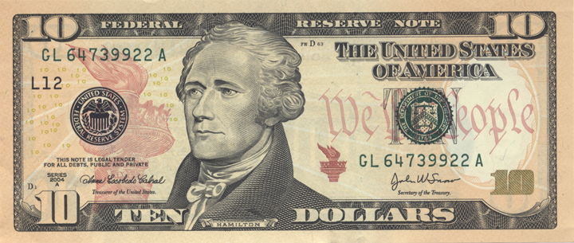
Question
What gives our money value? (Why is ten dollars worth ten dollars?)

Slide 6


Answer
Our government stands behind the worth of our money. (Ten dollars is worth ten dollars because Uncle Sam says it is worth ten dollars.)

Slide 7

Section 2: Our Banking System
The Purpose of Banks
  Save Money
  Safely Exchange $ for Goods and Services
  Basically Help Businesses and Individuals Manage Their $

Slide 8
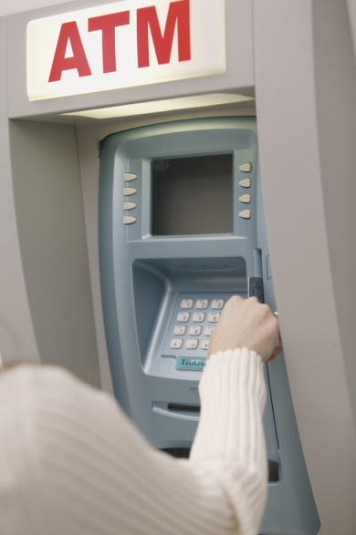
Bank Services
Checking Accounts
  Using checks / debit cards to use your money in the bank instead of paying with cash
Savings Accounts
  The bank pays interest to customers for saving their money in the bank. The bank uses customer’s savings to give out loans meant to help individuals and businesses.
Loans
  Provide loans for people and businesses,
  who then can help the economy grow.

Slide 9
Banking IS a Business
*Banks are a business. They want to make a profit.*
The largest source of profit for banks is interest paid on loans.
  Ex: Billy Bob borrows $10,000 from the bank to buy a new tractor. He will pay the bank back every month with interest, until he finally pays the bank about $11,000.

Slide 10
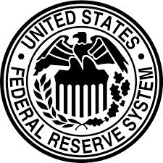
Section 3: The Federal Reserve System
*Key Thought: The Federal government regulates the banking industry and the nation’s money supply through the Federal Reserve System.

Slide 11
Functions of the Federal Reserve
Serving as the Government’s Bank
  Ex: Tax $ deposited in a govt. account @ a Federal Reserve Bank.
Serving as the Citizen’s Bank
  Ex: Fed Reserve helps process your checks
Regulating the Banks
  Ex: Makes sure banks have enough $ to supply people’s demand for withdrawals
Making Loans to Banks
  Help banks when customers want to withdraw a lot of $
Controlling the Money Supply
  Decide how much $ is available for people to spend.

Slide 12
Quick Review
What are the purposes of money?
Why is a twenty dollar bill worth 20 dollars?
What are the reasons for having banks?
If banks are businesses, how do they make money?
What is the Federal Reserve and what does it do?

Slide 13
Ch. 17 Assessment
Page 478
Complete # 1 – 12; 16 - 17
  Reviewing Key Terms
    Write out the sentence with correct term underlined.
  Comprehension and Critical Thinking and Activities
    Write out the question and your response.
    * Turn in for a grade when completed..

