Slide 1
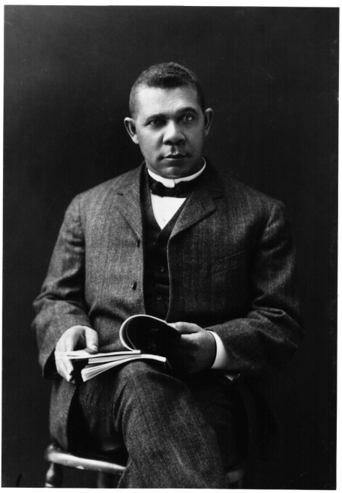
Unit 5: Life in Post-Slavery America
(1875 – 1928)
During the late 1800s and early 1900s African-Americans struggled to find their place in the United States, while also seeking ways to express their voice and culture.
Booker T. Washington (1856 – 1915) serves as an example of blacks trying to earn their success and prove their worth in America during this time period.

Slide 2

Quick Review
Ch. 14 - 16
In what ways did African-Americans seek to improve their lives and the lives of all blacks during the late 1800s and early 1900s?

Slide 3
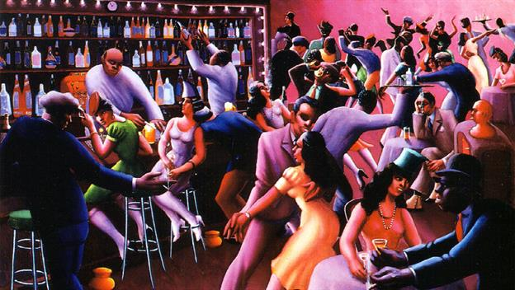
Ch 17: African Americans and the 1920s (1915 – 1928)
During this time, African-Americans continue to seek ways to organize and unite so that their voice and culture will be heard.

Slide 4
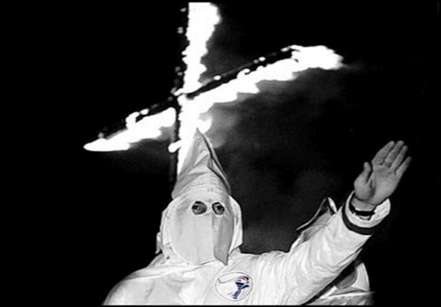
Section 1: Fighting Racism
A number of factors contributed to continued racism in the US during the 1920s.
An increase in labor strikes caused economic unrest.
Anxiety over the possible spread of communism to the America.
View by some whites that blacks and immigrants threatened ethnic purity
The development of ‘scientific’ theories which supported white superiority.
The resurgence of the Ku Klux Klan, who claimed to represent the values of White Protestants in America.
KKK are one of the most visible pictures of racism. What do you know about them?

Slide 5
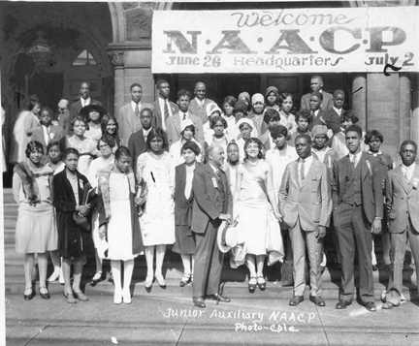
Section 2: Black Organizations in the 1920s
The NAACP grew in size and influence in the 1920s.
  The organization continued to focus on the judicial system to protect black Americans and enforce civil rights.

Slide 6
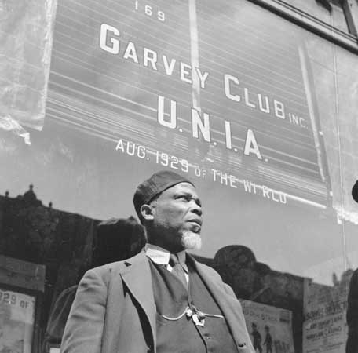
Section 2: Black Organizations in the 1920s
Marcus Garvey, an energetic leader born in Jamaica, founded the Universal Negro Improvement Association (UNIA) in 1914.
  The UNIA combined racial pride, Christian faith, and economic cooperation to promote the idea of Black Nationalism (Back to Africa Movement).

Slide 7
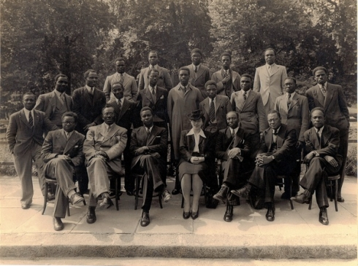
Section 2: Black Organizations in the 1920s
Marcus Garvey, W.E.B. Du Bois, and other influential blacks helped establish the international Pan-African Congress.
  It’s purpose was to promote the connection and cooperation of people of African descent around the world.

Slide 8
Quick Discussion
In reality, Marcus Garvey was unable to gain the support of African-American leaders for the UNIA and his belief that blacks needed to return to Africa in order to succeed. In fact, around 1927 Garvey was deported and not allowed to return to the US.
Why do you think African-American leaders were unwilling to support Garvey?

Slide 9
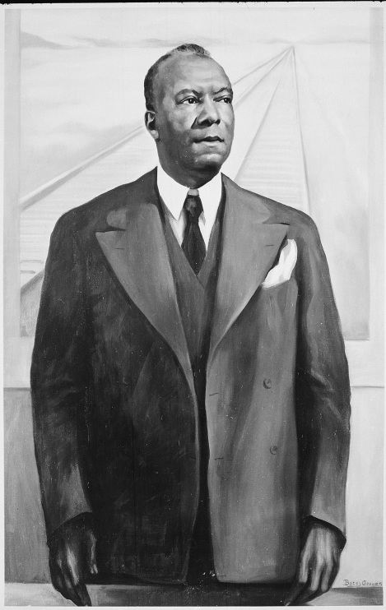
Section 3: Uniting Black Workers
When thousands of black migrants arrive in northern cities for work, most of them were not allowed to join white led labor unions.
In response, African Americans formed labor unions of their own.
By the 1920s the Pullman Company, which owned and operated passenger railroad coaches, was the largest employer of blacks in the US.
In 1925 A. Philip Randolph lead the formation of the ‘Brotherhood of Sleeping Car Porters’, a labor union intended to protect the interests of black workers for the Pullman Company.

Slide 10
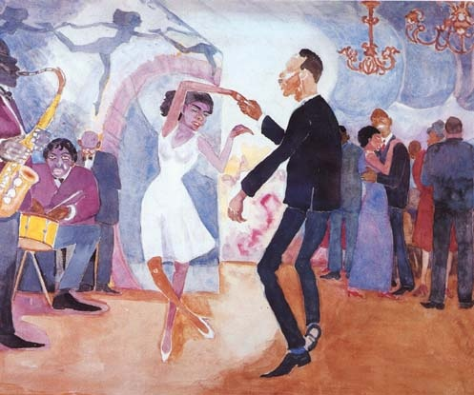
Section 4: The Harlem Renaissance
As more African-Americans congregated in the cities of the North, the city of Harlem, New York became the central location for the expression of black culture that came to be known as the Harlem Renaissance.
African-American artists, writers, and musicians gave voice to black culture in America as it had never quite been heard before. Their efforts contributed to the growing international reputation of African-American culture and to the 1920s being known as the ‘Jazz Age’.

Slide 11
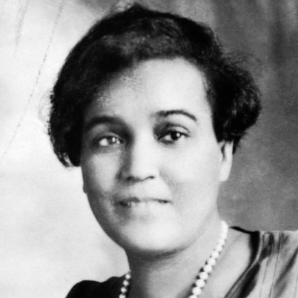
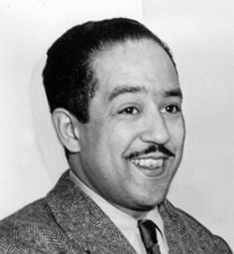
Section 4: The Harlem Renaissance
Authors
Jessie Fauset
  Her novels explored the lives of blacks who were more well-to-do.
Langston Hughes
  His poems inspired and gave voice to African-Americans and their struggles.
“I, too, sing America.
I am the darker brother.
They send me to eat in the kitchen
When company comes.
But I laugh,
And eat well,
And grow strong.
To-morrow
I’ll sit at the table”
From Hughes Poem: I, Too
What do you think about the excerpt from Hughes poem?

Slide 12
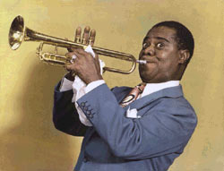
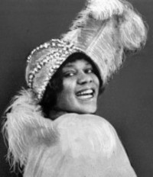
Section 4: The Harlem Renaissance
Musicians
Louis Armstrong
  The New Orleans native amazed audiences with his trumpet play and gravelly singing voice.
Bessie Smith
  Her powerful voice conveyed the depths of her emotions and experiences to listeners.
“She had music in her soul and felt everything she did.”
Said Louis Armstrong about Bessie Smith

Slide 13

Quick Discussion
The “good times” of the 1920s came to an end with the economic depression of the 1930s. Despite this, what do you think is the significance of the Harlem Renaissance and what do you think is it’s lasting legacy?

Slide 14
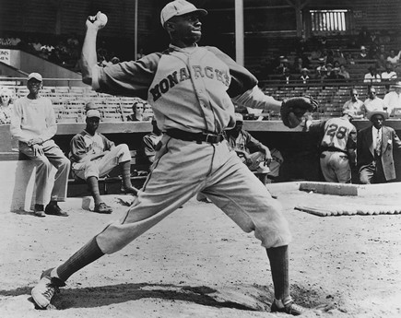
Section 5: Sports
(Professional)
Sports were becoming more and more popular during the 1920s, but blacks were banned from participating in white professional sports.
Black professional sports leagues developed, but the majority of them were unable to provide much opportunity to black athletes.

Slide 15
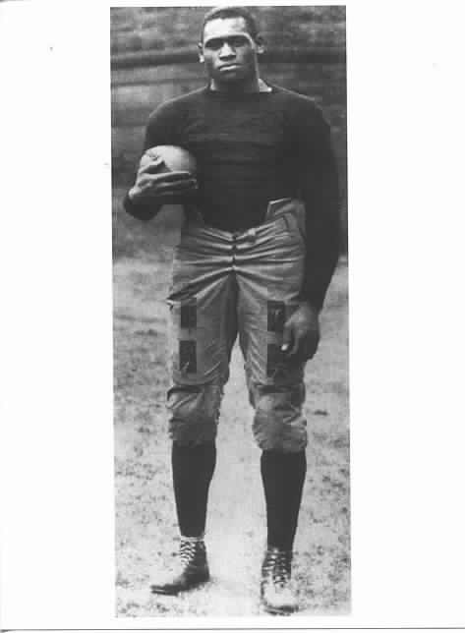
Section 5: Sports
(College)
Young black men were able to play sports for white northern universities, although most teams only had one black player.
Sports in black colleges and universities enjoyed great popularity during the 1920s, allowing for the development of traditional rivalries between schools.
Why do you think northern universities who allowed blacks to play sports usually only had one black player?

Slide 16
Quick Review
Ch. 17: African Americans and the 1920s
Can you discuss some examples of African-Americans organizing and expressing their voice during the 1920s?

