Slide 1
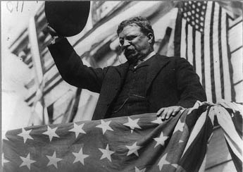
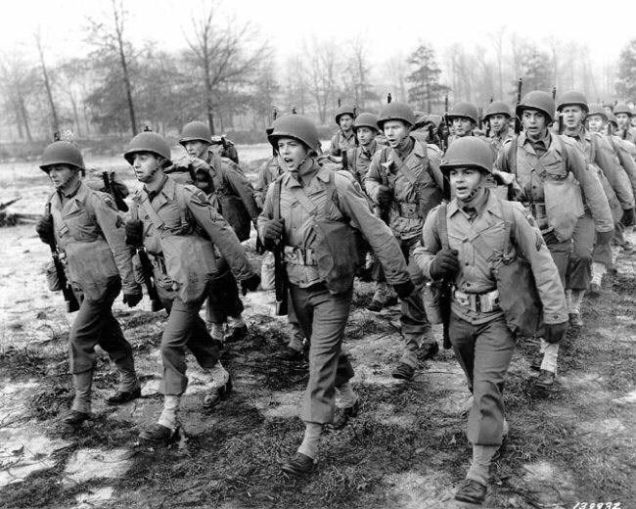
Unit 5: Emergence of the Modern United States (1890 – 1920)
The United States makes progressive changes in it’s government at home while beginning to become a global power abroad through imperialism and involvement in World War 1.

Slide 2

Quick Review of Ch. 13 - 14
What was the goal of Progressives and how did they go about trying to achieve it?
What motivated the US to become more involved on a global stage?

Slide 3
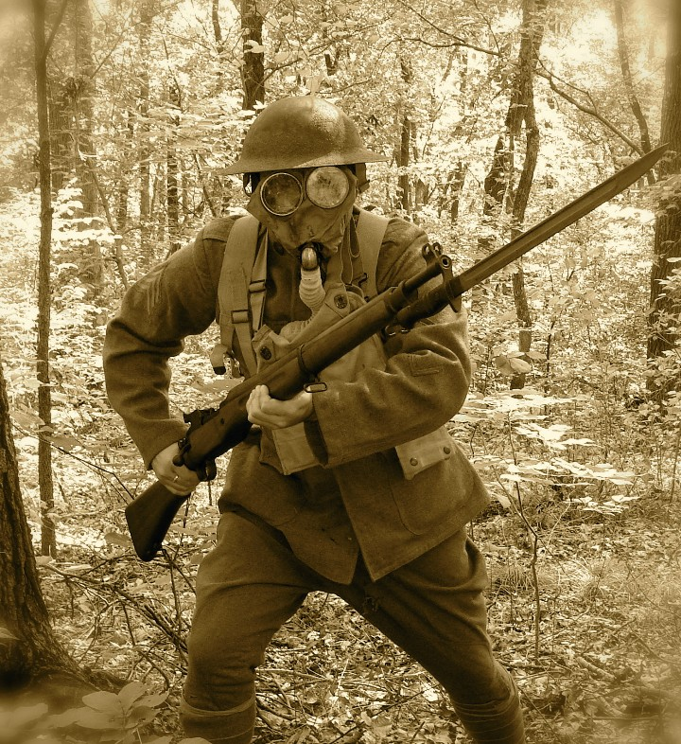
Chapter 15: World War I and Beyond (1914 – 1920)
When warfare breaks out in Europe, the United States hesitantly joins the fight. This will have a major impact on the United States, as well as the rest of the world.

Slide 4
Section 1: From Neutrality to War
When war broke out among the nations of Europe, the US attempted to remain neutral at first but eventually decided to join the conflict.

Slide 5
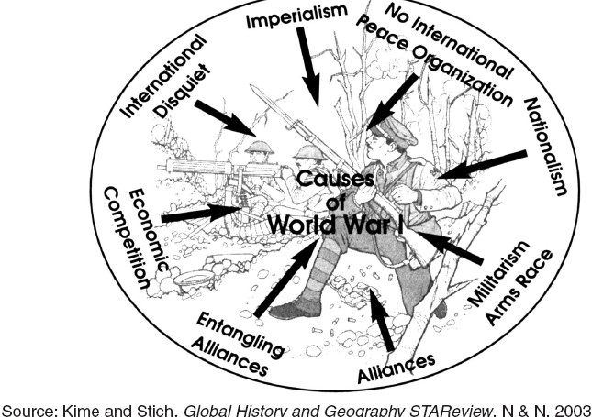
What caused World War I?
Nationalism and Competition Heighten Tension Among European Nations
Militarism leads to a Buildup of Weapons in Europe
Alliances Make European Nations Overconfident and Reckless

Slide 6
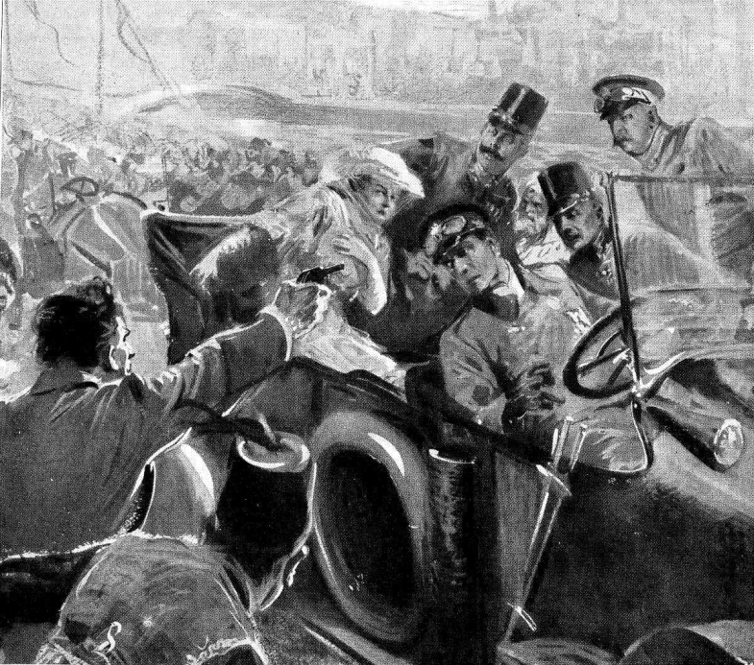
What caused World War 1?
Finally, the assassination of Francis Ferdinand, heir to the throne of Austria-Hungary, and his wife by Serbian radicals triggered alliances between nations that led to the beginning of a major war.
Ferdinand was visiting Bosnia, a province of Austria-Hungary. The Serbian radicals believed Bosnia rightfully belonged to Serbia, so they attacked.

Slide 7
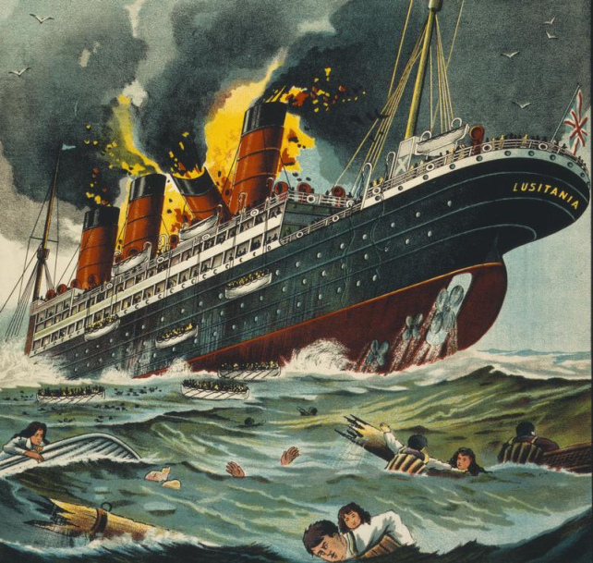
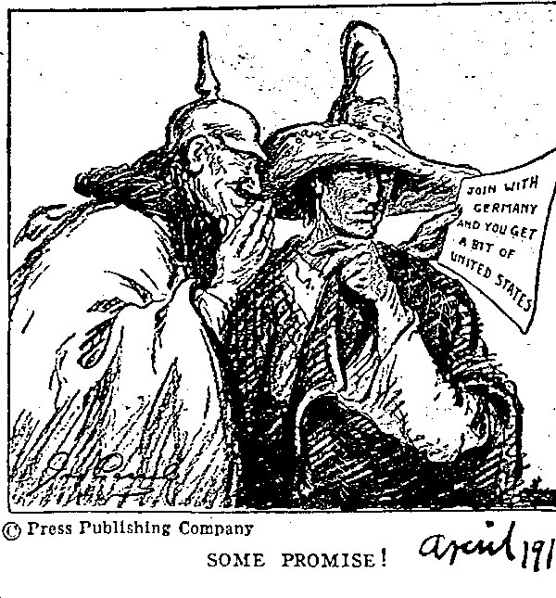
Why did the US get involved in WW1?
Friendship with England and France.
Germany continued unrestricted submarine warfare despite promises to stop.
  German subs sank passenger ships containing British, French and American citizens.
In the Zimmerman Note, Germany offered Mexico the chance to regain lost US territory. (This was the last straw for the US.)

Slide 8
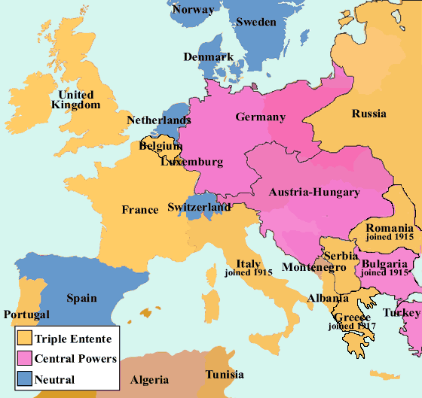
Some Key Nations Involved in WW1
Allied Powers vs Central Powers
France
England
Russia
United States
Germany
Austria-Hungary
Ottoman Empire
Bulgaria

Slide 9

Quick Discussion
Do you think the US made the right decision to get involved in the ‘Great War’ (WW1)? Why?

Slide 10
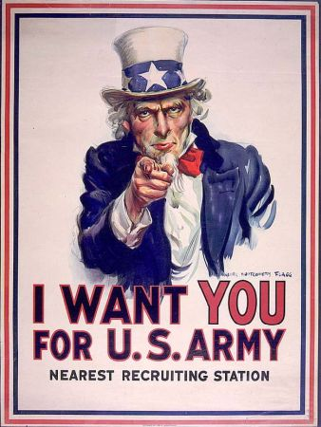
Section 2: The Home Front
During World War I, the federal government became much more involved in the daily lives of Americans to promote the war effort.
  Regulated Industrial and Agricultural production
  Worked to Gain Public Support for the War
  Established a New Military Draft System, requiring those men selected to serve. (Selective Service Act)

Slide 11
Quick Discussion
Do you think the government had the right to regulate agriculture and industry during this time of war? Why?

Slide 12
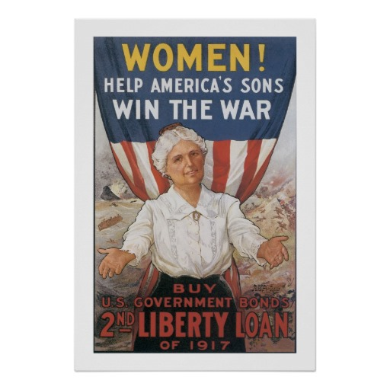
Impact of World War I on Americans
Required sacrifice but also brought new economic opportunities.
Women become more involved in the workplace and in supporting the war, helping them gain the right to vote.
Economic opportunities in the industrial North encourage many African-Americans to migrate North.

Slide 13
Section 3: Wilson, War, and Peace
When the US joins WW1 in 1917 (it started around 1914), the allied and central powers were locked in a deadly stalemate (tie).
The addition of fresh American forces to those of France, England, and Italy on the Western Front helped give the allies the military advantage they needed.
In November of 1918, an exhausted Germany surrendered, ending the conflict.

Slide 14
After the Carnage
US President Woodrow Wilson hoped to establish a lasting world peace after the war.
Many Allied leaders, however, blamed Germany for starting WWI, so they insisted Germany make payments for war damages and attempted to weaken Germany so that it couldn’t threaten Europe again.

Slide 15
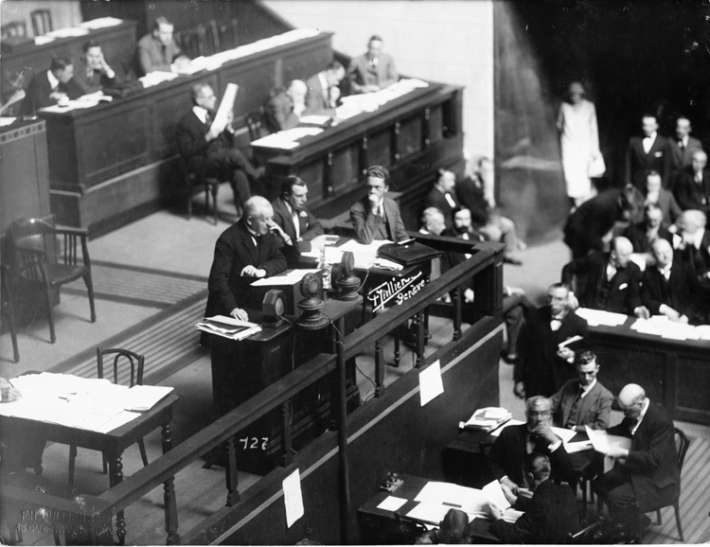

Attempt to Maintain Peace
During peace talks following the war, the League of Nations is formed in an attempt to maintain peace among nations.
However, US politicians are unable to agree on the US joining the League, and without full American support, the League of Nations proves to be unable to maintain peace for very long.

Slide 16

Section 4: Effects of the War
Uneasy Impact on the World
  Produced an unstable international order
  Germany’s loss of territory and harsh reparations imposed by Allies creates a desire for revenge (WW2 Coming Soon)
  A deadly form of the flu spreads
  Austro-Hungarian and Ottoman Empire cease to exist
  Britain and France victorious but economically and politically weakened

Slide 17
Effects of the War on the US
African-Americans and women made advances but then lost their jobs to returning soldiers
The emergence of the Soviet Union (Russia) leads Americans to a fear of Communism spreading to the US
  This fear was known as ‘The Red Scare’
The US becomes a creditor nation (loaning money to others), making the US an economic power in the world
US comes out strong, confident, and prosperous

Slide 18

Quick Review
What were some causes of World War I?
Why did the US get involved in World War I?
What were some of the effects of WW I on the world and on the US?

